Slide 1
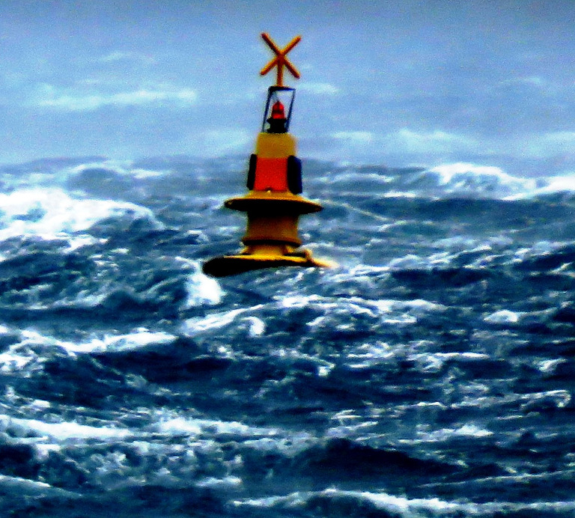
Vizualization of real time data and modelling outputs
Relational database and web interface:
Task 3: Database design and automated measurements insertion & processing
Task 8: Create dynamic web content with meteotsunami hazard forecast
Damir Ivanković

Slide 2
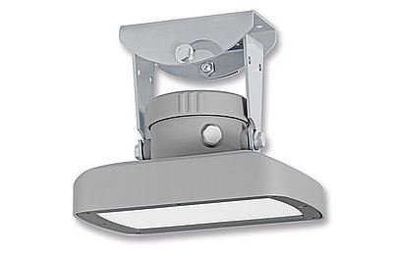
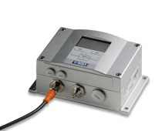
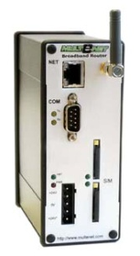
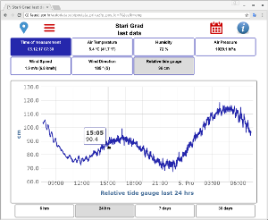
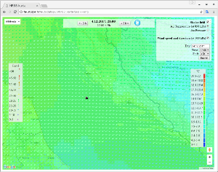
Real-time data transfer, processing and visualisation
sensors
Models run (servers)
Embedded computer
Site – station
Internet
MEDAS
Application
server
FTP server (file)
ORACLE database
ORACLE App. Serv.
Data center – at IOF Split
Web pages with results

Slide 3
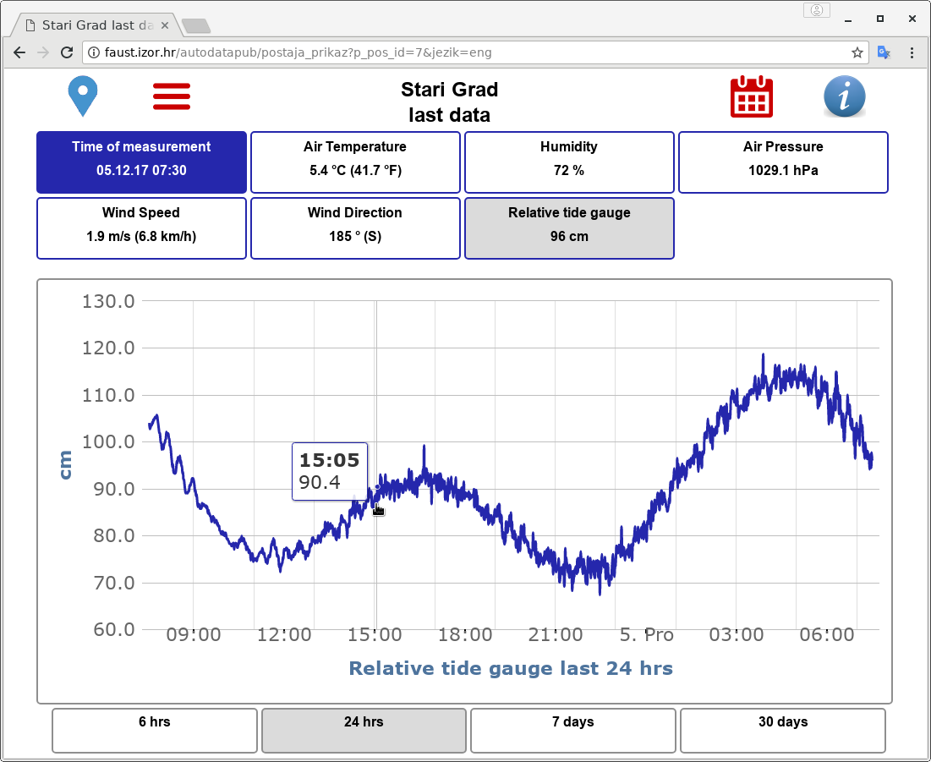
Real-time data from measuring stations
Database driven dynamic web pages
Responsive design
Adjustable to various parameters number

Slide 4
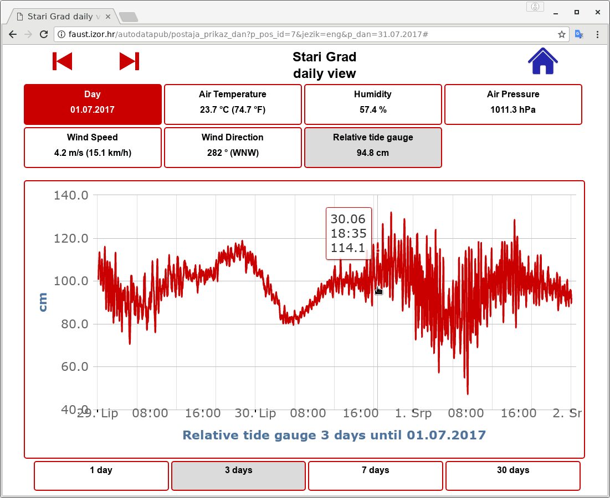
Real-time data from measuring stations
Daaily view
JSON data loading in the background

Slide 5
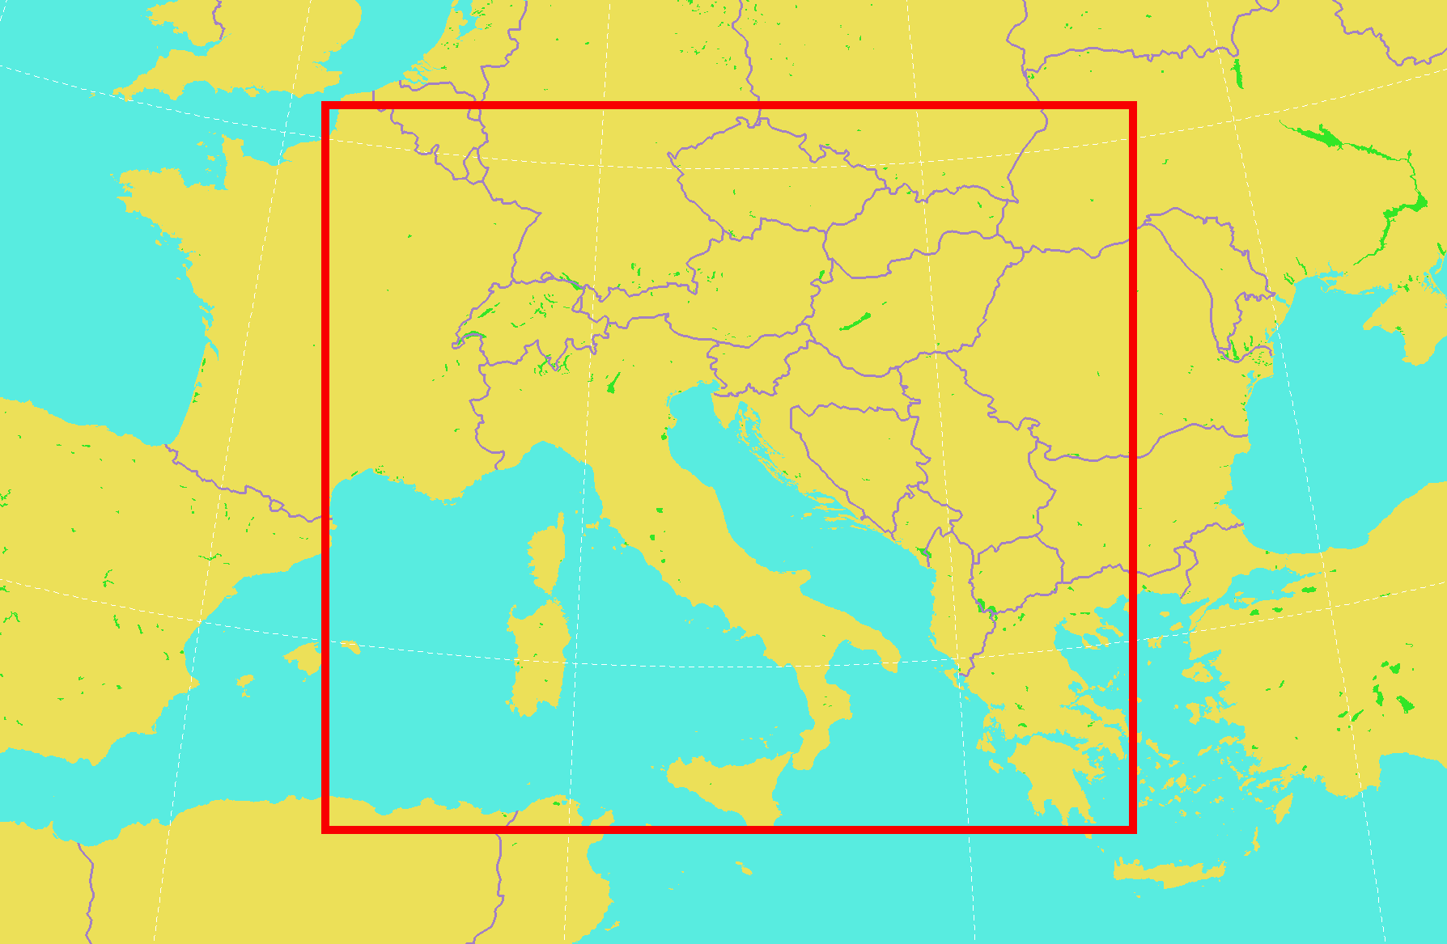
Aladin model vizualization
Transformation of limited-area Lambert projection grid to Mercator projection
Visualization of regular gridded scalar values in Google maps API v3 environment (using JavaScript).
Time component
Synchronized and dynamically loaded using AJAX and JSON

Slide 6
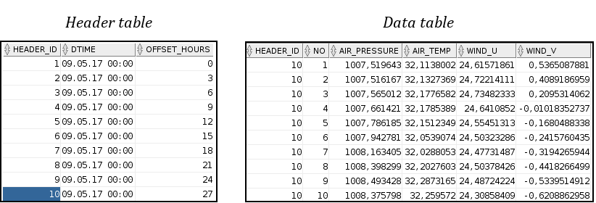
Database tables

Slide 7
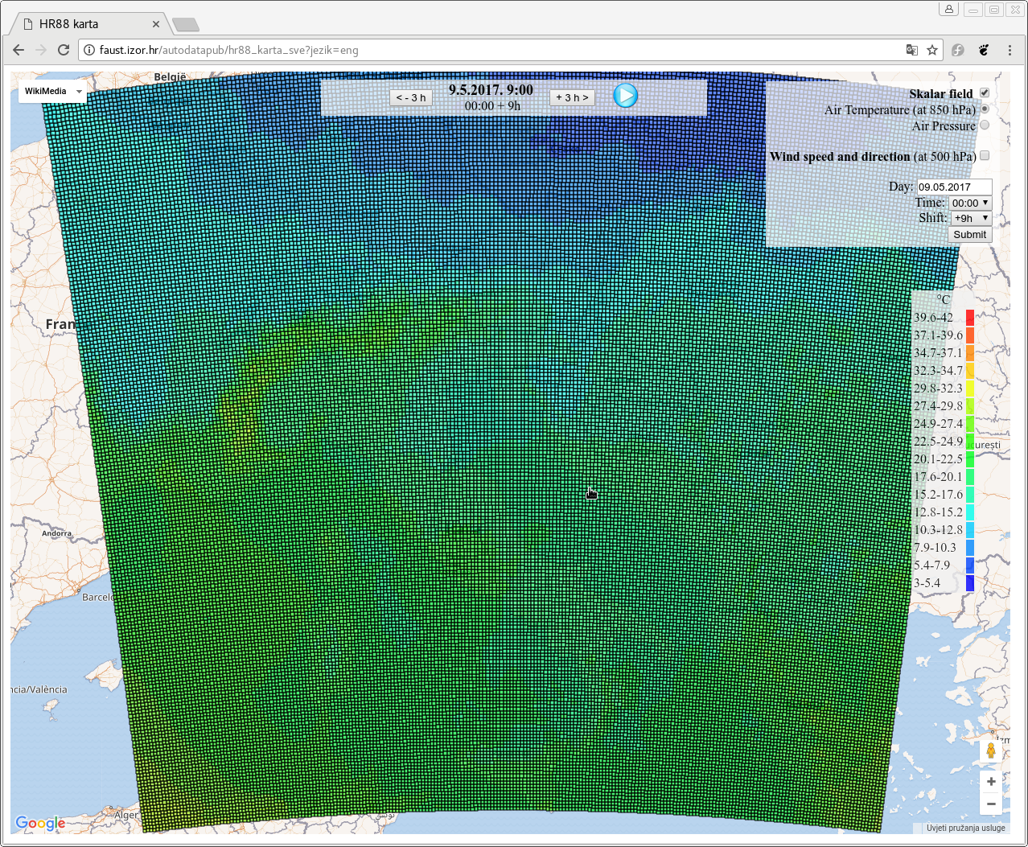
Full model domain

Slide 8
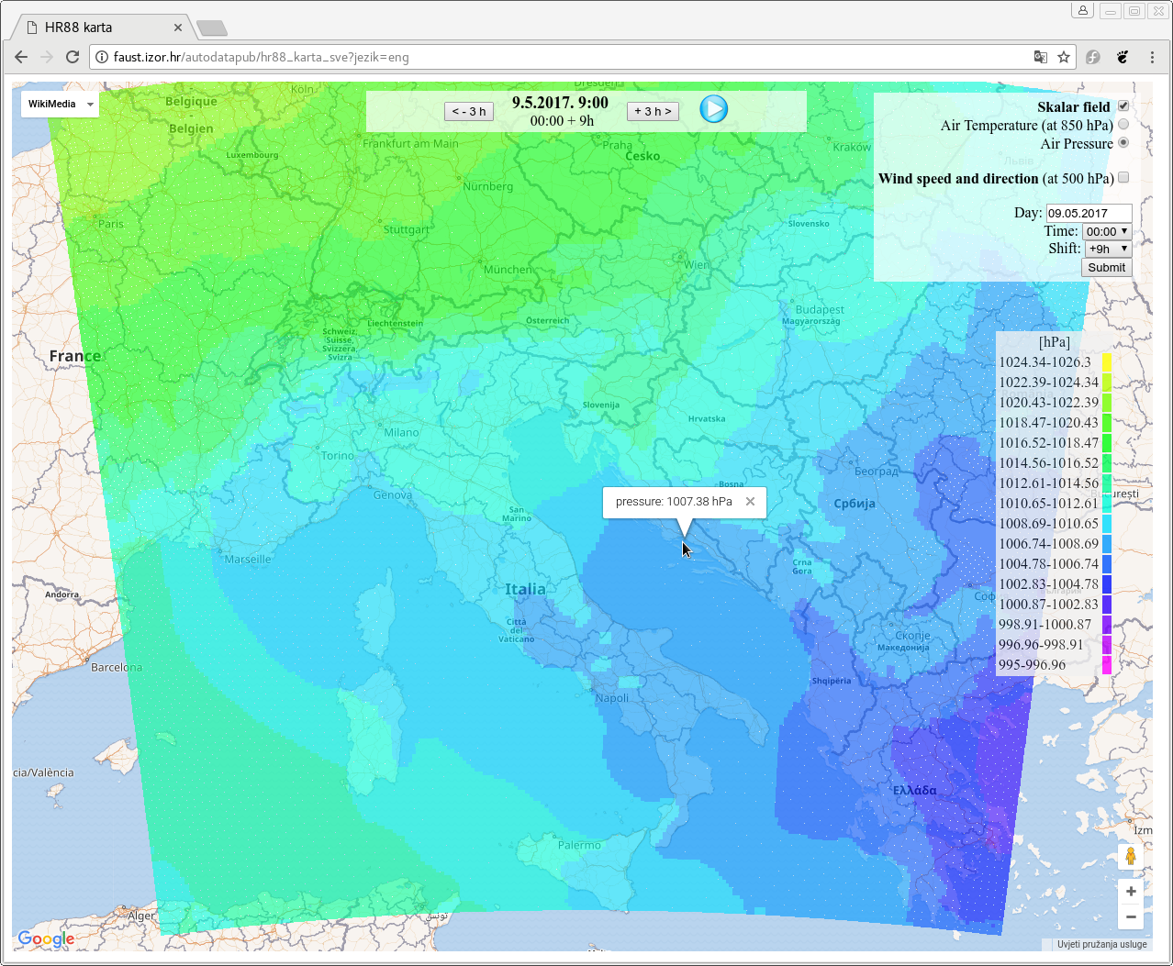
Interactivity

Slide 9
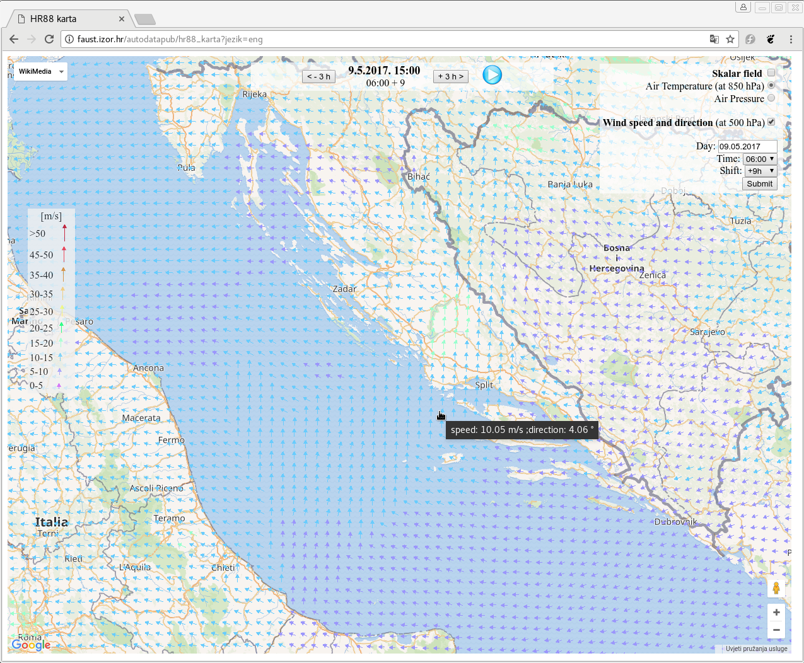
Interactivity

Slide 10
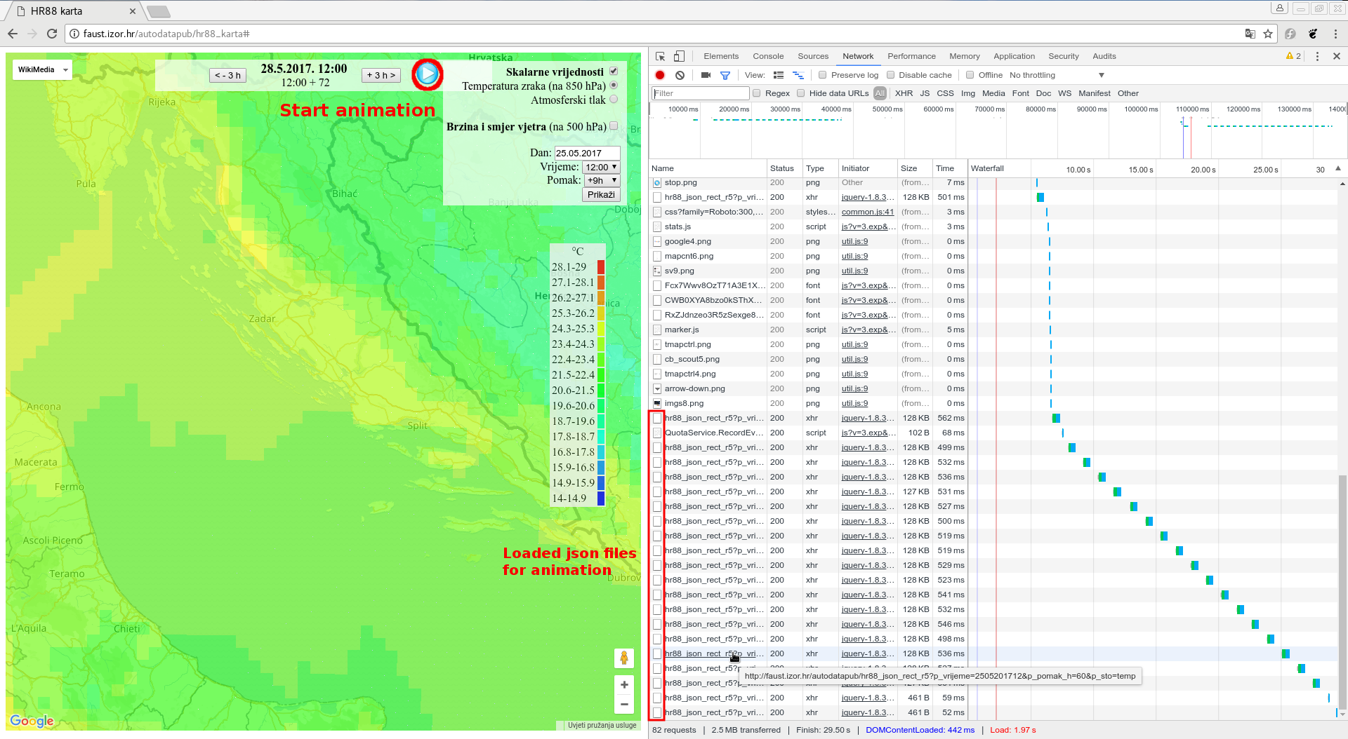
Loading speed and animations

Slide 11
Conclusion
At this moment there are two types of visualizations used for presenting model results on the Internet:
generated static images
generated a georeferenced image used as an overlay with a zoom-able map
The third type of solution: dynamically created scenes at client side using JavaScript.
Can be combined with other layers
The map is interactive (user can get value for each point by clicking on the map).
Animations, in that case are easy to achieve, with no need for preprocessing data.
Scalar layer in the case of bigger zoom looks “pixelated”.

