Slide 1


Development and implementation of MESSI modelling system :
High resolution climate forecast of the Adriatic Sea

Slide 2
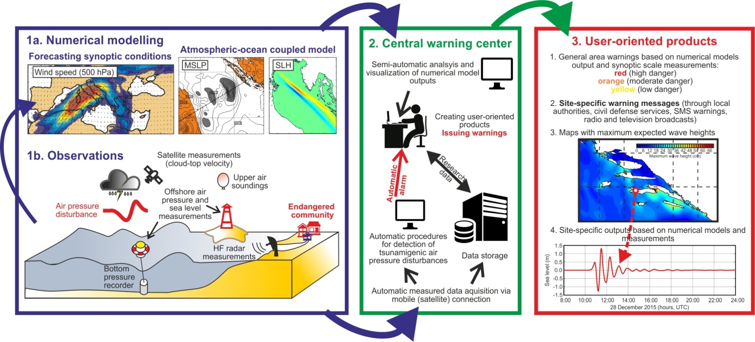
Modelling component of the MESSI Project

Slide 3
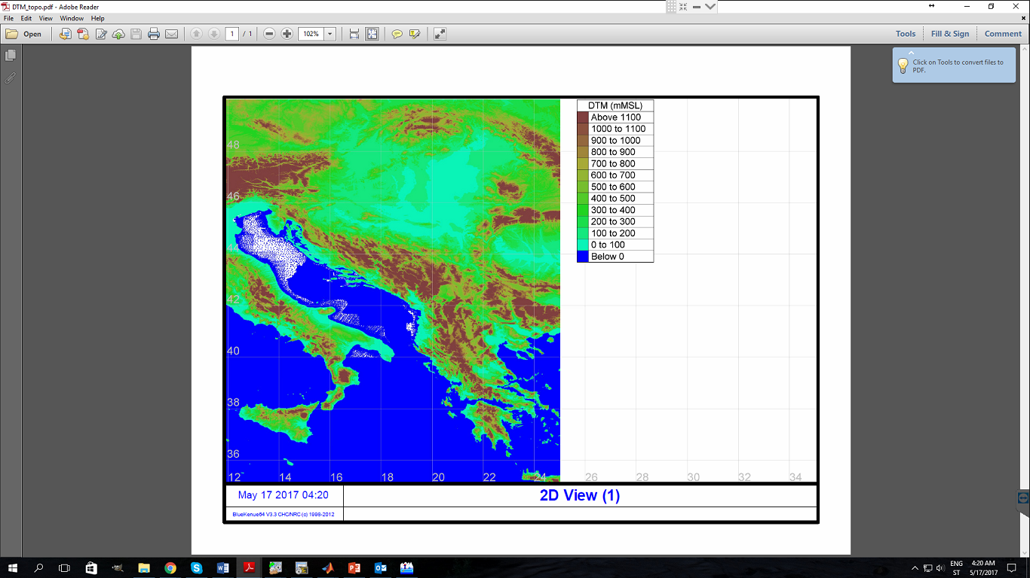
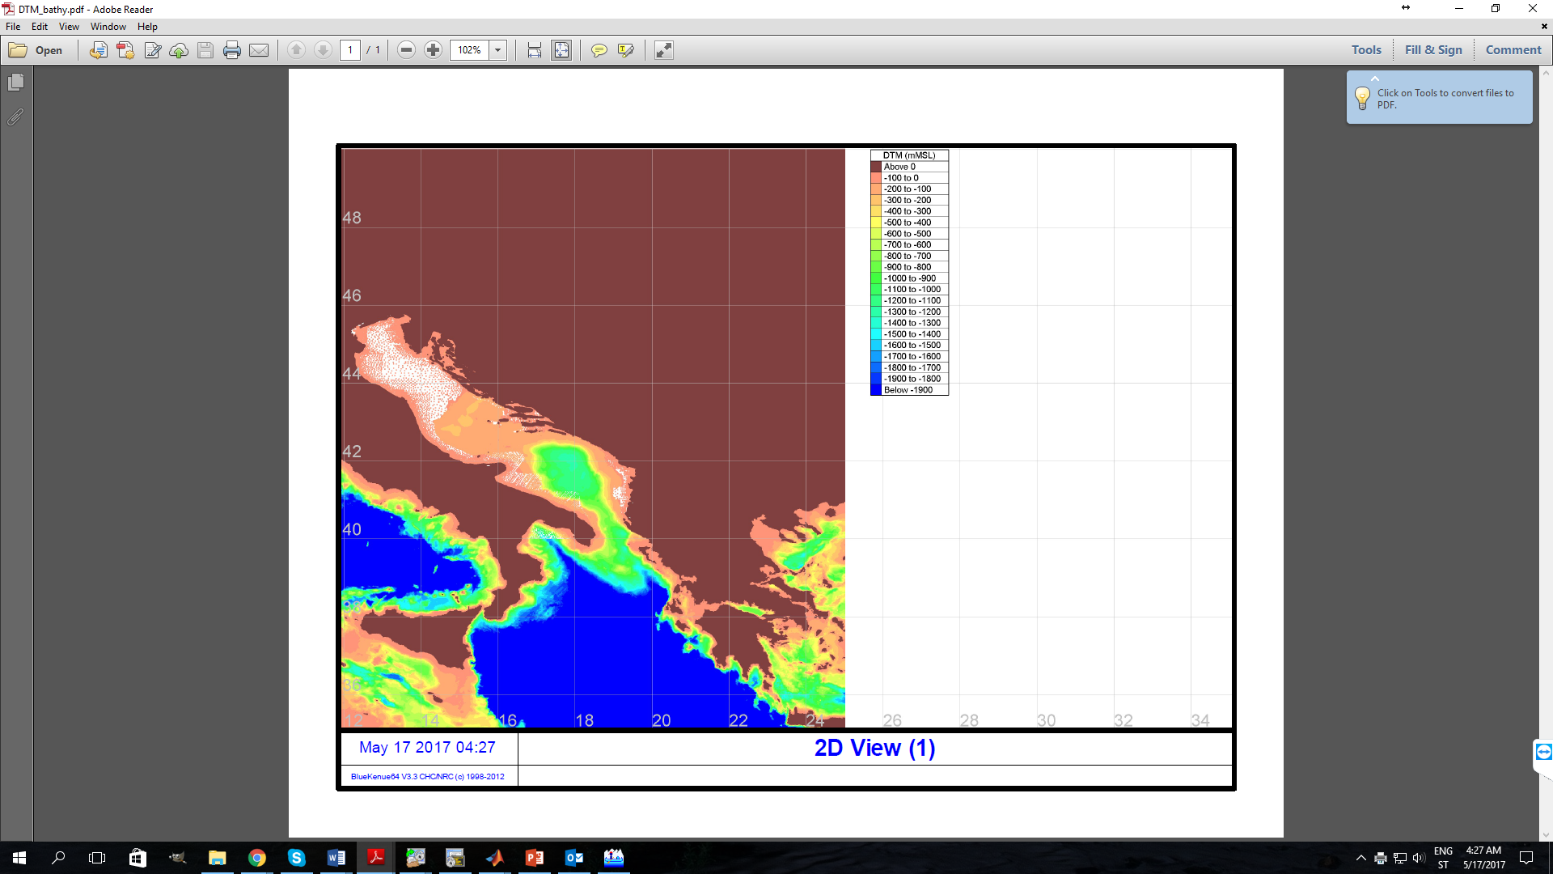
Step 1 of the modelling strategy – DTM Bathymetry/Topography
DTM generated with combination of data from etopo1, GEBCO, digital version of maps, Navigation Chart data and precise coastline developed by IZOR.

Slide 4
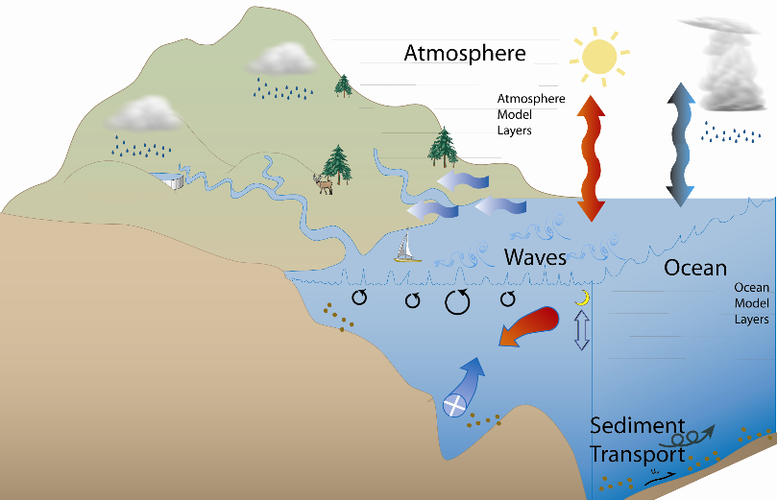
Step 2 of the modelling strategy – Development of the Numerical Modelling Suite
WRF
Sea surface
temperature,
ice, etc.
Weather Research and Forecasting Model
10m wind, 2m air temperature, 2m pressure, rain, etc.
10m wind and MSL Pressure
ADCIRC
ROMS
MCT
ADvanced CIRCulation Model for Shelves, Coasts and Estuaries
Regional Ocean Modeling System
Model Coupling Toolkit
Sea Surface Elevation

Slide 5
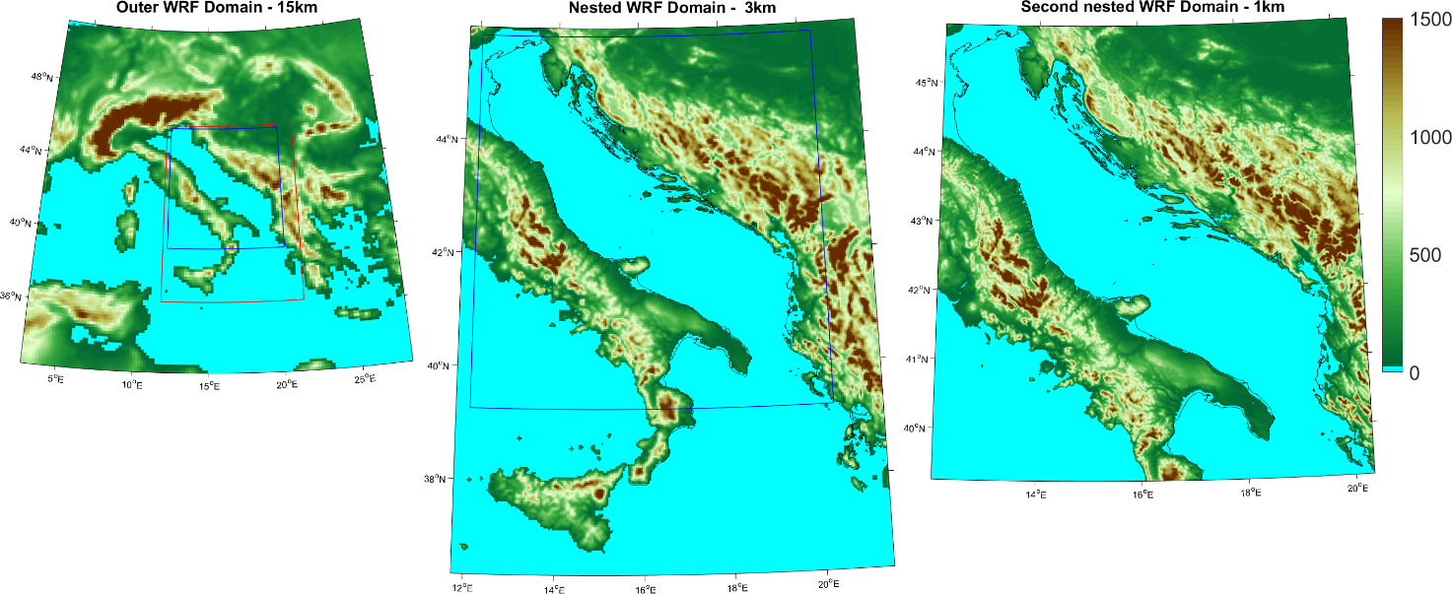
Step 3 of the modelling strategy – Development of the Domain Grids
WRF
Atm. Modelling

Slide 6
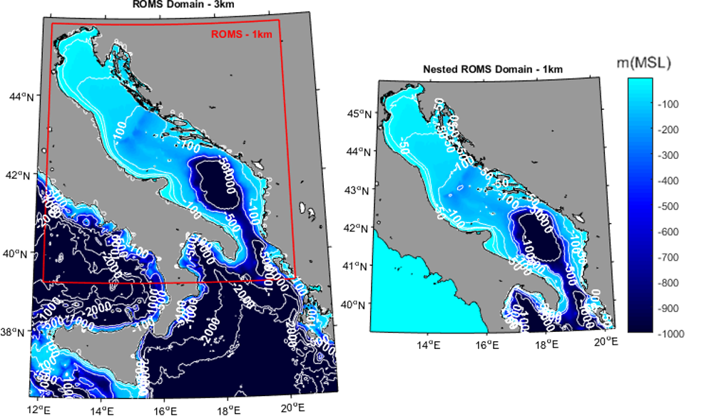
Step 3 of the modelling strategy – Development of the Domain Grids
ROMS
Ocean Modelling

Slide 7
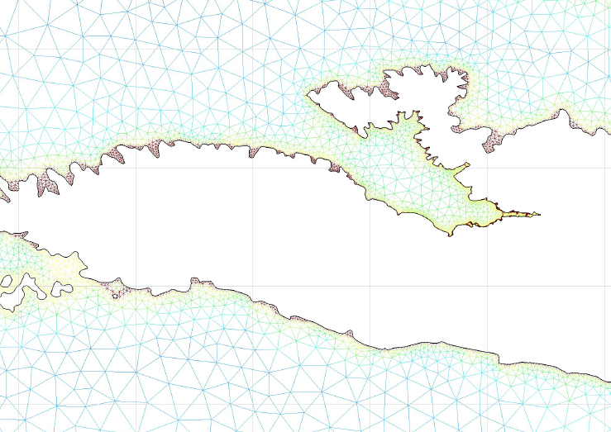
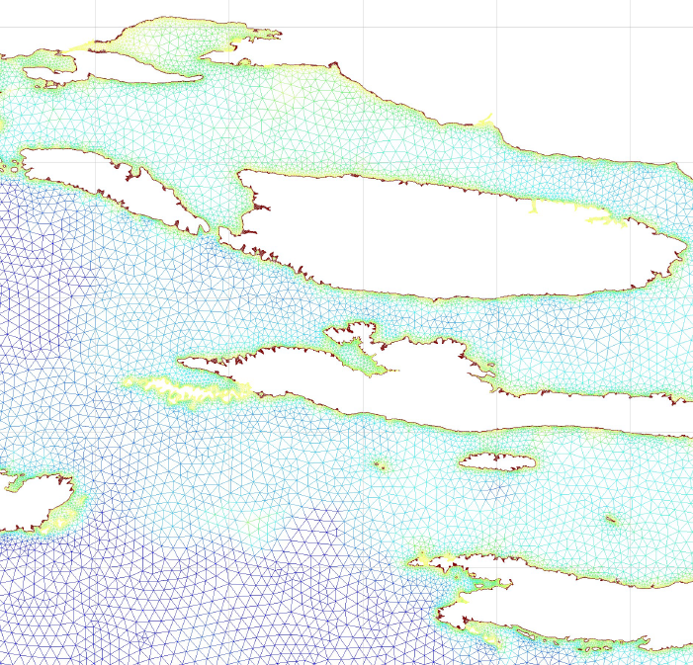
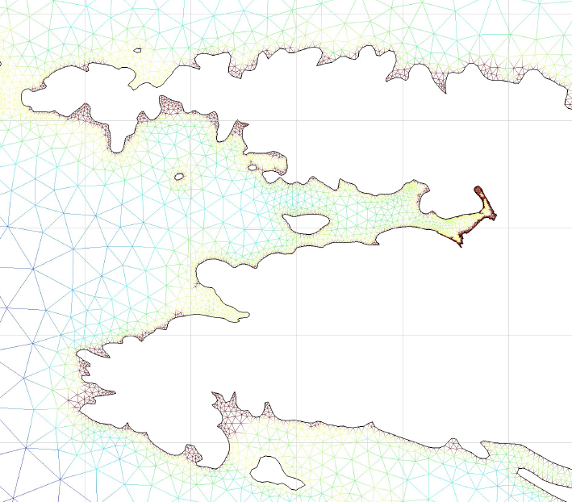
Step 3 of the modelling strategy – Development of the Domain Grids
ADCIRC
Nearshore Modelling

Slide 8
Step 4 of the modelling strategy – Operational Model
d-2
d day
d+2
d-1
d+1
16h real time simulation of fully coupled 3D WRF (15-3km) & ROMS (3-1km)
At midnight on day d+1 forecast for day d+1 to d+2 is available online for Low Resolution
d+2
d+1
At 20h of day d downscaling to WRF (1km) coupled with ADCIRC (up to 15m)
On day d+1 forecast for day d+1 to d+2 is available online for High Resolution.

Slide 9
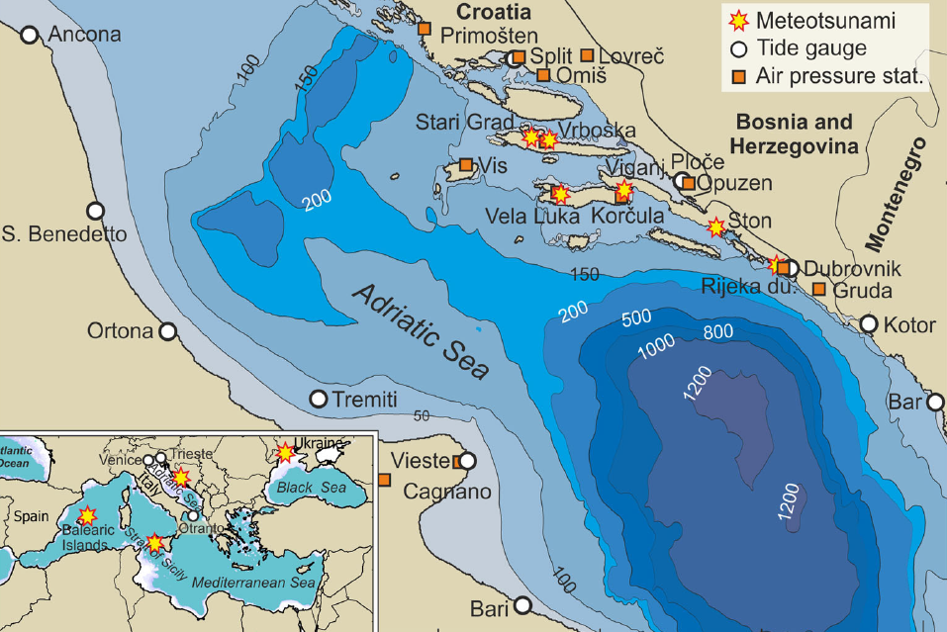
Step 5 of the modelling strategy – Validation of the Models
Between the 25th and 26th of June 2014 the eastern coast of the Adriatic Sea was hit by two tsunami-like waves which were observed as follow:
First wave
25/06 06:00 UTC: wave of ~3m height at Vela Luka on Korčula Island
25/06 11:00 UTC: wave of ~1m height & 10-20 min period at Rijeka Dubrovačka (~120km from Vela Luka)
25/06 13:00 UTC: wave of ~1m height & 20 min period at Stari Grad on Hvar Island
25/06 15:00 UTC: wave of ~1.5m height & 5-10 min period at Vrboska on Hvar Island
Second wave
26/06 ~12:00 UTC: wave of ~0.8m height at Viganj & wave of ~1m height at Ston both on Pelješac

Slide 10
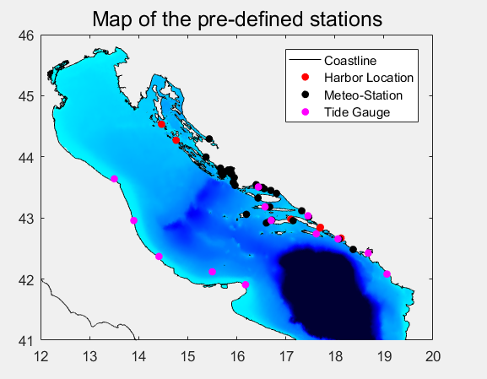
Step 5 of the modelling strategy – Validation of the Models
Both Atmospheric Pressure and Sea Level were recorded during the meteotsunami of June 2014.
The available measurements are as follow:
45 Meteo Stations located in Croatia – including amateur measurements
6 Sea Level Stations in Italy
3 Sea Level Stations in Croatia
2 Sea Level Stations in Montenegro

Slide 11
Step 5 of the modelling strategy – Validation of the Models
Location | Max. Measured Height (cm) |  |  | Max. Modeled Height (cm)
 | Date | Mes. | Mod. | Date | Mod. | Mes.
Ancona | 25-Jun 18:31 | 34.8 | 28.5 | 25-Jun 20:10 | 41.7 | 27.0
St Benedetto | 26-Jun 15:30 | 45.1 | 28.6 | 26-Jun 16:40 | 34.0 | 27.9
Ortona | 25-Jun 16:21 | 55.9 | 25.2 | 25-Jun 16:45 | 43.7 | 49.0
Tremiti | 25-Jun 14:56 | 27.8 | 31.3 | 26-Jun 15:52 | 33.0 | 23.6
Vieste | 26-Jun 17:07 | 42.1 | 11.5 | 25-Jun 15:04 | 36.1 | 27.9
Otranto | 26-Jun 16:20 | 36.6 | 8.5 | 26-Jun 02:31 | 14.6 | 6.26
Split | 25-Jun 16:07 | 38.1 | 41.1 | 26-Jun 15:18 | 48.9 | 26.6
Ploće | 26-Jun 15:53 | 45.2 | 43.0 | 25-Jun 15:13 | 57.4 | 22.7
Dubrovnik | 25-Jun 13:57 | 28.6 | 24.1 | 25-Jun 14:12 | 32.0 | 14.3
Kotor | 26-Jun 15:24 | 35.5 | 34.4 | 26-Jun 14:50 | 37.9 | 22.5
Bar | 26-Jun 16:00 | 32.5 | 16.12 | 26-Jun 13:35 | 29.5 | 22.8

Slide 12
Step 5 of the modelling strategy – Validation of the Models
Location | Max. Measured Height (cm) |  |  | Max. Modeled Height (cm)
 | Date | Mes. | Mod. | Date | Mod. | Mes.
Vela Luka | 25-Jun 06:00 | ~300.0 |  | 25-Jun 15:06 | 108.7
Rijeka Dubrov. | 25-Jun 11:30 | ~250.0 |  | 25-Jun 14:12 | 75.1
Stari Grad | 25-Jun 13:00 | ~100.0 |  | 26-Jun 15:15 | 114.5
Vrboska | 25-Jun 15:00 | ~150.0 |  | 26-Jun 16:11 | 104.4
Viganj | 26-Jun 12:00 | ~80.0 |  | 25-Jun 15:10 | 71.2
Ston | 26-Jun 12:00 | ~100.0 |  | 25-Jun 14:22 | 60.0
Additional Data: From local observers

Slide 13
Step 5 of the modelling strategy – Validation of the Models

Slide 14
Step 5 of the modelling strategy – Validation of the Models

Slide 15
Step 5 of the modelling strategy – Validation of the Models

Slide 16
Step 5 of the modelling strategy – Validation of the Models
Statistical Comparison
WRF
vs.
Measurements

Slide 17
Step 5 of the modelling strategy – Validation of the Models

Slide 18
Step 5 of the modelling strategy – Validation of the Models
Statistical Comparison
ROMS/ADCIRC
vs.
Measurements

Slide 19
Step 5 of the modelling strategy – Validation of the Models
Modelled Meteotsunami Waves:
Sea Surface Pressure

Slide 20
Step 5 of the modelling strategy – Validation of the Models
Modelled Meteotsunami Waves:
Sea Surface
Elevation

Slide 21


Conclusions
Model Set-Up – Domain, physics and forcing
Wave Effects on Currents (WEC) in COAWST Model
Challenges:
High resolution modelling vs. Computational resources
Choice of the “best” available forcing fields
Parameterization of the models
Available datasets for validation of the modelling system
Trigger of the Meteotsunami WRF/ADCIRC component
Operationalization – data transfer, web, etc …
Principal Goal:
Making sure that generated model datasets can be used for the research purposes as well as by local authorities and citizens – quality is a priority!
Thank you!

