Slide 1


Meteotsunami Atlas
Pseudo Spectral Approximation Approach (PSA) estimating meteotsunami hazard

Slide 2
Risk Assessment of Meteotsunamis
Challenge:
Meteotsunamis in the Eastern Adriatic are rare events and reliable observations of such events are extremely scarce. It is then extremely difficult to produce any kind of statistics and quasi impossible to define the potential coastal risks associated with these events with measurements.
Proposed solution:
In order to better understand the risks associated with meteotsunamis and to be able to produce some statistical analysis, idealized cases of meteotsunamis are used. The effects of the wind and ocean surface gravity waves are ignored.
Risk = maximum nearshore elevation + associated currents.
Proposed Method:
In order to quantify the effects of the uncertain parameter (i.e. the meteotsunami wave pressure) on the nearshore surface elevation at some predefined locations, known to be at risk, a non-intrusive Pseudo Spectral Approximation method is used.

Slide 3
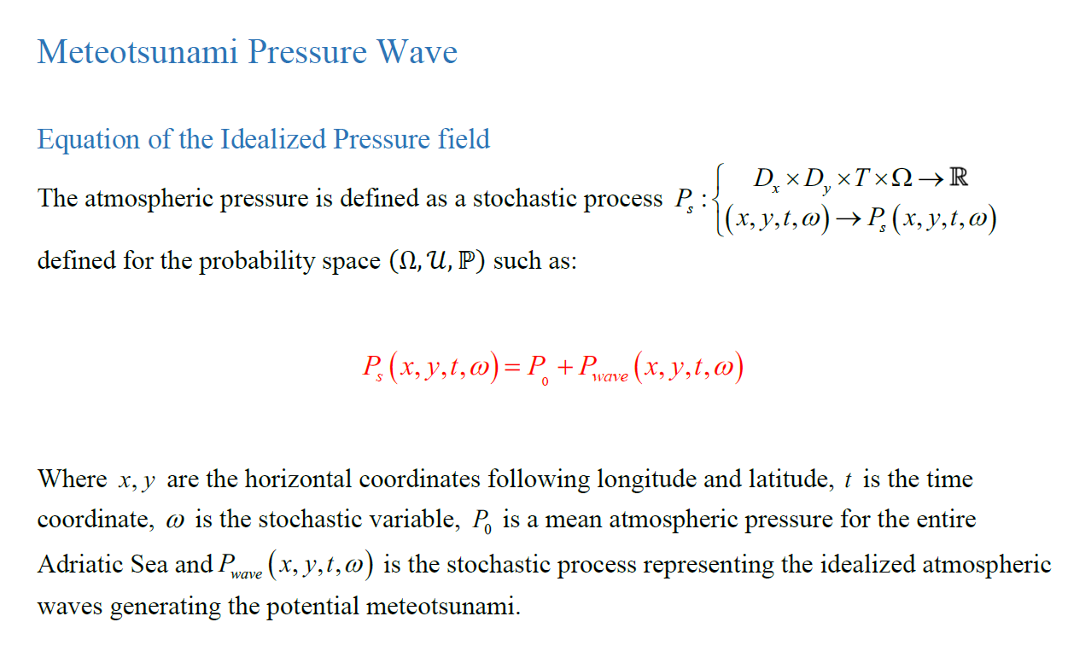
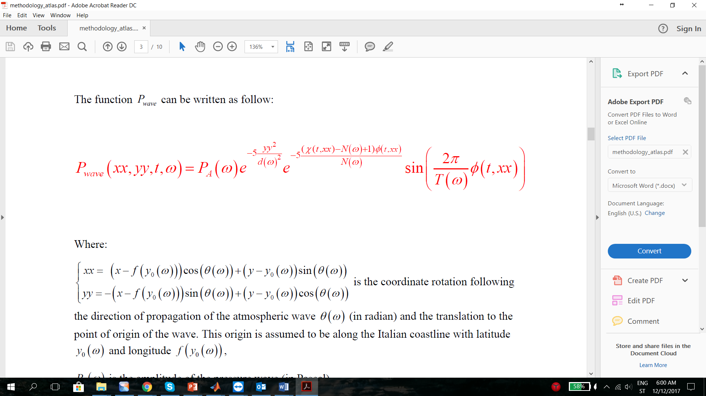

Idealized Meteotsunami Pressure Field

Slide 4
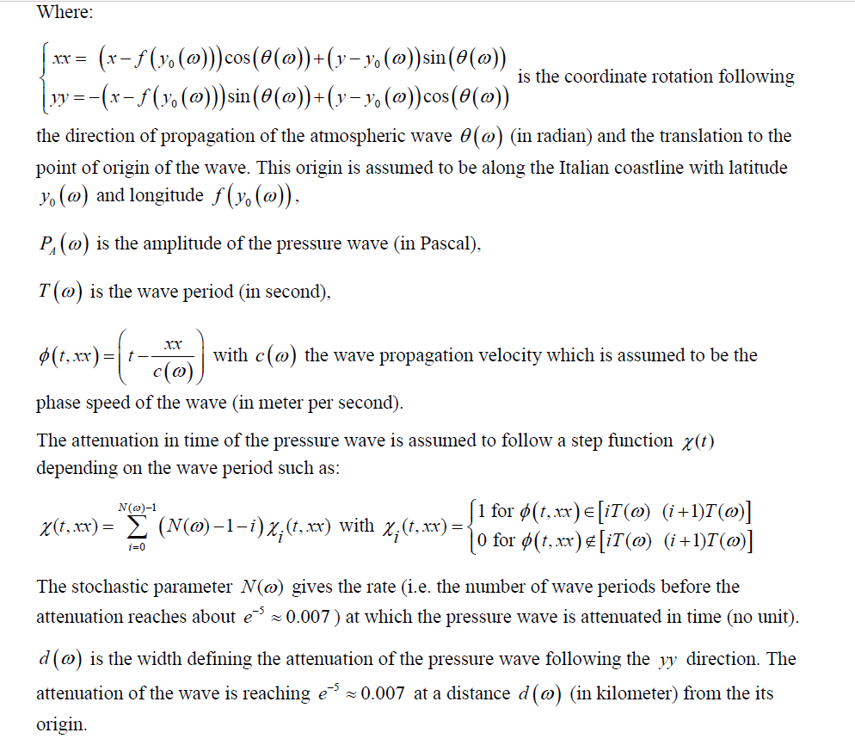
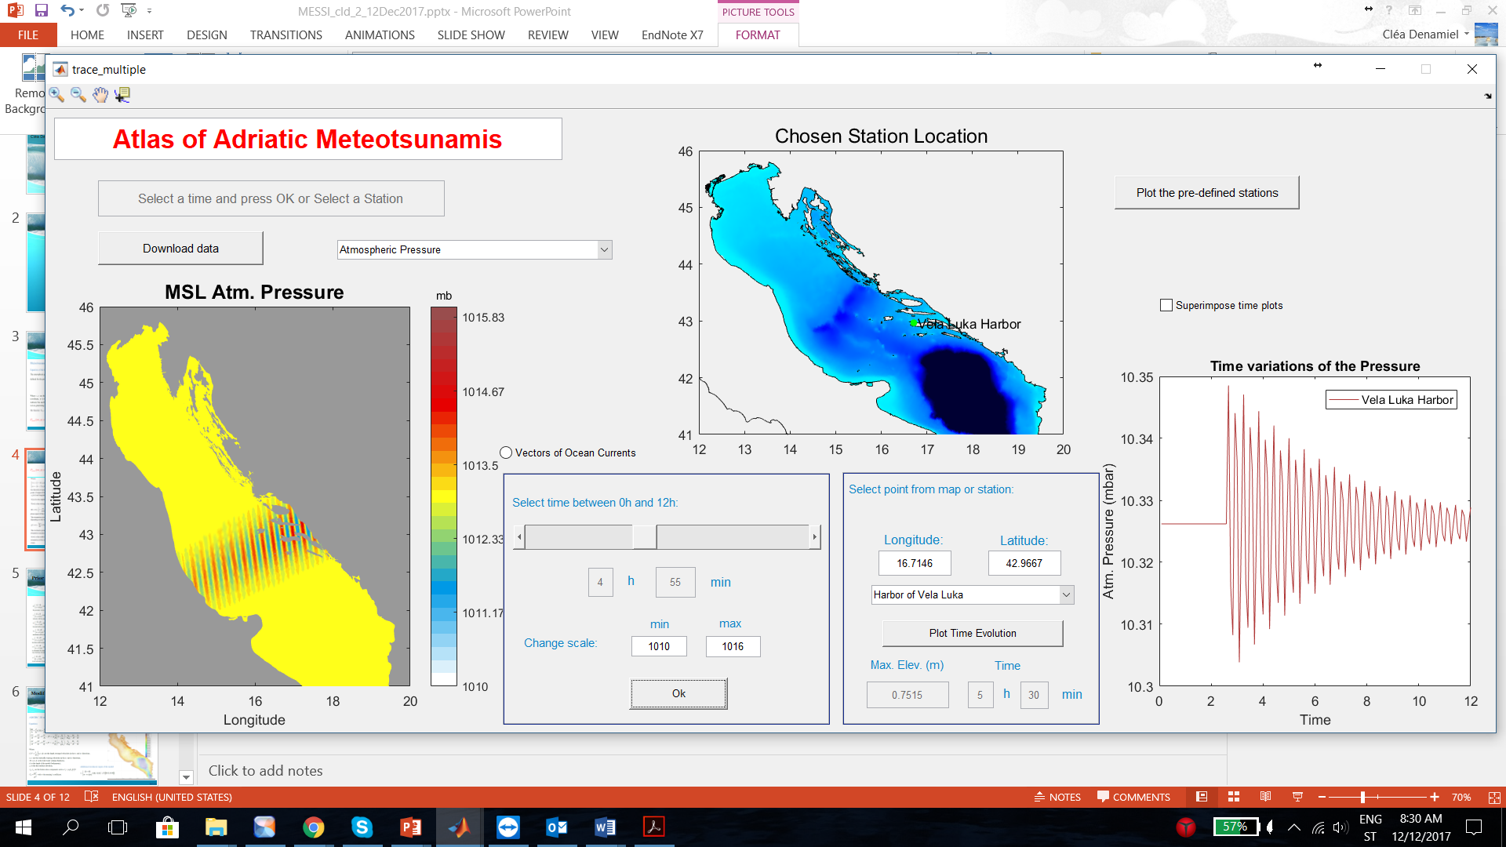
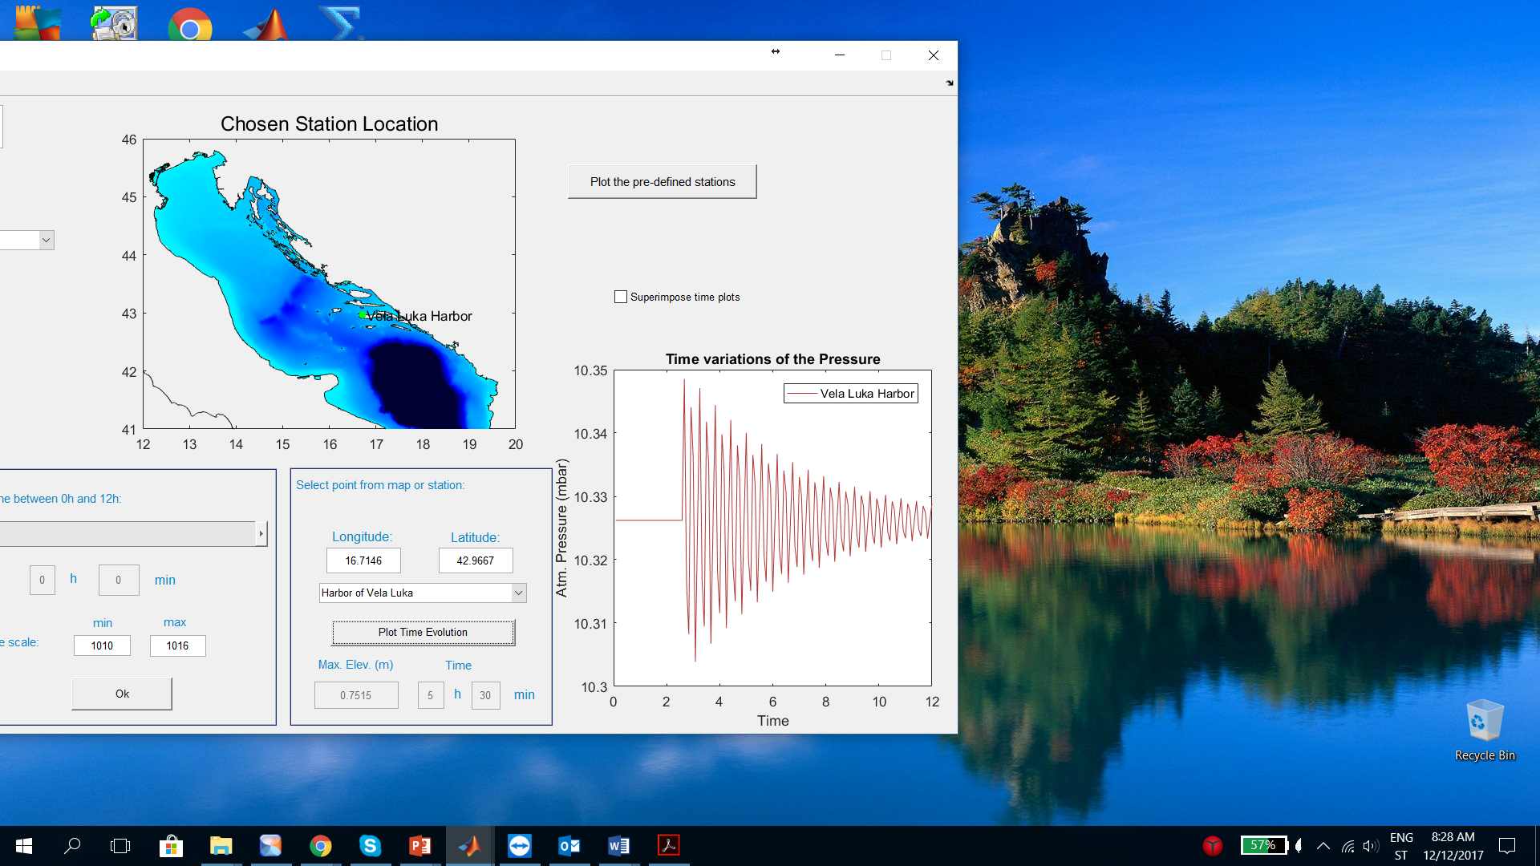

Slide 5
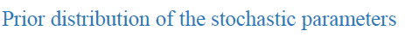
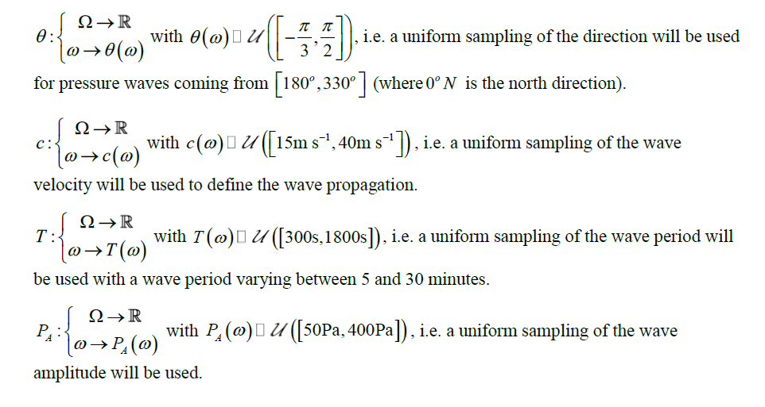
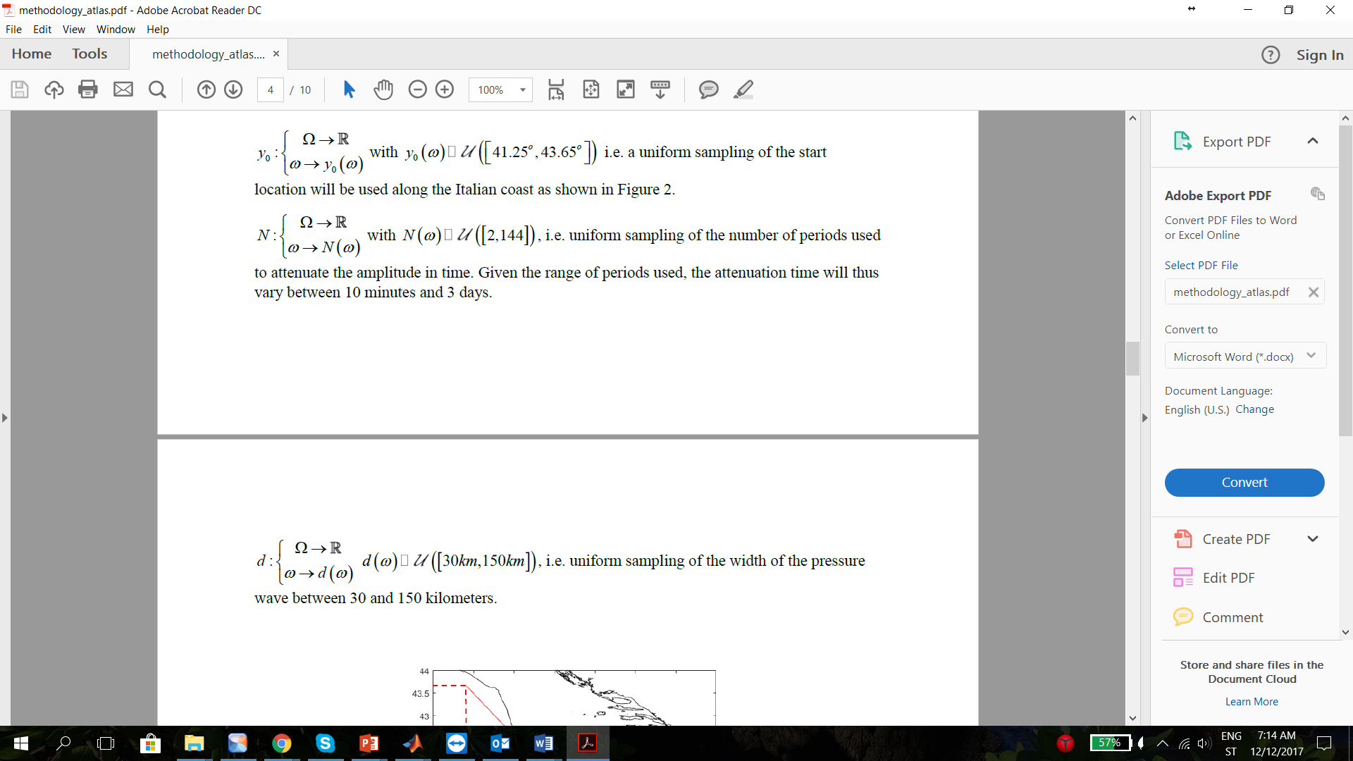
Prior distribution of the Meteotsunami Pressure Wave
Prior distributions of the stochastic parameters used in the definition of the pressure wave are based on the previous studies of Adriatic meteotsunamis.
However, given the lack of data, it was extremely difficult to assess the “real” distributions of the parameters and a choice was made to only use uniform distributions. It is thus assumed that within the range of the uniform distributions, the generation of any pressure waves generation is equally probable.
The distribution of some parameters is based on the article by Šepić and Vilibić (2011) which defined some of the meteotsunami pressure wave parameters following measurements made in Croatia.

Slide 6
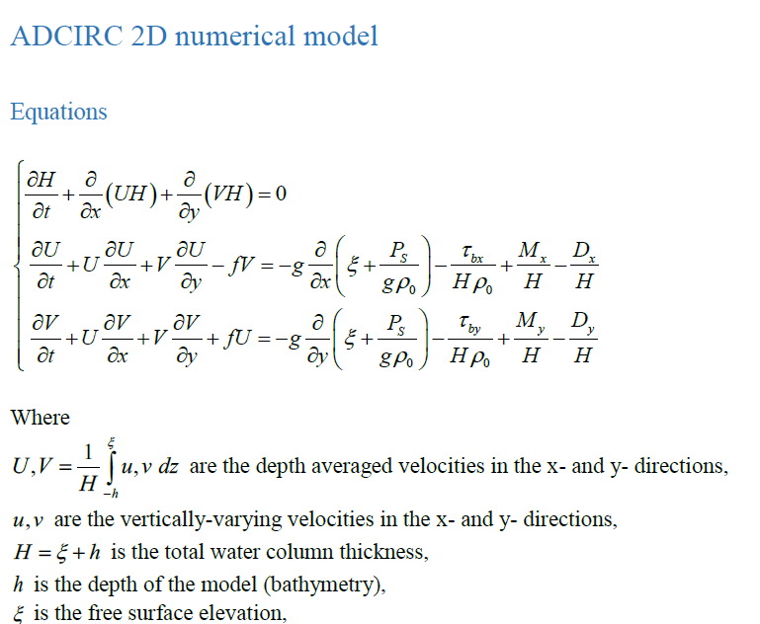
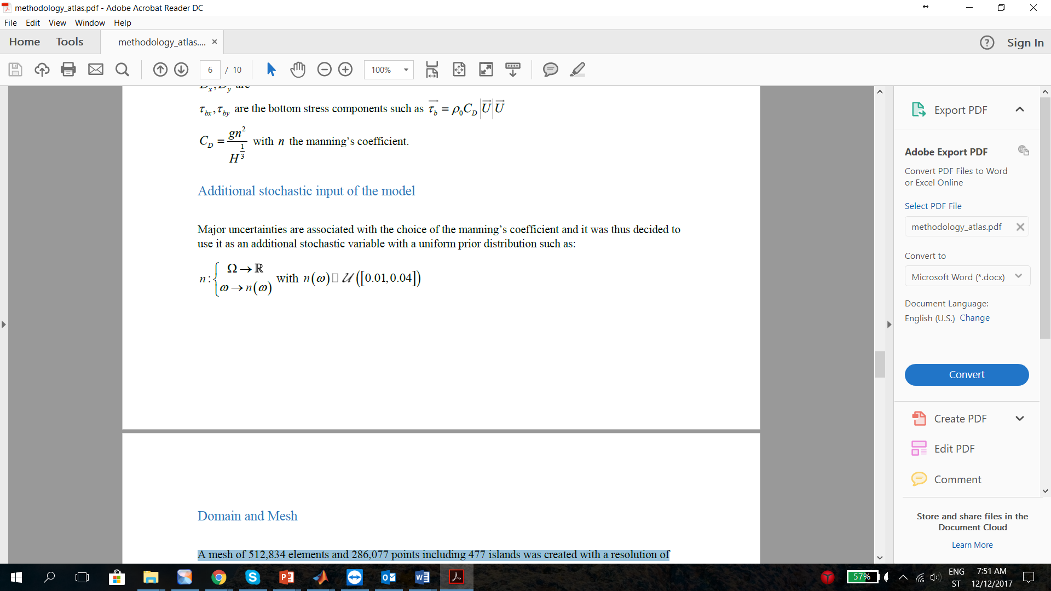
Modified Version of ADCIRC to include “Meteotsunami Pressure Wave”
A mesh of 512,834 elements and 286,077 points including 477 islands was created with a resolution of 15m near the coastal areas where the meteotsunamis are known to occur.
A mesh of 512,834 elements and 286,077 points including 477 islands was created with a resolution of 15m near the coastal areas where the meteotsunamis are known to occur.

Slide 7
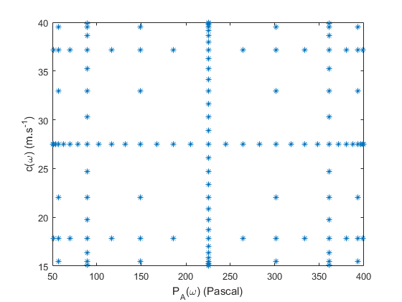
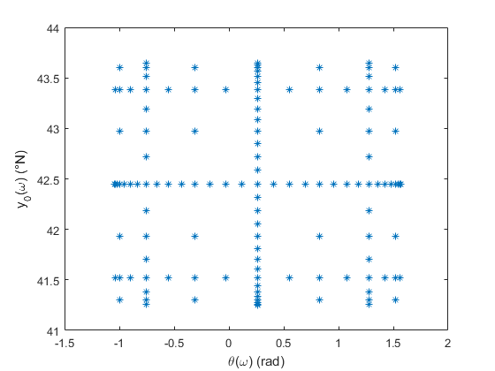
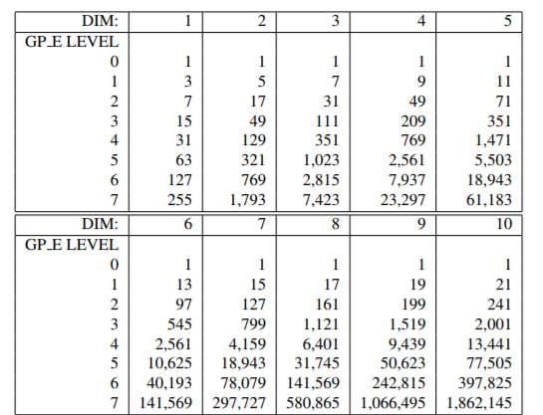
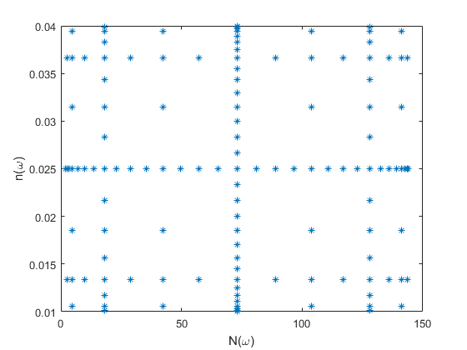
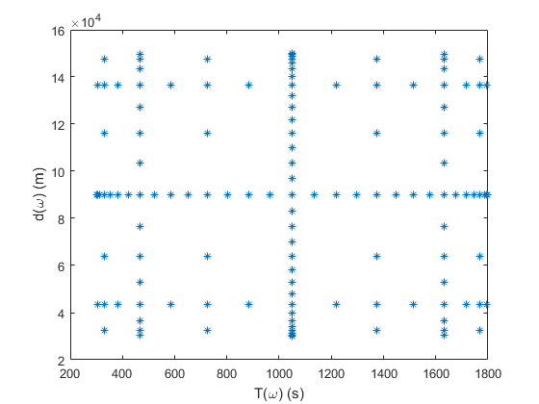
Gauss Patterson Sparse Grid Definition
The number of unique simulations that must be run with ADCIRC given for 4 p  and 8 r  with
the Gauss-Patterson rule is 6,401. Given the complexity of the ADCIRC model and the spatial
resolution of the mesh, this number of simulation can be achieved in a reasonable time using the
ECMWF HPC resources. For 5 p  the number of unique simulations increases to 31,745 which
is of course not realistically possible to achieve.
Gauss Patterson rules are used to form a sparse grids which allow to chose wisely the simulations of the Atlas.
The number of unique simulations that must be run with ADCIRC given for a polynomial order of 4 and 8 random variables with the Gauss-Patterson rule is 6,401.

Slide 8
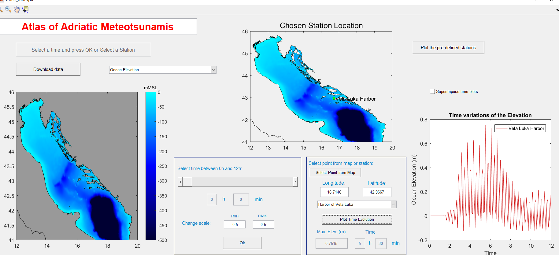
Atlas of Adriatic Meteotsunamis
n Gauss Patterson rules are used to form a sparse grid,

Slide 9
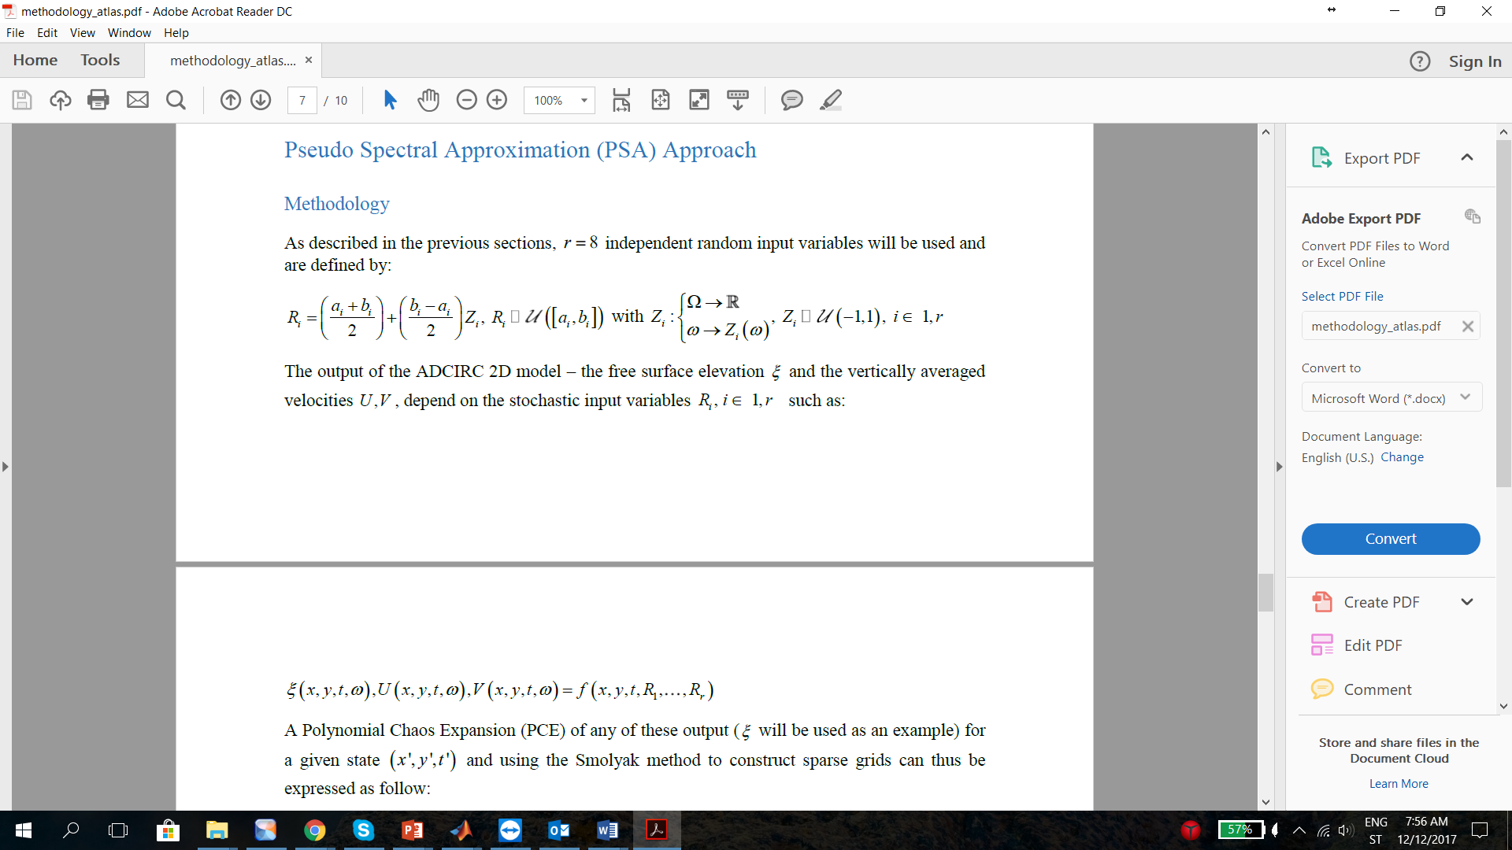

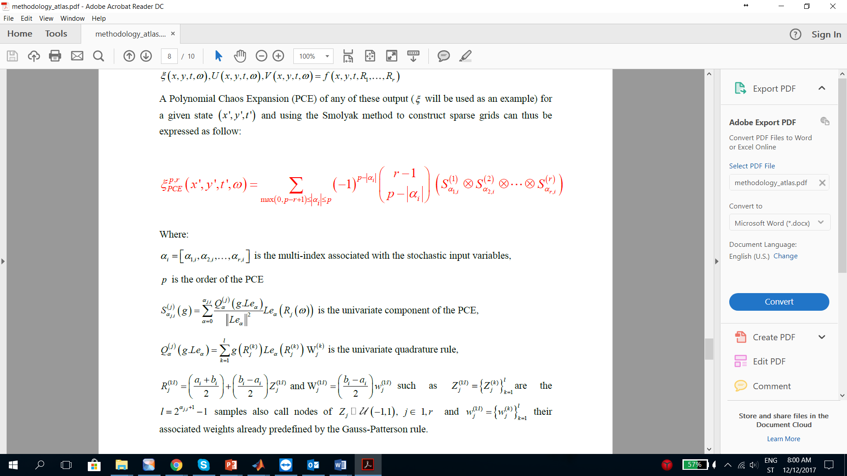
Pseudo Spectral Approximation: The Mathematic Description

Slide 10
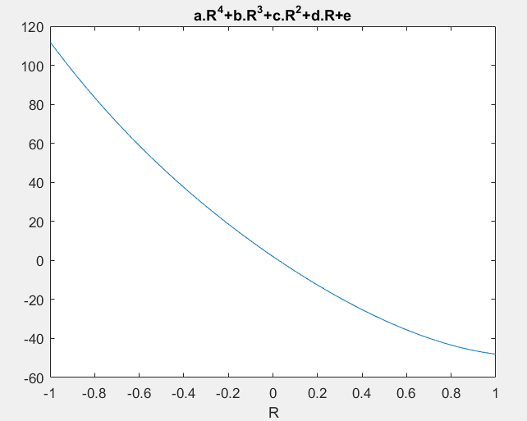
Pseudo Spectral Approximation: The Simple Description
For 3 random variables if the sum of all individual polynomial orders is 1 then:
α = [1 0 0] or α = [0 1 0] or α = [0 0 1]
Polynomial order: 4
For any random variable R exist a polynomial such as: aR⁴+bR³+cR²+dR+e
Just the way to do a numerical integration with as less as possible number of points => this is the way coefficients a,b,c,d,e are found!
Atlas simulations
Fitted Polynomial of order 4
Parameters used to do the Atlas simulations

Slide 11
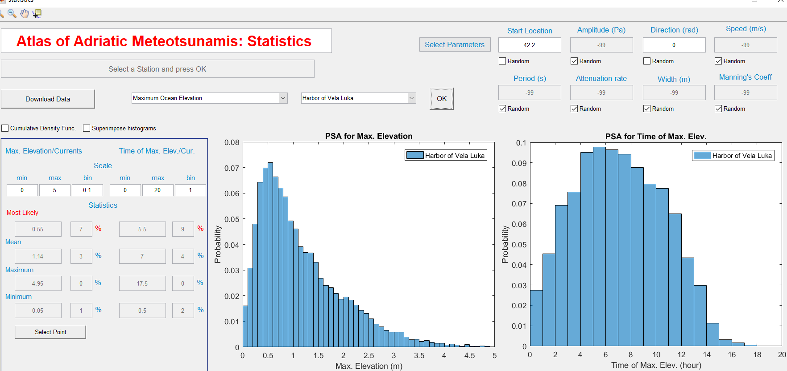
Pseudo Spectral Approximation: The Outcome

Slide 12


Conclusions
Model Set-Up – Domain, physics and forcing
Wave Effects on Currents (WEC) in COAWST Model
Challenges:
PSA never used for geosciences purpose
Huge number of simulations required: 6401
Definition of the idealized pressure wave
Convergence of the method
Principal Goal:
To provide in a few minutes a risk assessment concerning Meteotsunamis in the Eastern Adriatic!
Thank you!

