Slide 1
Installation of MESSI research and warning network
Hrvoje Mihanović¹, Jadranka Šepić¹, Stipe Muslim¹, Ivica Vilibić¹, Damir Ivanković¹, Dalibor Jelavić¹, Toni Mašće¹, Vlado Dadić¹, Vedrana Kovačević², Miroslav Gačić²
(1) Institute of Oceanography and Fisheries, Split, Croatia
(2) Istituto Nazionale di Oceanografia e di Geofisica Sperimentale – OGS, Trieste, Italy
Thanks to: colleagues from ISPRA – Italy (Marco Picone, Gabriele Nardone, Maurizio Ferla, Giovanni Arena)
MESSI final meeting, 12 December 2017, Split, Croatia

Slide 2
Project MESSI
Name: Meteotsunamis, destructive long ocean waves in the tsunami frequency band: from observations and simulations towards a warning system (MESSI)
Principal investigator: Jadranka Šepić (IOF)
Co-principal investigator : Miroslav Gačić (OGS)
Funding: Unity through knowledge fund (UKF)
Budget: 1.806.395,11 HRK (1.353.295,11 HRK - UKF) -> ~ 240 000 EUR
Project realization period: 15 December 2015 – 14 December 2017
Participating institutions: Institute of Oceanography and Fisheries (Split, Croatia); Istituto Nazionale di Oceanografia e di Geofisica Sperimentale (Trieste, Italy); Meteorological and Hydrological Service of Croatia (Zagreb, Croatia); University of the Balearic Islands (Palma de Mallorca, Spain); International Tsunami Research, Inc. (Victoria, BC, Canada)
Web page: www.izor.hr/messi/

Slide 3
Project POZOR
Name: Praćenje potencijalno opasnih oscilacija razine mora i njihov doprinos poplavama obalnih područja u budućoj klimi (POZOR)
Principal invesitigator: Jadranka Šepić
Funding: The Environmental Protection and Energy Efficiency Fund; Institute of Oceanography and Fisheries
Budget: 242.250,00 HRK -> ~ 32 000 EUR
Project realization period: 6 November 2014 – 31 May 2017
Participating institutions: Institute of Oceanography and Fisheries (Split, Croatia)
Web page: http://jadran.izor.hr/~sepic/POZOR/ (in Croatian)

Slide 4
Project MESSI
Practical and operational component (meteotsunami forecast and warnings) significantly lags for the scientific component!
The main objective of the MESSI project is to build a reliable prototype of a meteotsunami warning system based on real time measurements, operational atmosphere and ocean modeling and real time decision-making process.
Vilibić et al., Frontiers, 2016

Slide 5
Task 3. Installation of meteotsunami research and warning network
A number of ocean-atmospheric and atmospheric stations will be
installed in the middle Adriatic area in order to:
obtain sea level and air pressure measurements at the most endangered locations;
obtain atmospheric measurements from locations far from shore, allowing for a timely warning;
Track sea level and atmospheric pressure parameters along propagation and generation route of a meteotsunami - enabling relevant scientific research.

Slide 6
Task 3. Installation of meteotsunami research and warning network
Procedures:
public procurement process for all the instruments purchased within the project;
inspection of suitable locations, obtaining permits from local authorities, port authorites and harbour master’s offices;
Memorandum of Understanding with Istituto Superiore per la Protezione e la Ricerca Ambientale (ISPRA) – Italy;
organization of microbarograph installation in Italy;
inspection and installation of three microbarographs in Italy (thanks to Stipe, Toni and Italian colleagues).

Slide 7
Task 3. Installation of meteotsunami research and warning network
Ancona
X

Slide 8
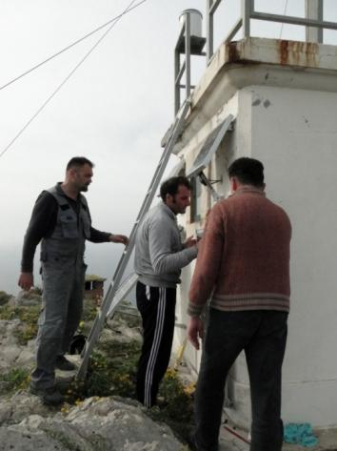
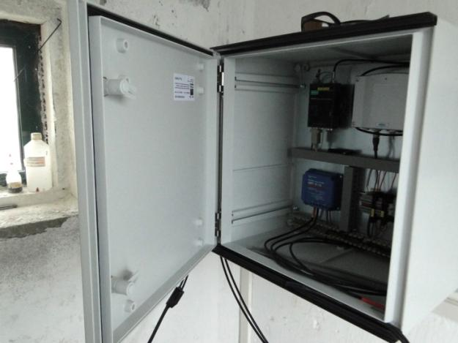
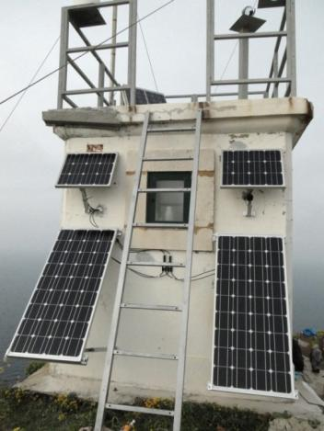
Task 3. Installation of meteotsunami research and warning network
Palagruža, March 2017, installation of microbarograph station

Slide 9
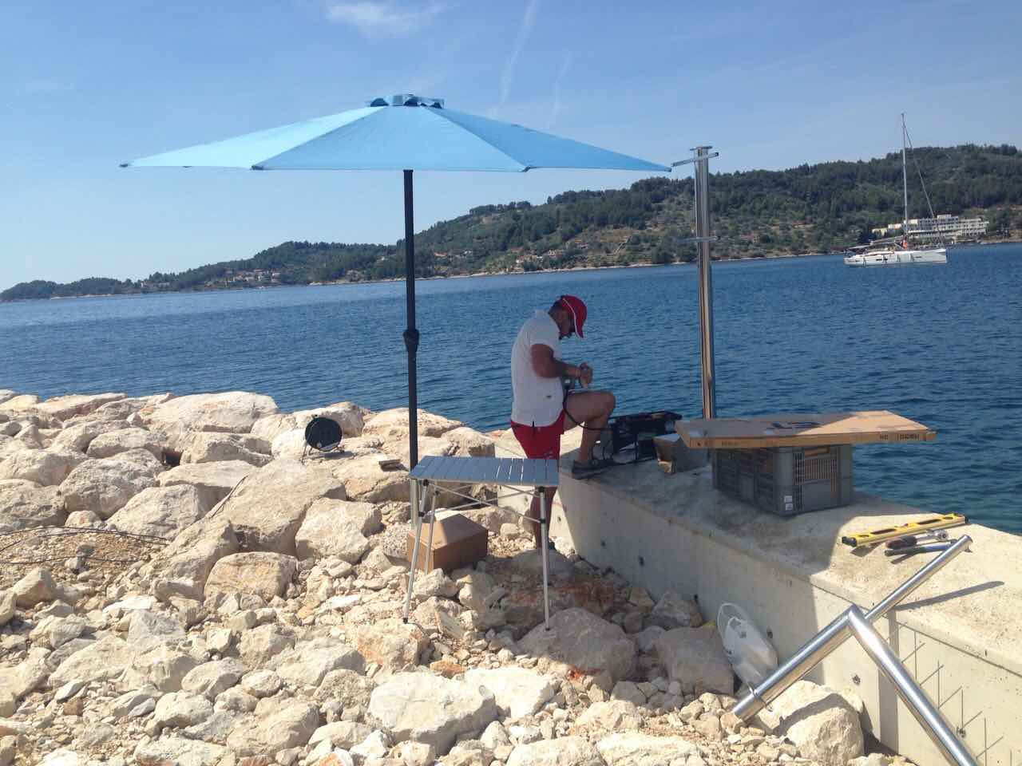
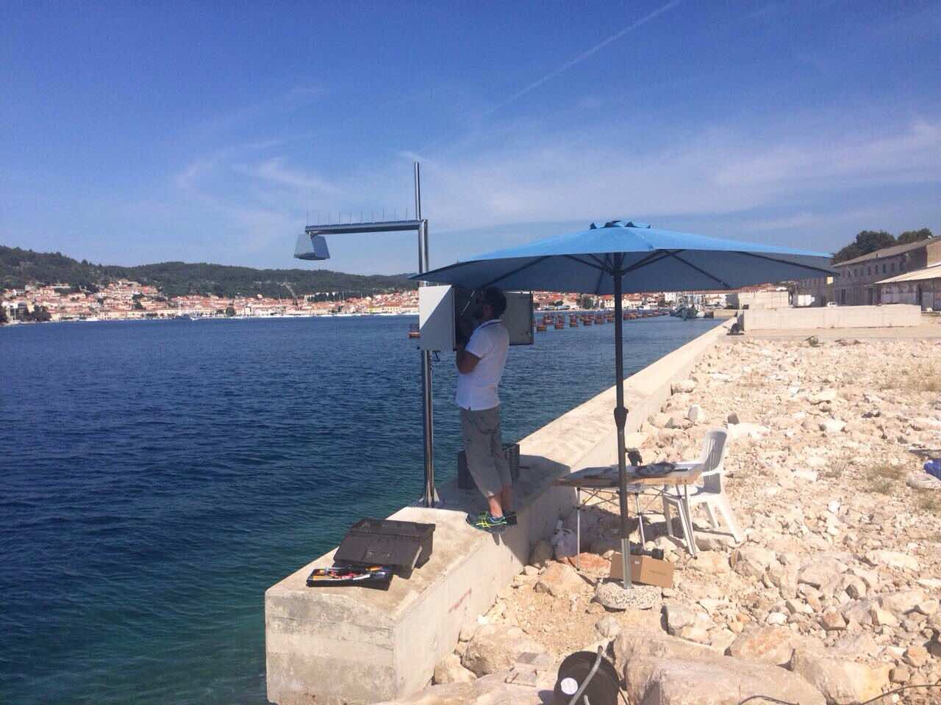
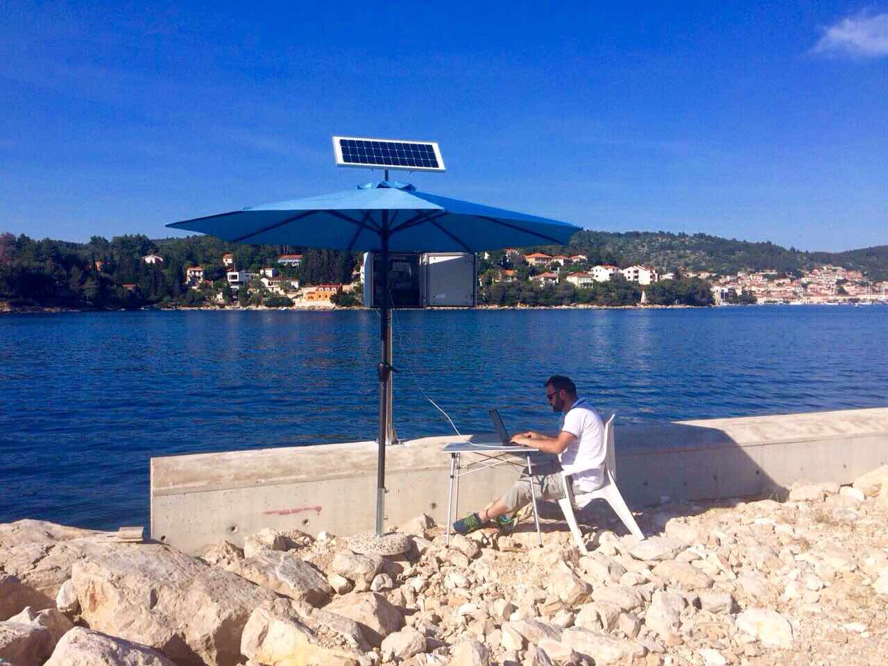
Vela Luka, May 2017, installation of tide gauge station

Slide 10
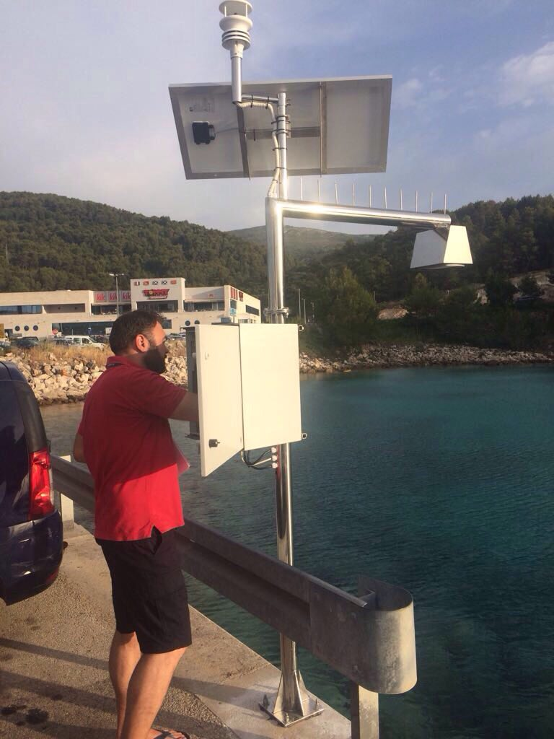
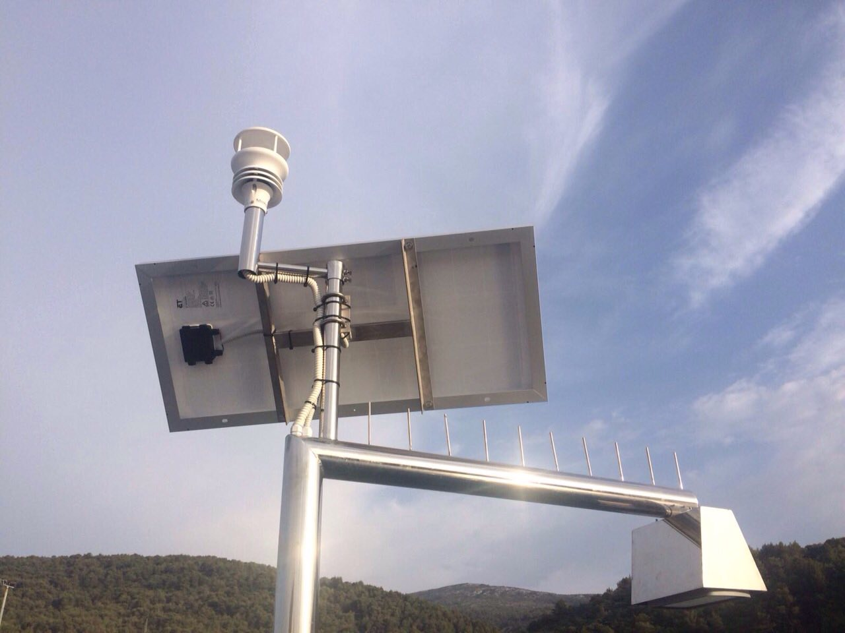
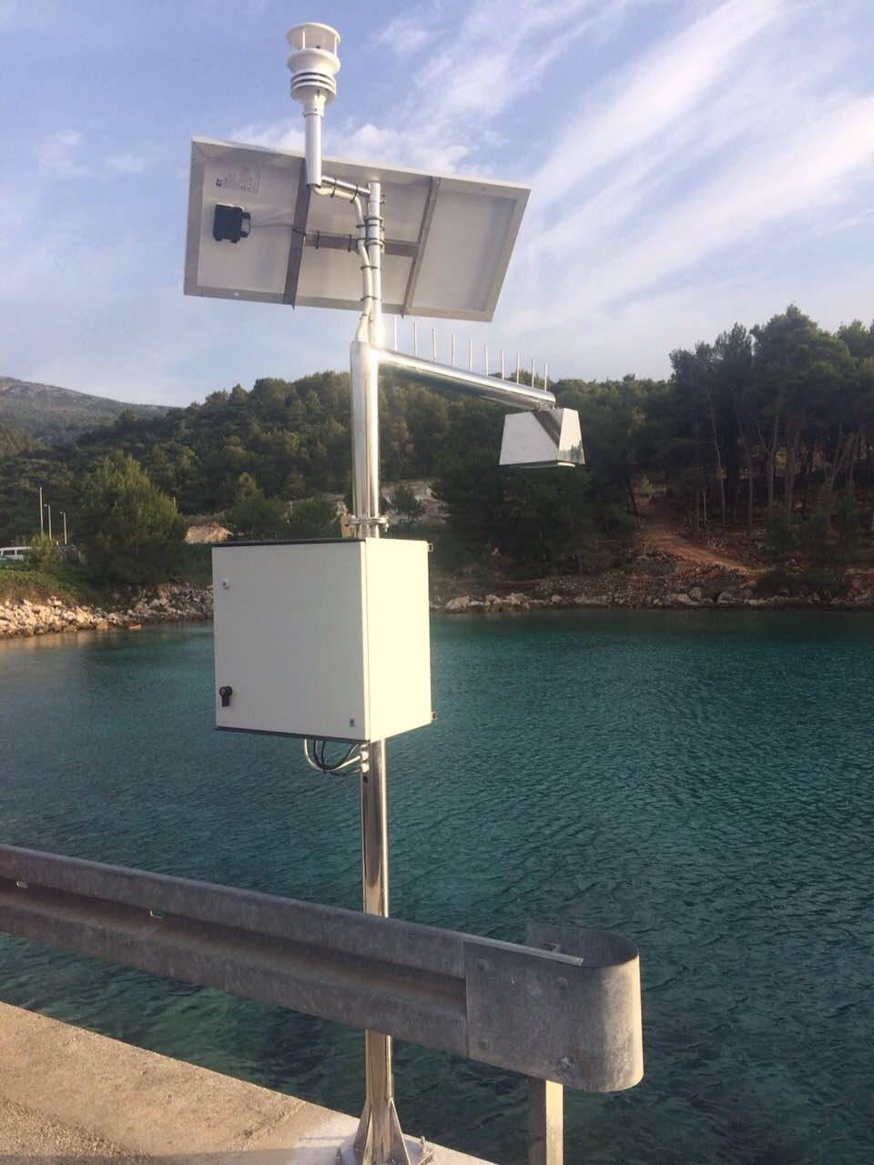
Stari Grad, June 2017, installation of tide gauge station

Slide 11
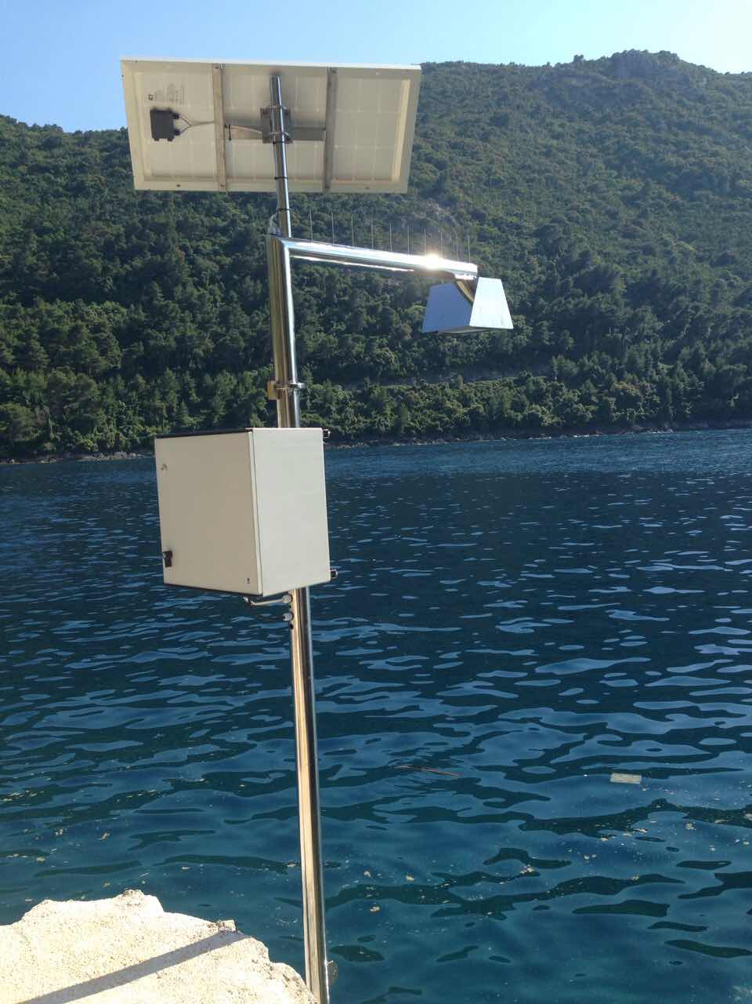
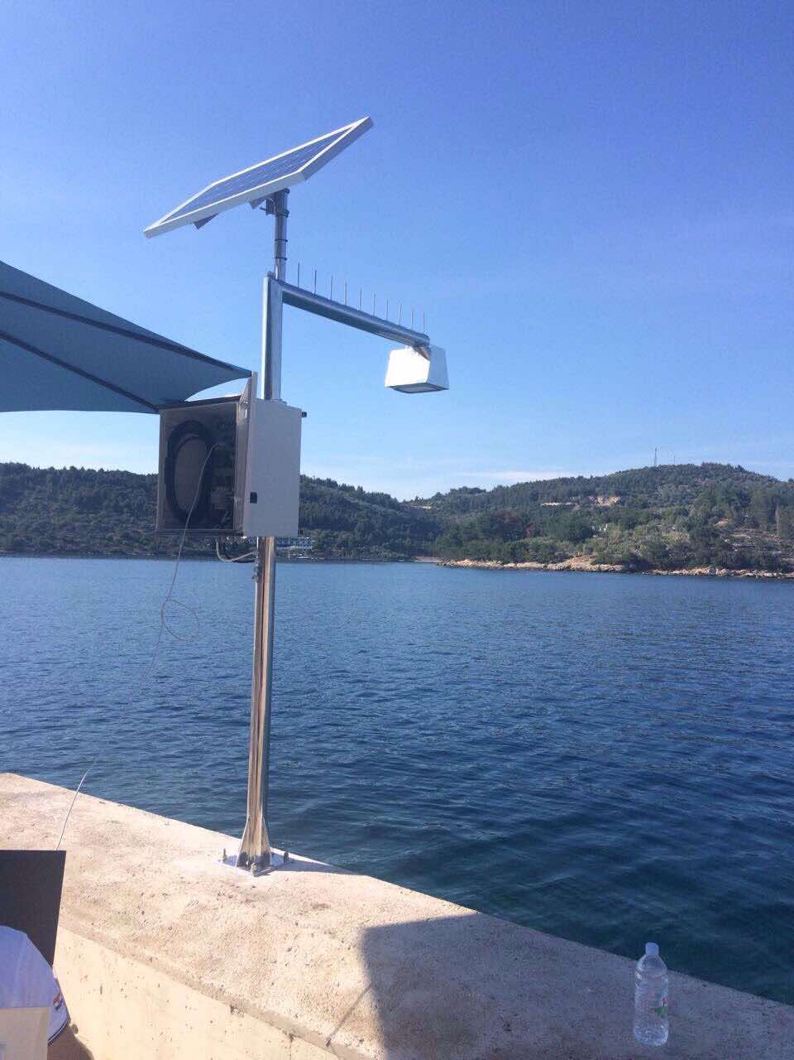
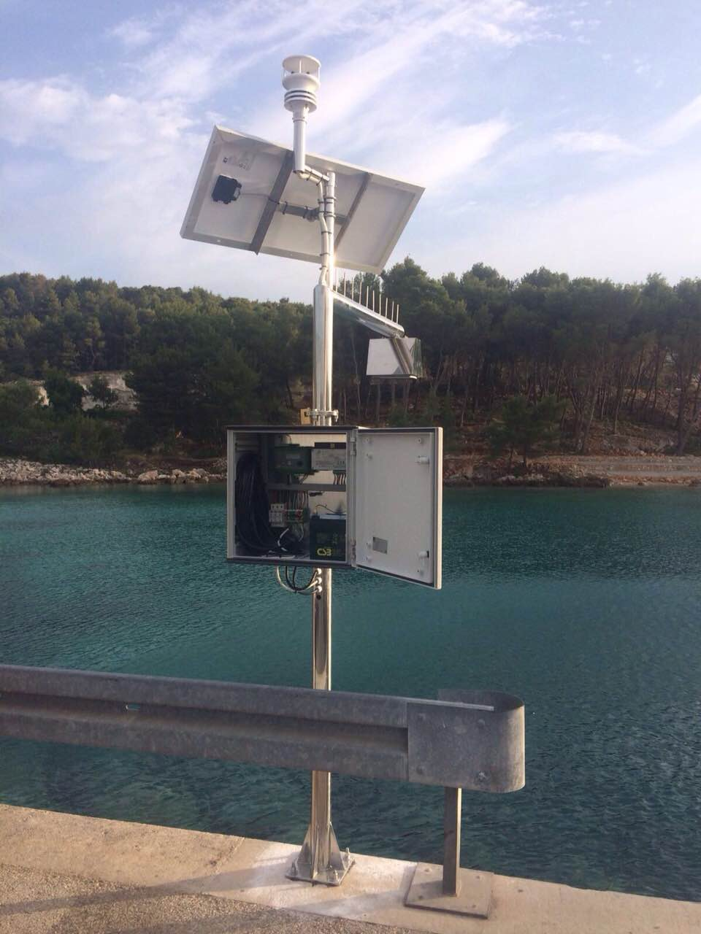
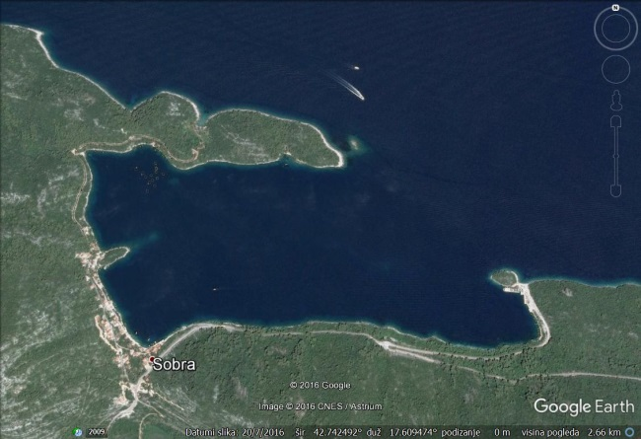
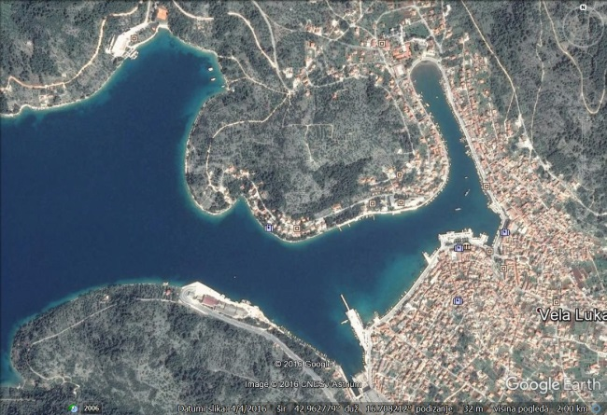
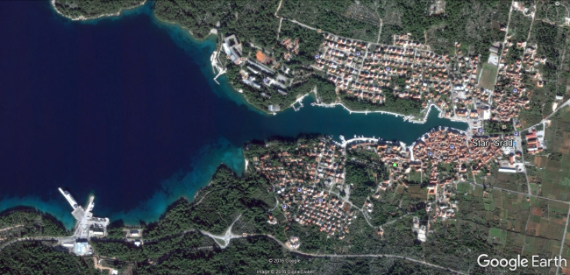
Sobra
(Mljet Island)
May 2017
Vela Luka
(Korčula Island)
May 2017
Stari Grad
(Hvar Island)
June 2017

Slide 12
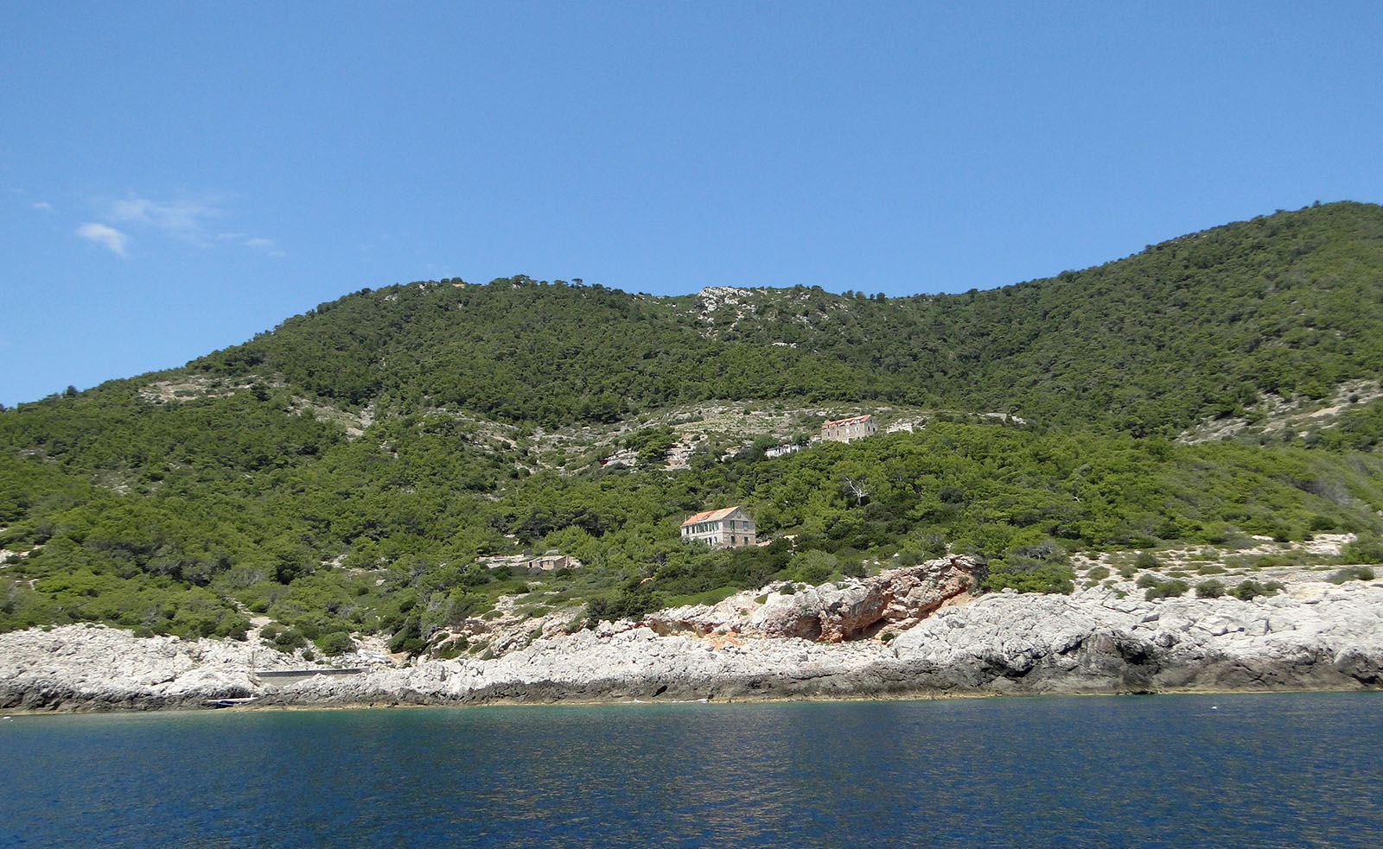
SVETAC
VIS
BIŠEVO
Planned
microbarograph
Svetac (Sveti Andrija), June 2017, inspection for the microbarograph installation

Slide 13
Planned
microbarograph
VIS
BIŠEVO
BRUSNIK
BIOS DVA
Svetac (Sveti Andrija), June 2017, inspection for the microbarograph installation

Slide 14
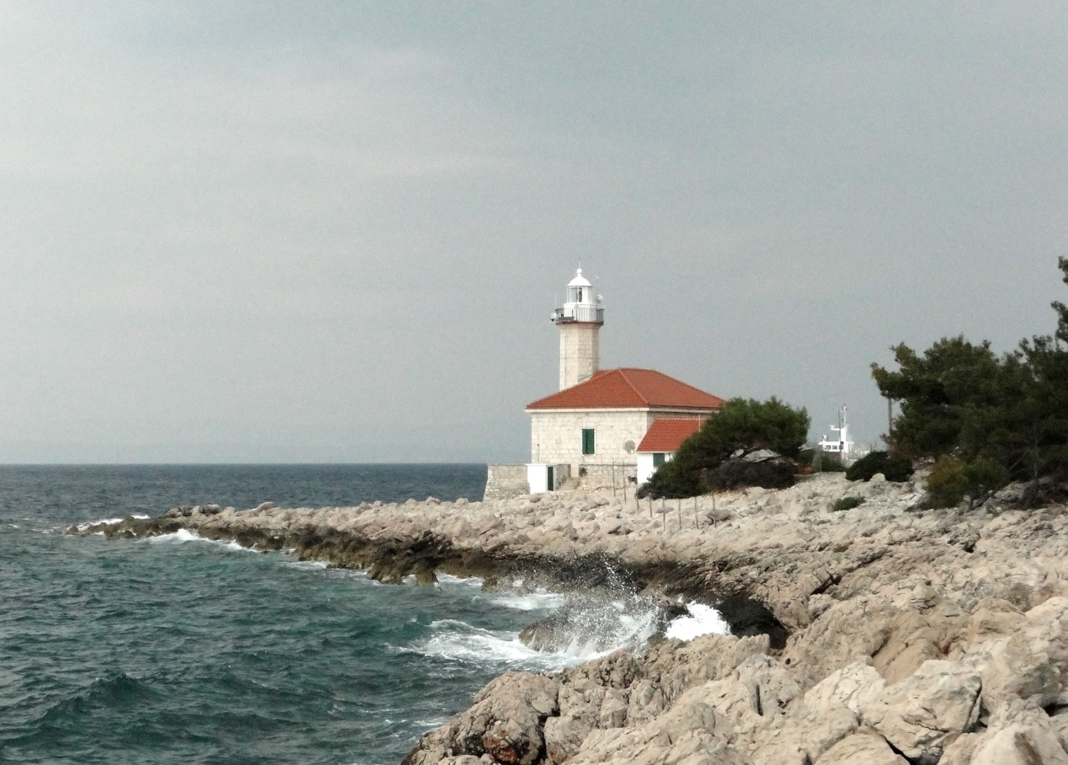
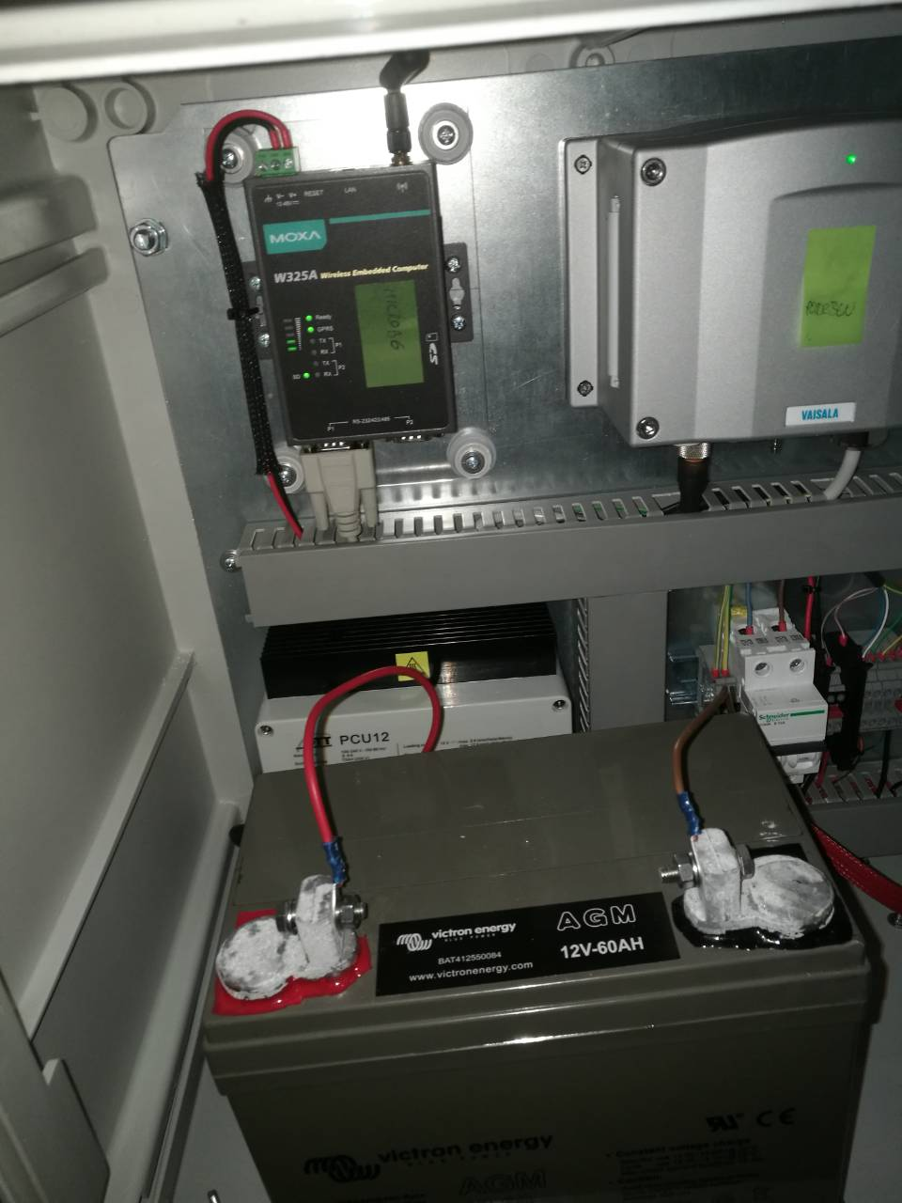
Ražanj (Brač), microbarograph installed in November 2017

Slide 15
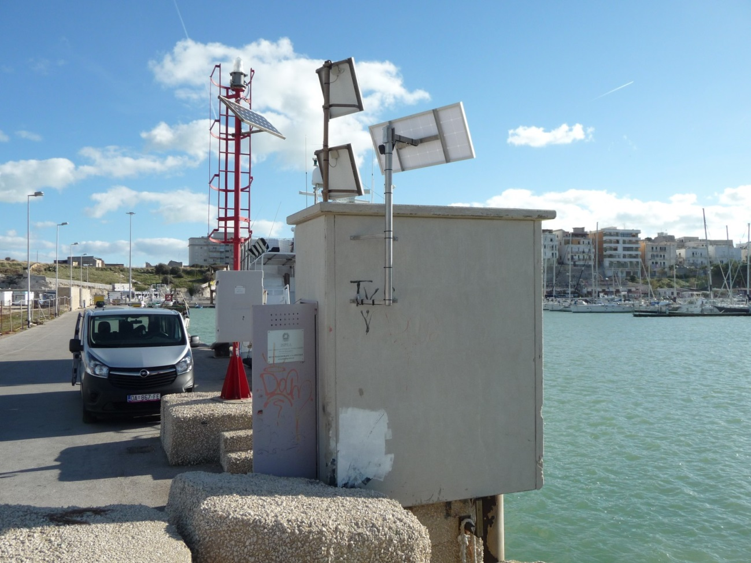
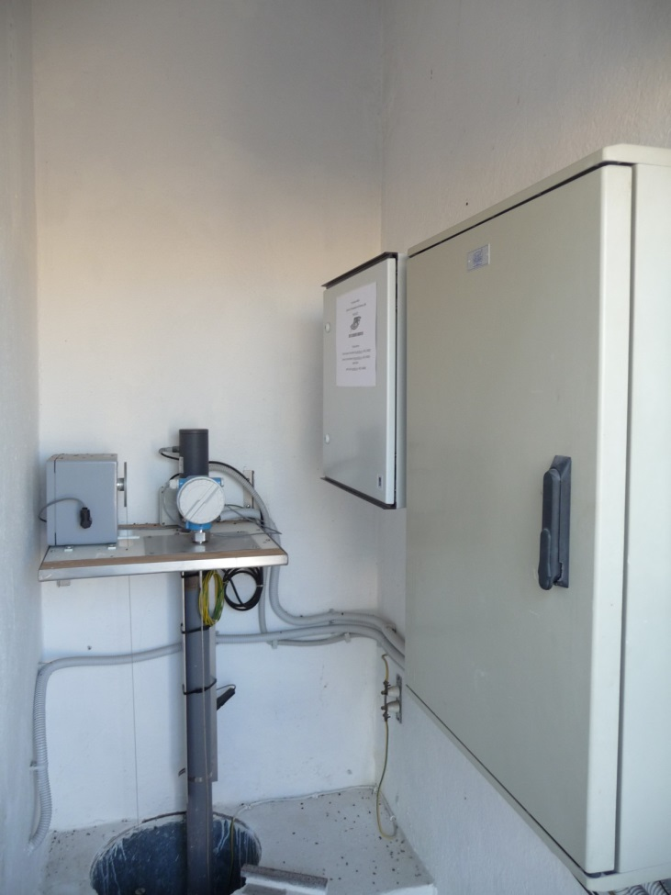
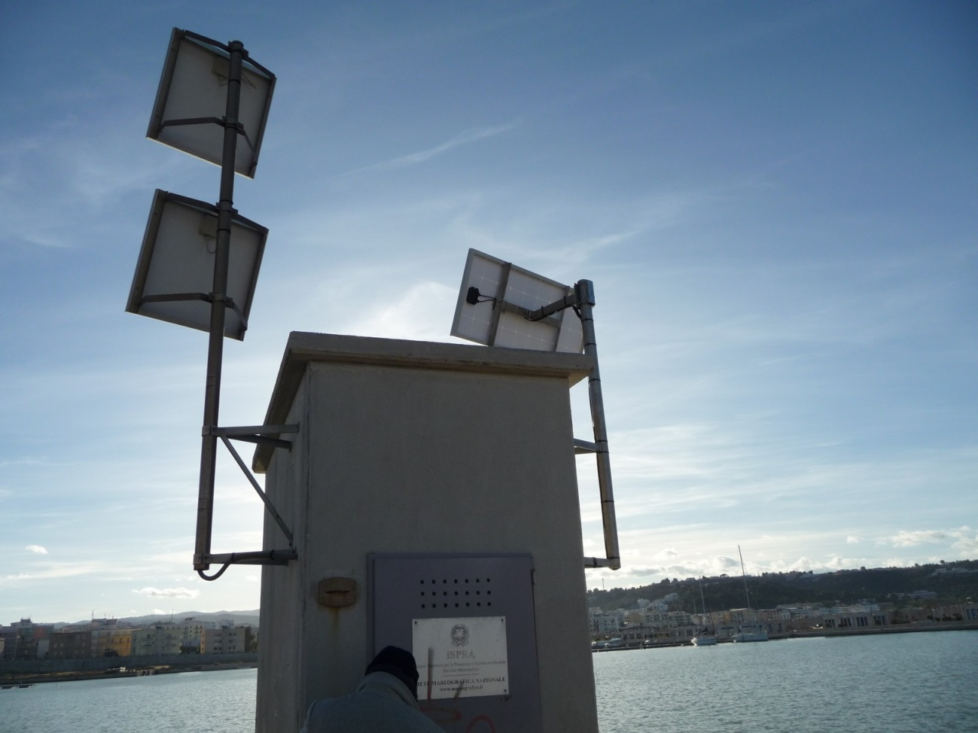
Vieste – Italy, November 2017, installation of microbarograph @ tide gauge

Slide 16
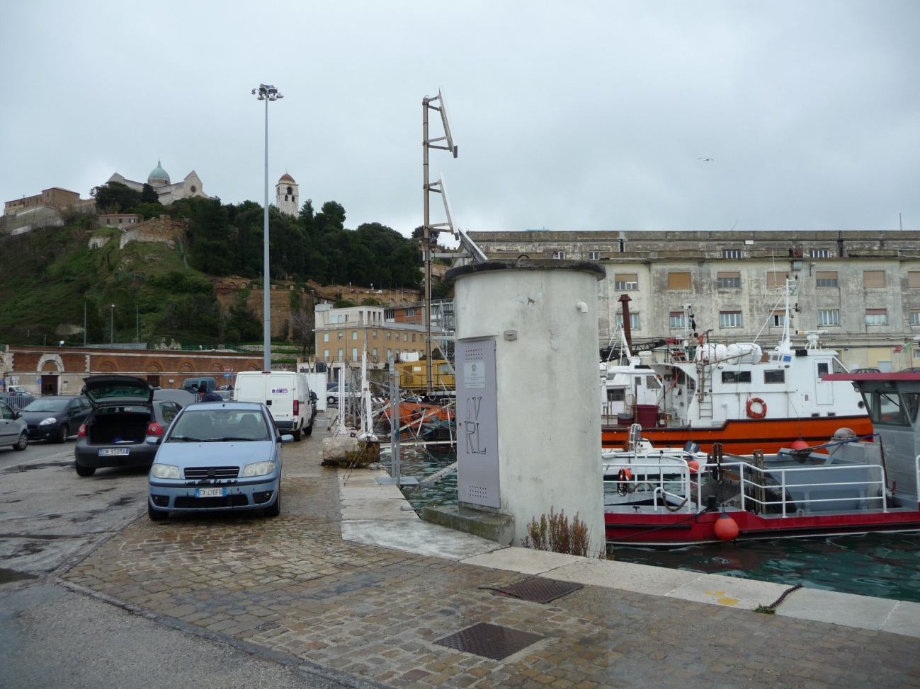
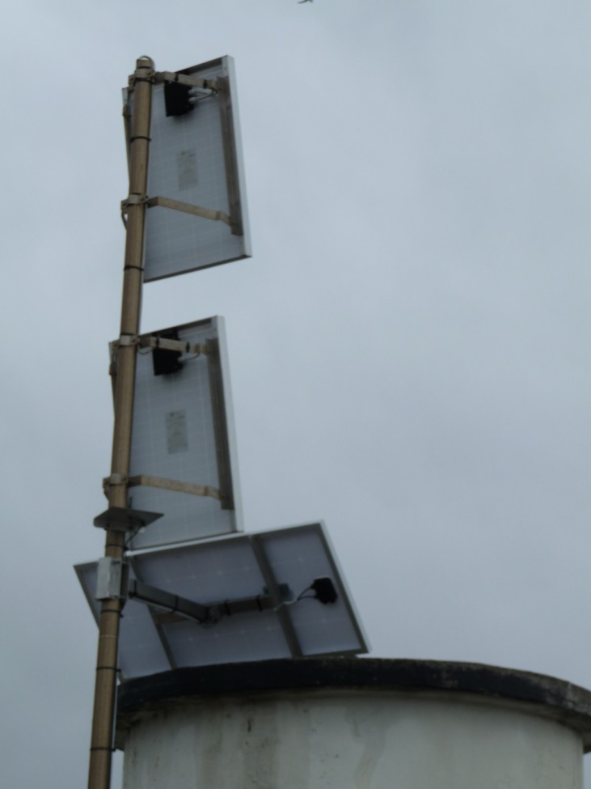
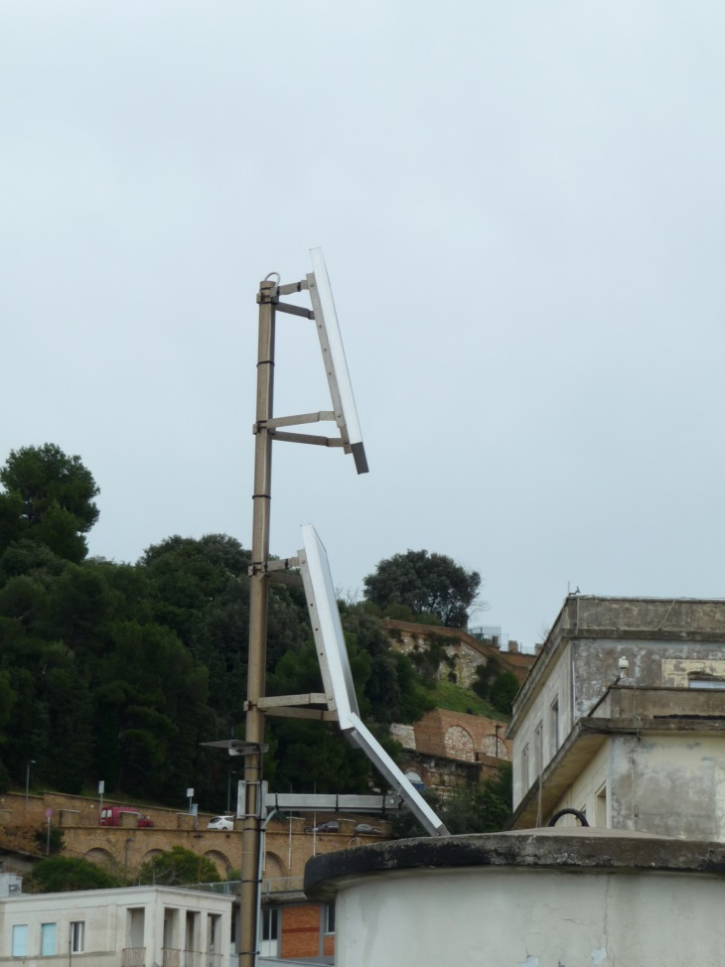
Ancona – Italy, November 2017, installation of microbarograph @ tide gauge

Slide 17
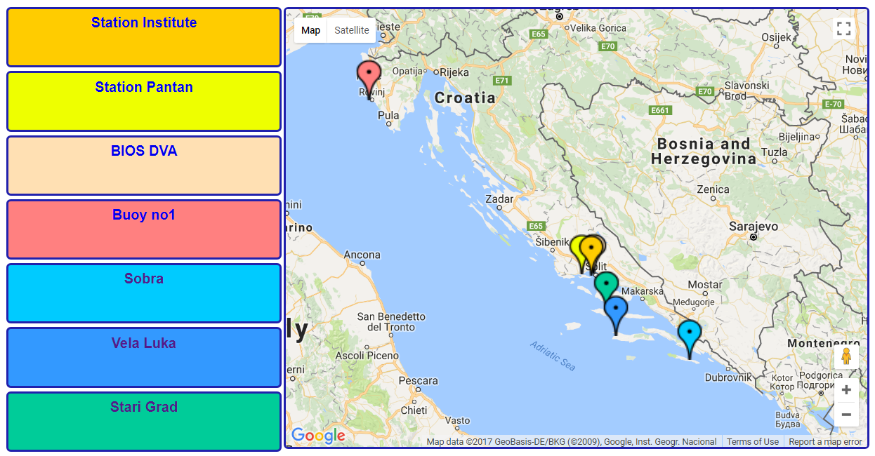
Online measuring stations
http://faust.izor.hr/autodatapub/postaje?jezik=eng

Slide 18
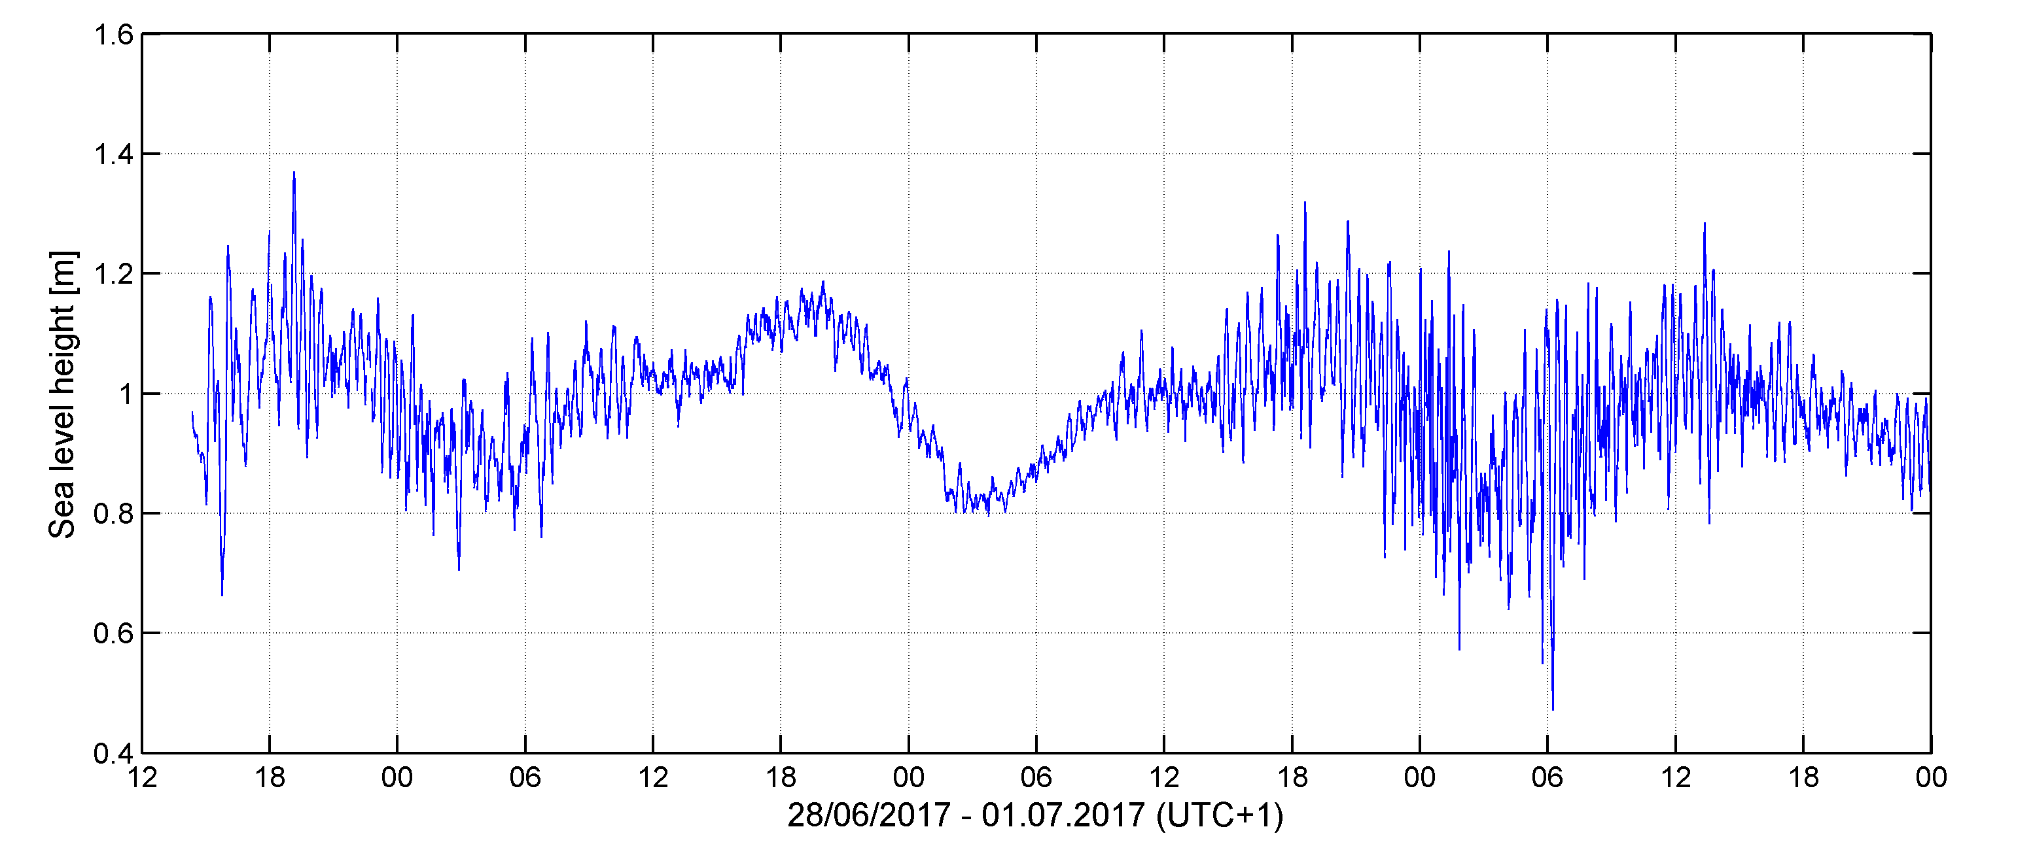
Tide gauge measurements
1st meteotsunami event
2nd meteotsunami event
Start of measurements
(28 June 2017)
Stari Grad tide gauge

Slide 19
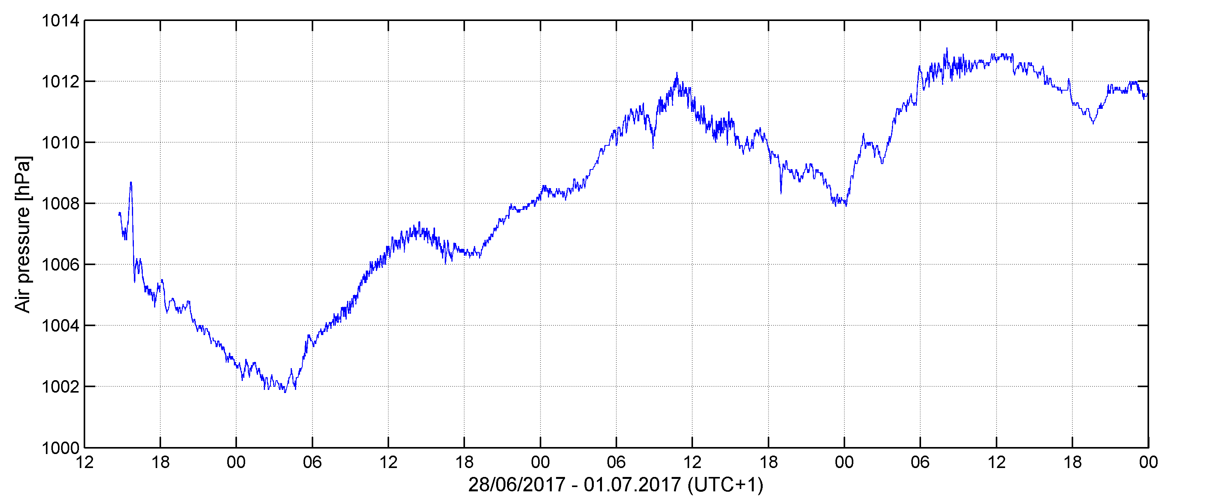
Tide gauge measurements
1st meteotsunami event
2nd meteotsunami event
Start of measurements
(28 June 2017)
Stari Grad tide gauge

Slide 20
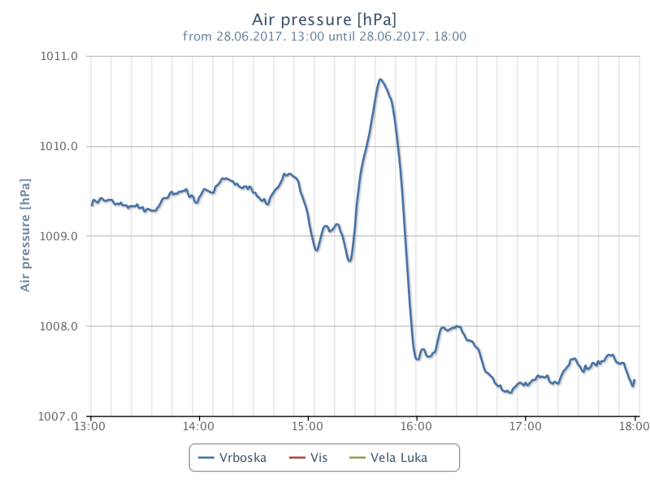
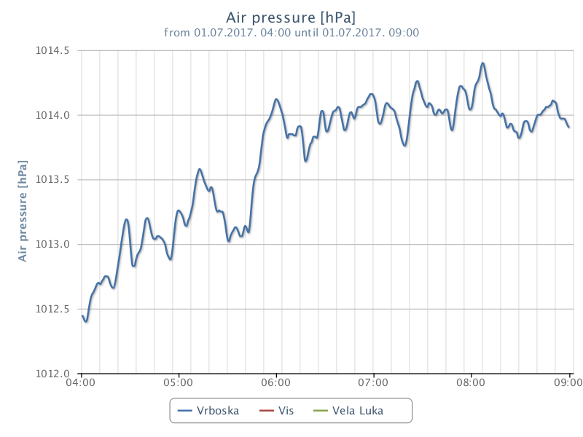
Microbarograph measurements
1st meteotsunami event
(28 June 2017)
2nd meteotsunami event
(1 July 2017)
http://jadran.izor.hr/barograf/index_eng.htm
Vrboska microbarograph

Slide 21
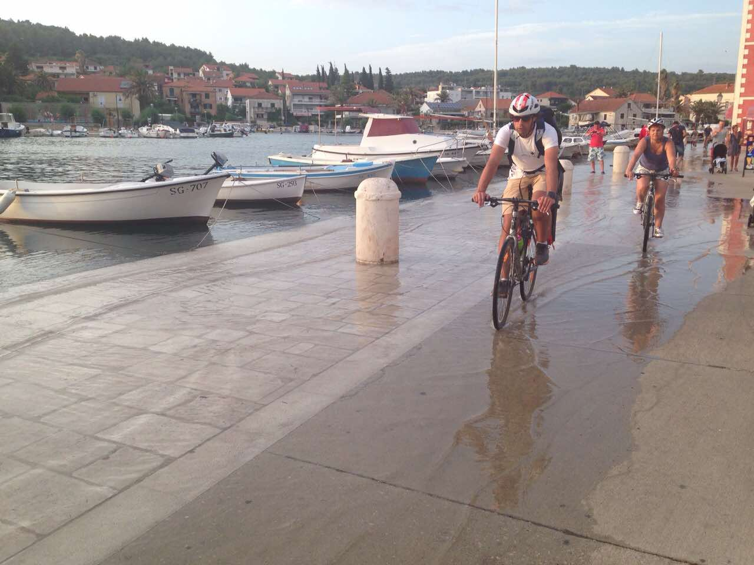
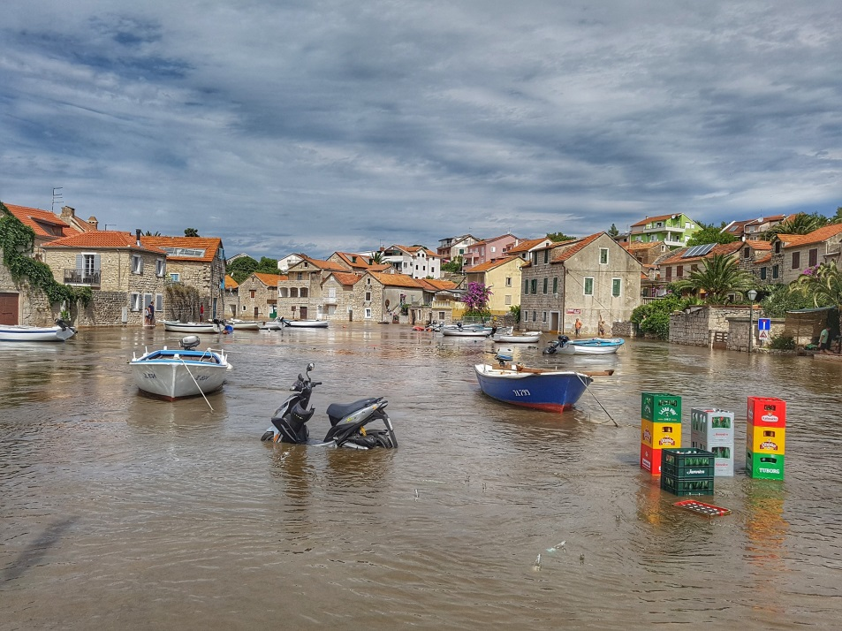
1st meteotsunami event
(28 June 2017)
2nd meteotsunami event
(1 July 2017)
Stari Grad
Vrboska

Slide 22
Current status:
Three tide gauges installed (Sobra, Vela Luka, Stari Grad); Stari Grad is collocated with meteorological sensors, Vela Luka will be in near future;
Eight air pressure sensors installed, one more in the procces of installation (Svetac Island).
Data will be delivered each minute
Thank you for your attention
Vela Luka (Korčula)

