Slide 1

Meteotsunamis, destructive long ocean waves in the tsunami frequency band: from observations and simulations towards a warning system (MESSI)
Jadranka ŠEPIĆ, Miro Gačić, Gordana BEG PAKLAR, Vlado DADIĆ, Clea DENAMIEL, Natalija DUNIĆ, Tomislav DŽOIĆ, Kristian HORVATH, Damir IVANKOVIĆ, Dalibor JELAVIĆ, Hrvoje KALINIĆ, Žarko KOVAČ, Vedrana KOVAČEVIĆ, Toni MAŠĆE, Frano MATIĆ, Iva MEĐUGORAC, Hrvoje MIHANOVIĆ, Sebastian MONSERRAT, Stipe MUSLIM, Alexander RABINOVICH, Maja TELIŠMAN PRTENJAK, Martina TUDOR, Ivica Vilibić

Slide 2





MESSI project
Project Title: Meteotsunamis, destructive long ocean waves in the tsunami frequency band: from observations and simulations towards a warning system (MESSI)
Principal Investigator: Jadranka Šepić
Co-Principal Investigator: Miro Gačić
Funding: Unity Through Knowledge Fund
Budget: 1.806.395,11 HRK (1.353.295,11 HRK - UKF)
Project Duration: 15 December 2015 – 14 December 2017
Involved Institution:
  Institute of Oceanography and Fisheries, (Split, Croatia)
  Istituto Nazionale di Oceanografia e di Geofisica Sperimentale (Trieste, Italy)
  Meteorological and Hydrological Service (Zagreb, Croatia)
  University of the Balearic Islands (Palma de Mallorca, Spain)
  International Tsunami Research, Inc. (Victoria, BC, Canada)

Slide 3
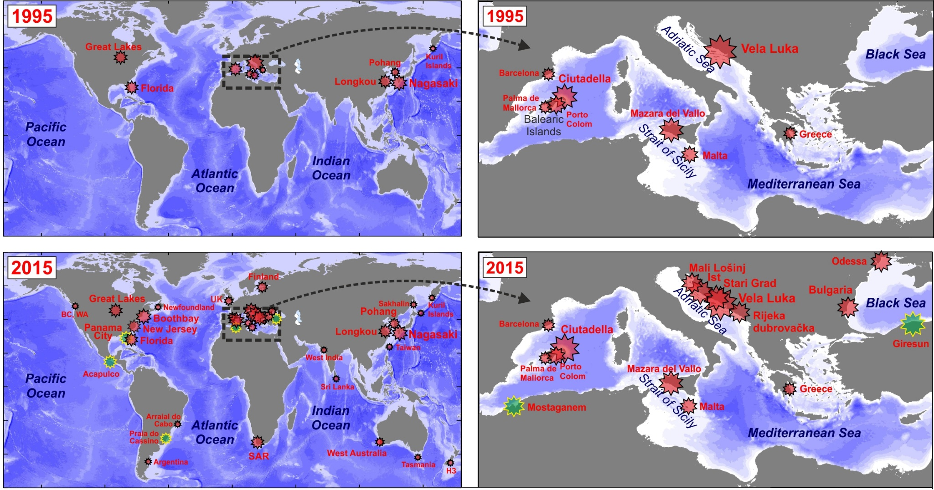
MESSI project - motivation
Meteotsunamis are a global phenomena and an ever present threat for numerous coastal communities!
Vilibić et al. 2016

Slide 4
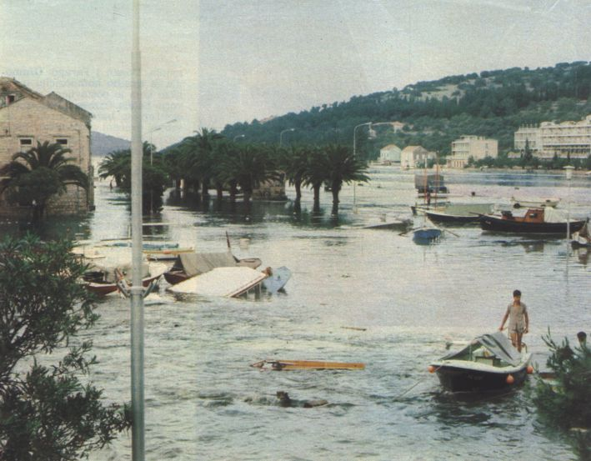
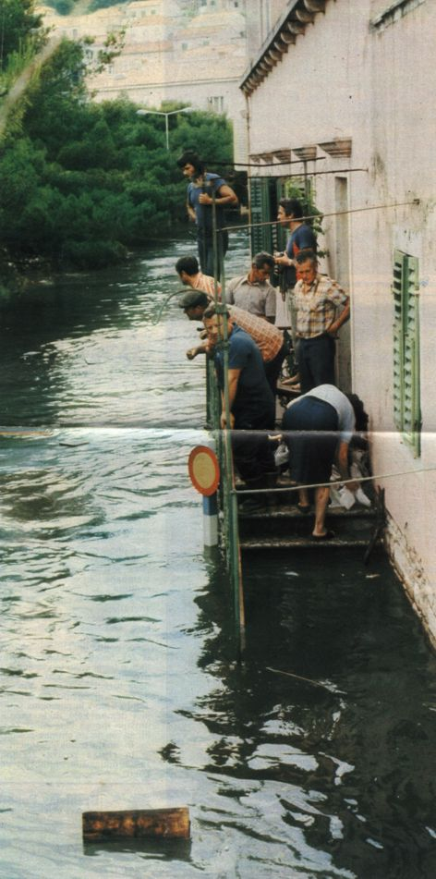
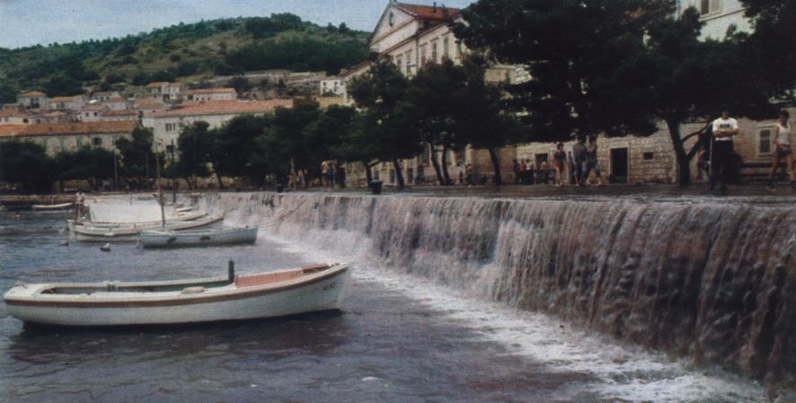
MESSI project - motivation
On 21 June 1978, Vela Luka (Korčula island, Croatia) was devastated by 6 m high meteotsunami waves.
Oscillations of ~17 min period lasted throughout the morning hours.
This is up to date the strongest known World meteotsunami.
There have been more strong meteotsunami events in Vela Luka (and rest of the Adriatic!) throughout 20 and 21st century => motivation for meteotsunami research project.

Slide 5
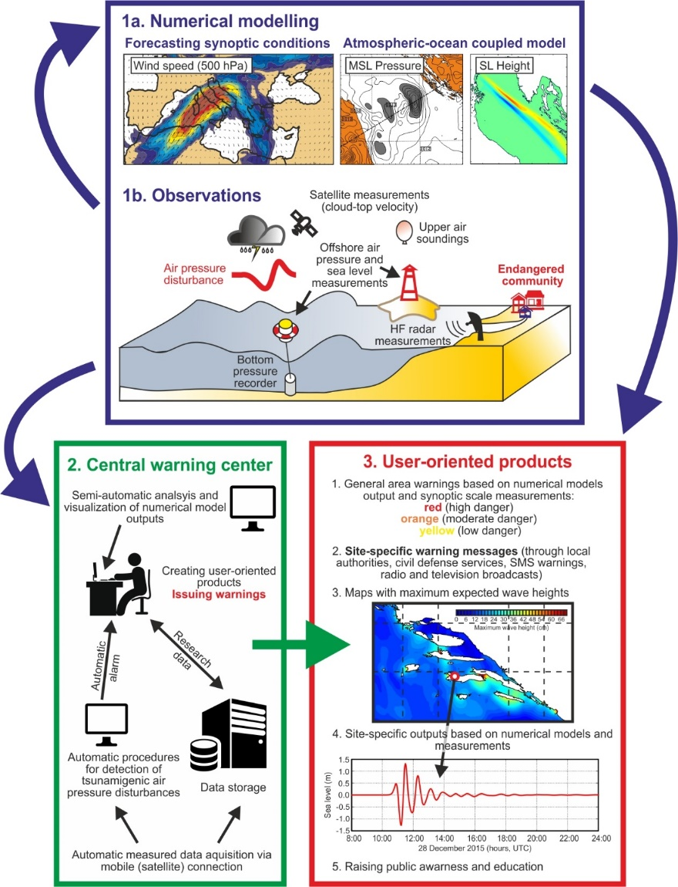
MESSI project - main task
Practical and operational component (meteotsunami forecast and warnings) significantly lags for the scientific component!
The main objective of the MESSI project is to build a reliable prototype of a meteotsunami warning system based on real time measurements, operational atmosphere and ocean modeling and real time decision-making process.
Vilibić et al. 2016

Slide 6
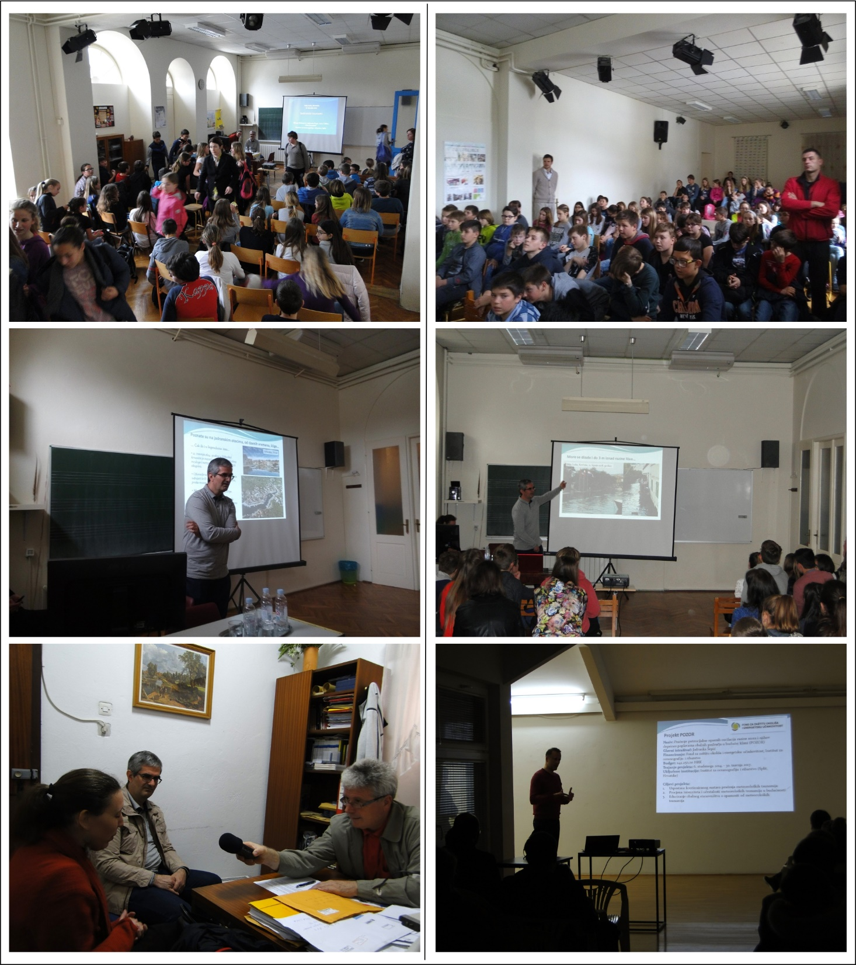
MESSI project – other objectives
Supporting and supplementing operational oceanographic products and services currently developed at the national level
Using a novel approach and techniques for tracking and forecasting potentially hazardous events
Collaborating and networking with top-level international scientists
Transfer of knowledge to PhD students and post-docs
Transfer of knowledge to engineers
Helping vulnerable local communities
Examining various aspects of meteotsunamis like:
  Generation of meteotsunamis over complex bathymetry
  Propagation and interaction of free and forced ocean waves
  Transfer of energy from atmosphere to the sea
  Refraction and reflections of free waves
  Other...
Vela Luka, 6. travnja 2017.

Slide 7
MESSI project – tasks
Task 1. Assessment of historical Adriatic meteotsunamis
Task 2. Design and construct of a meteotsunami monitoring station prototype
Task 3. Installation of a meteotsunami research and warning network
Task 4. Estimate occurrence rate of meteotsunamis in the past, present and future climate
Task 5. Mapping of meteotsunami hazard and creation of meteotsunami warning matrices
Task 6. Setup of operational atmospheric and ocean models
Task 7. Set up a prototype of warning system
Task 8. Create dynamic web content with a meteotsunami hazard forecast
Task 9. Dissemination towards potential users

Slide 8
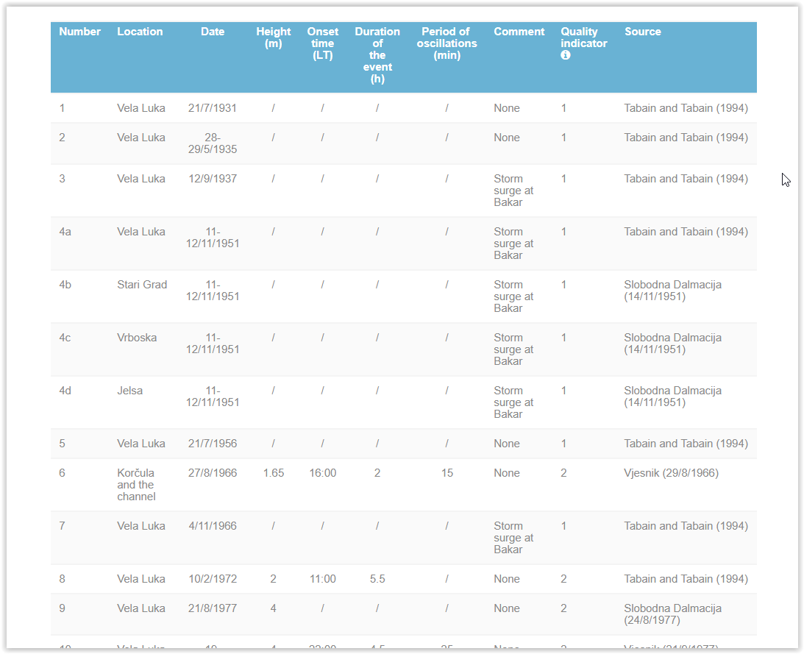
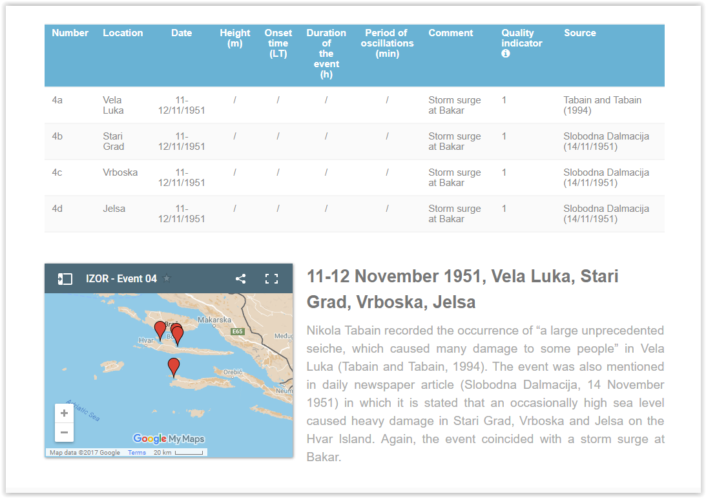
Task 1. Assessment of historical Adriatic meteotsunamis
Prior to project:
Historical tide gauge records and news paper articles were examined (by prof. Mirko Orlić & Iva Vrkić)
First version of the Adriatic meteotsunami catalogue has been published (Acta Adriatica, 2016)
During early stages of project:
On-line version of the Adriatic meteotsunami catalogue has been built
(jadran.izor.hr/~sepic/meteotsunami_catalogue)
On-line version is regularly updated with new events
The 2014 multimeteotsunami event has been studied in detail and reproduced with several atmospheric and ocean models

Slide 9
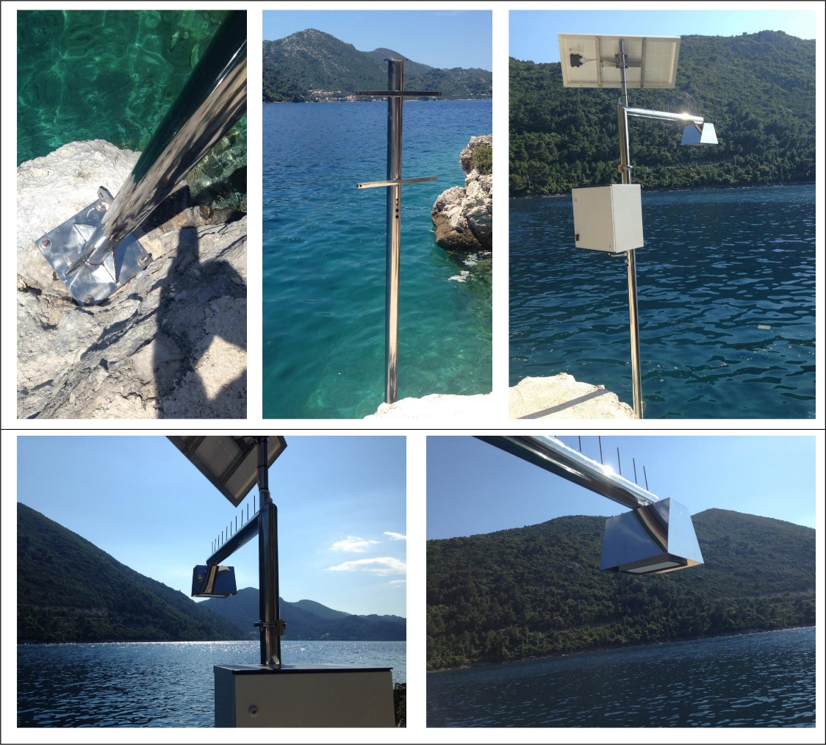
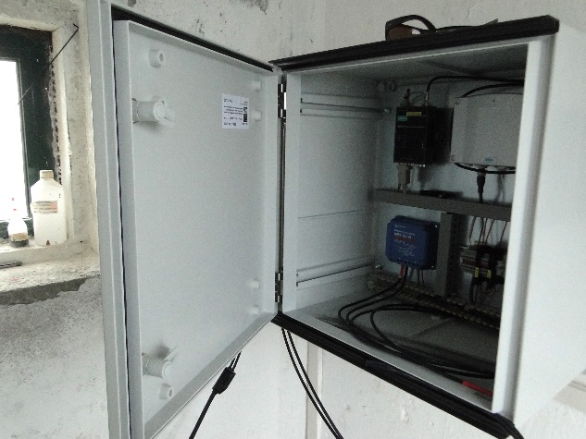
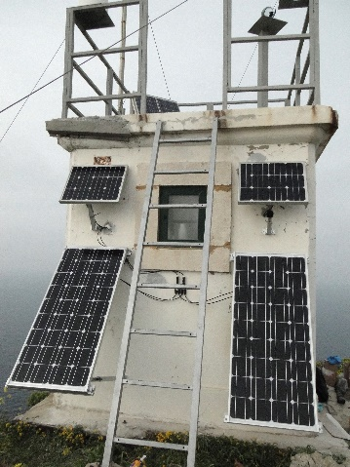
Task 2. Design and construction of a meteotsunami monitoring station prototype
Three types of stations have been planned:
Atmospheric stations
  air pressure measurements
Ocean stations
  sea level measurements
Ocean atmospheric stations
  sea level measurements, and atmospheric variables measurements
Ocean station (Sobra, Mljet)
Atmospheric station (Palagruža)

Slide 10
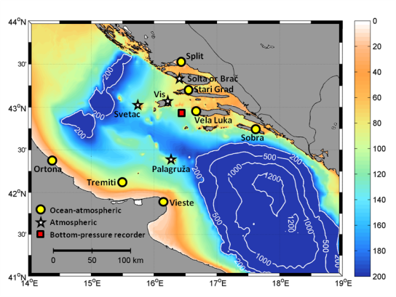
Task 3. Installation of a meteotsunami research and warning network
Realized:
Three ocean stations installed (Stari Grad, Vela Luka, Sobra)
Three air pressure stations renewed (Vrboska, Vela Luka, Vis)
Five new air pressure stations installed (Ražanj, Palagruža, Ancona, Vieste, Ortona)
One additional atmospheric station (a few variables) installed (Stari Grad)
To be done:
Install air pressure station on Svetac
Install atmospheric station (a few variables) in Vela Luka
Solve communication problems with Palagruža station
Install meteorological station in Vis & Vela Luka schools

Slide 11
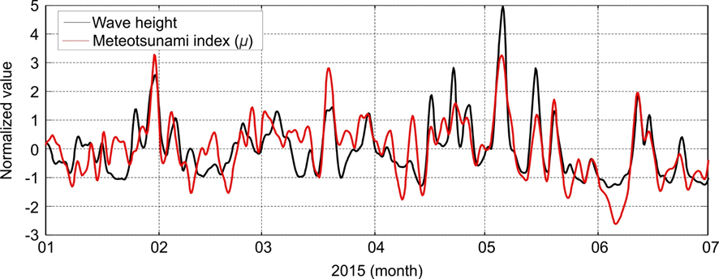
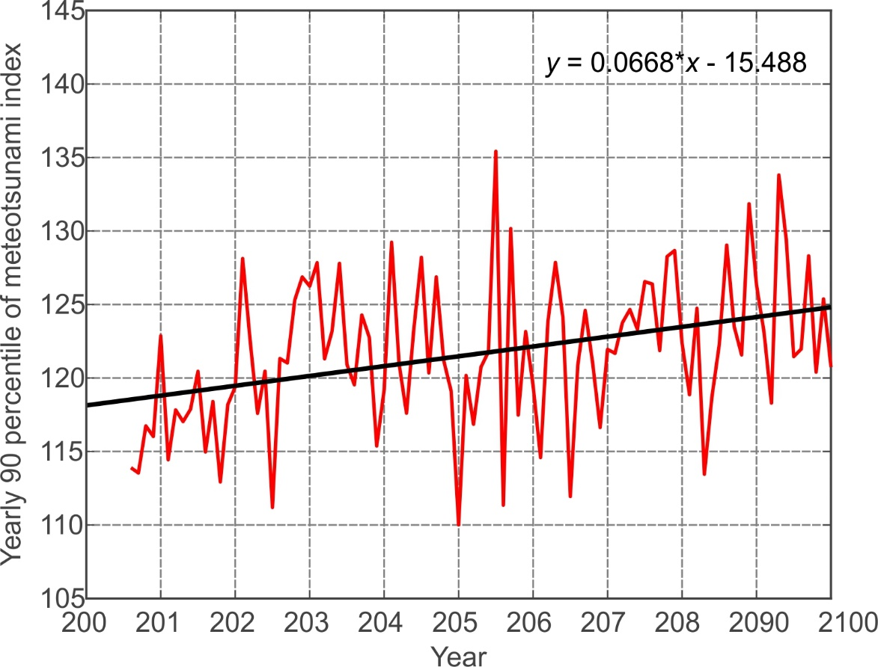
Task 4. Estimate occurrence rate of metetosunamis in past, present and future climates
Estimation is based on meteotsunami index – a quantitative link between prognostic atmospheric variables and sea level oscillations
Past and present estimates have been made for Ciutadella (Balearic Islands) and the Middle Adriatic
Meteotsunami index vs. measured wave heights (Ciutadella, Balearic Islands)
Evolution of meteotsunami index for Ciutadella (RCP85)
Sea level time series measured at the Adriatic endangered locations are still not of sufficient length to construct reliable index for the Adriatic.
Future estimates have, thus, been made for Ciutadella only -> more meteotsunamis in future?

Slide 12
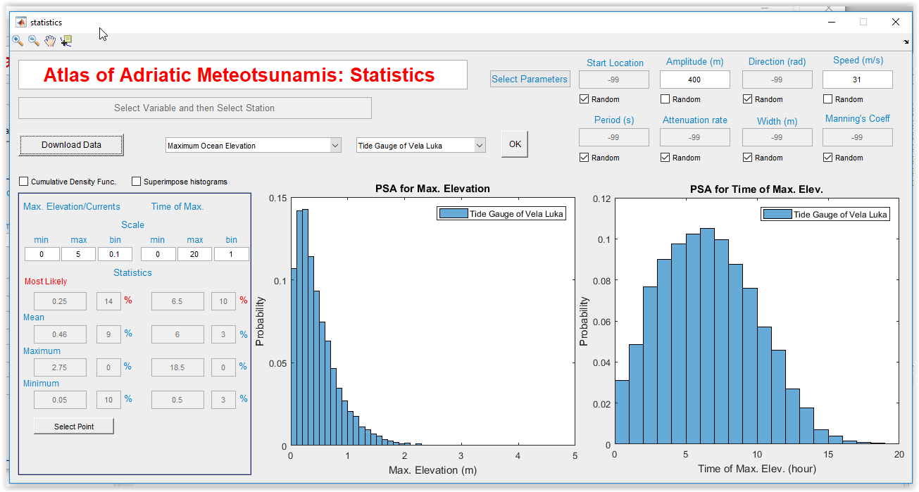
Task 5. Mapping of meteotsunami hazard and creation of meteotsunami warning matrices
The coastal risk (maximum elevation and currents) are statistically given via the application of the Pseudo Spectral Approximation (PSA) method with the pressure field and the manning’s coefficient defined as a stochastic processes used to force the 6,401 high-resolution ADCIRC simulations
Distribution of maximum expected elevations in Vela Luka in dependance on pressure field propagation parameters.

Slide 13
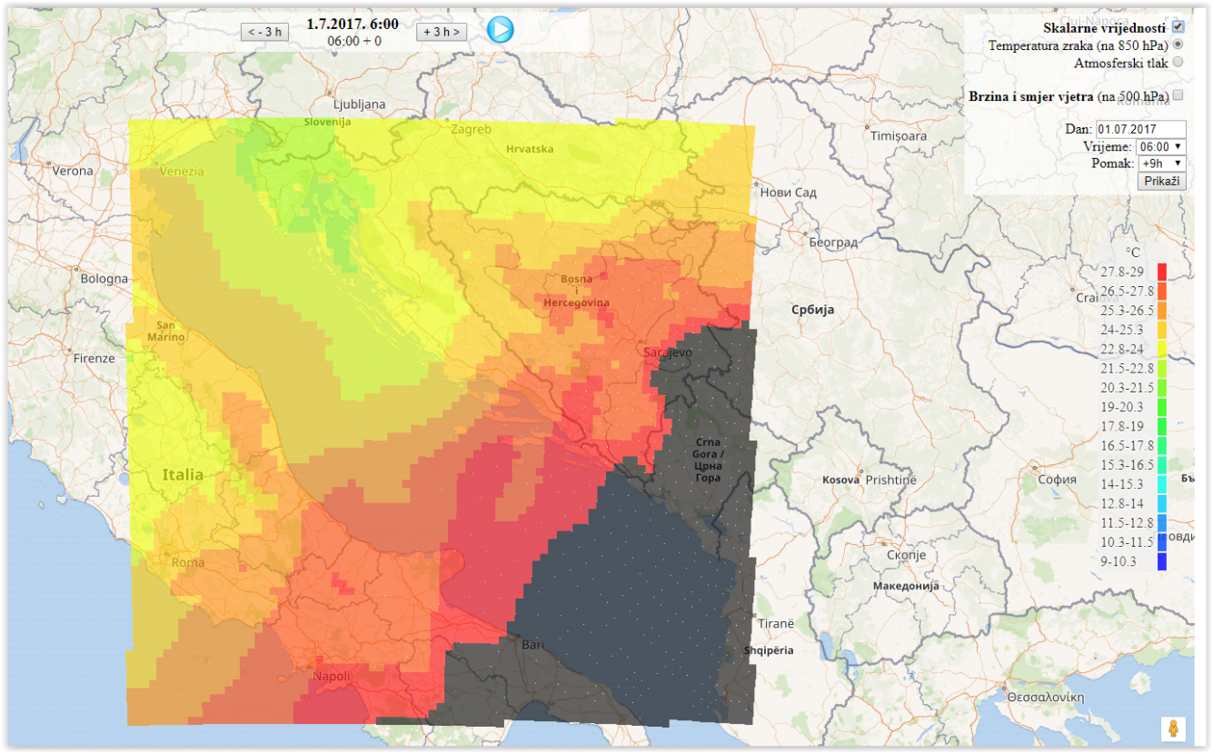
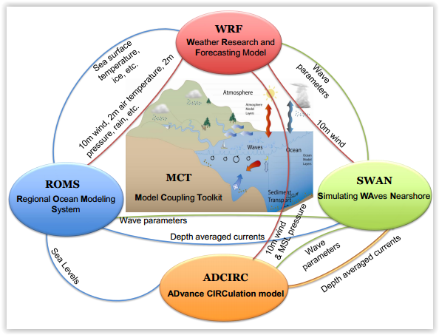
Task 6. Setup of operational atmospheric and oceanographic models
Outputs of ALADIN model are delivered daily – synoptic forecast available.
Coupled ROMS-WRF atmosphere-ocean model at 1 km (ROMS) -3 km (WRF) resolution
Temperature field at 850 hPa on 1 July 2017 (06:00 UTC)
High resolution ADCIRC model for meteotsunami modelling
512,834 elements
286,077 points
394 islands
10 m coastal resolution at meteotsunami prone areas
Strong temperature front over the Adriatic right at the time of meteotsunami

Slide 14
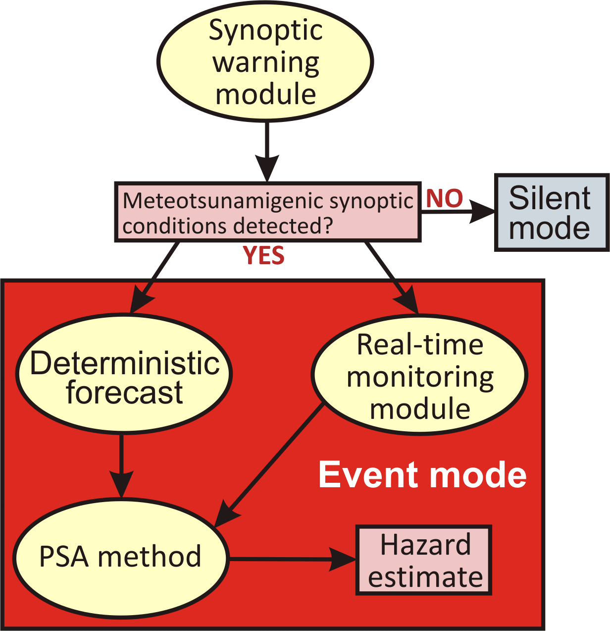
Task 7. Set up a prototype of a warning system
When fully operational, the Adriatic meteotsunami early warning system (MeEWS) will consist of:
synoptic warning module – 7 day advance warning
probabilistic pre-modelling module – 1 day advance warning
real-time monitoring module – 1 hour advance warning
Should be partly operational within a few weeks.

Slide 15
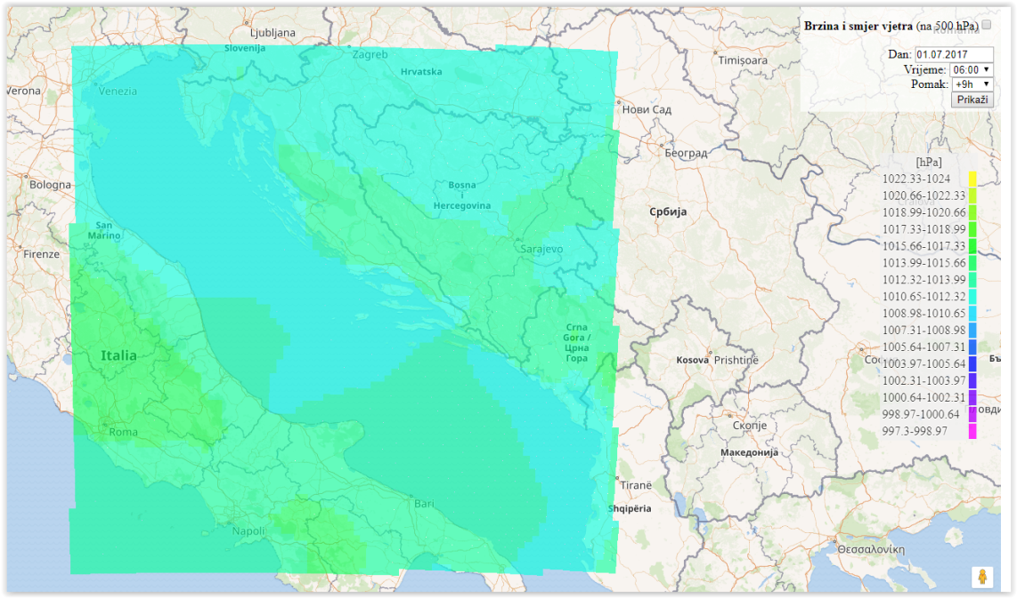
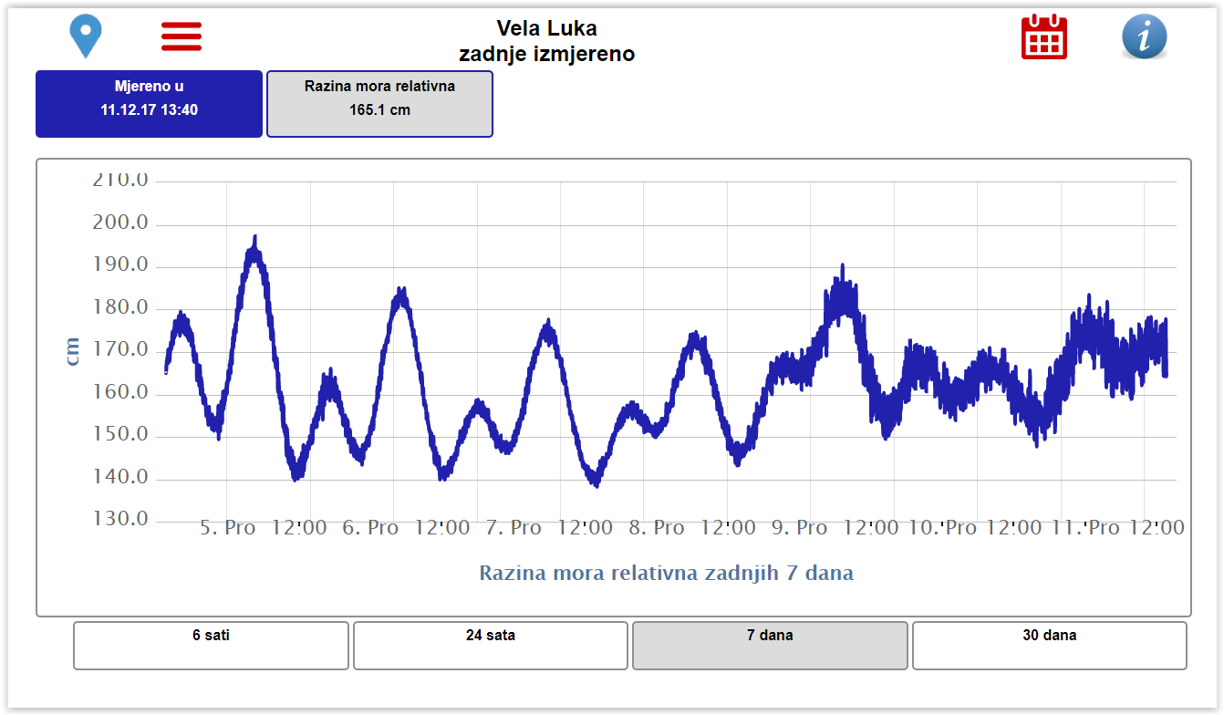
Task 8. Create dynamic web content with a meteotsunami hazard forecast
Real time monitoring
Data from sea level and five air pressure stations on-line
Data from remaining air pressure stations will soon be on-line.
http://faust.izor.hr/autodatapub/postaje
Synoptic modelling
Relevant synoptic data from ALADIN are on-line
http://faust.izor.hr/autodatapub/hr88_karta
Meteotsunami modelling
To be on-line soon!

Slide 16
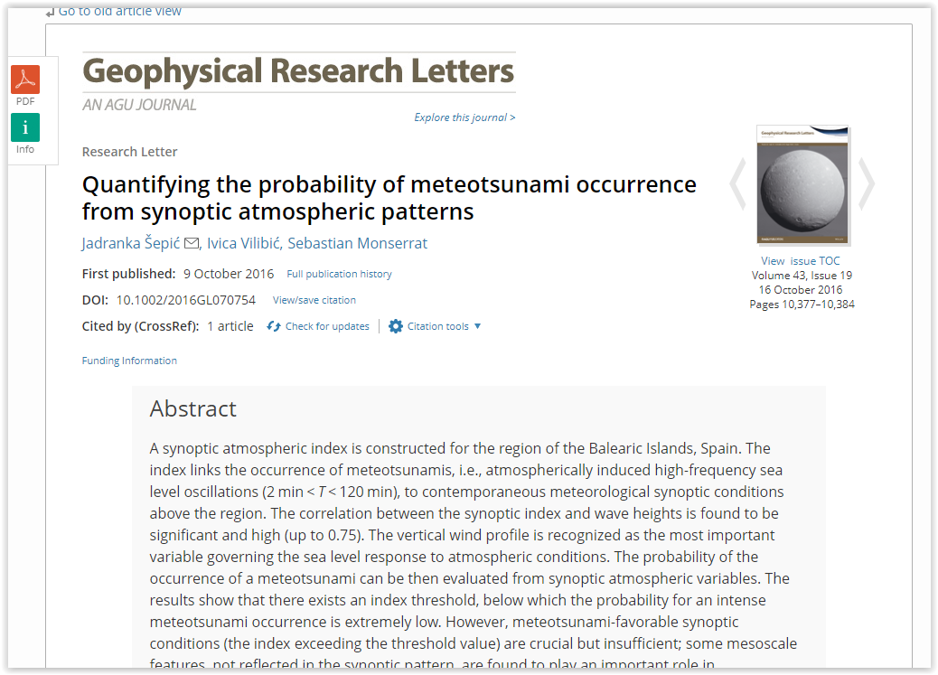
Task 9. Dissemination towards potential users
Dissemination to scientific communicity :
6 papers published (Scientific Reports, Geophysical Research Letters, ... )
20+ conference presentations
One special issue of PAGEOPH (with a number of meteotsunami papers) soon to be realized
Dissemination to stake holders and general public
Meetings with local authorities in Vela Luka, Stari Grad and Sobra
Public lectures in Vela Luka (including lectures in schools), Sobra and Split

Slide 17
Thank you for your attention and for partipication in MESSI project

