Slide 1
Overview of MESSI project scientific results
Jadranka ŠEPIĆ, Miro Gačić, Gordana BEG PAKLAR, Vlado DADIĆ, Clea DENAMIEL, Natalija DUNIĆ, Tomislav DŽOIĆ, Kristian HORVATH, Damir IVANKOVIĆ, Dalibor JELAVIĆ, Hrvoje KALINIĆ, Žarko KOVAČ, Vedrana KOVAČEVIĆ, Toni MAŠĆE, Frano MATIĆ, Iva MEĐUGORAC, Hrvoje MIHANOVIĆ, Sebastian MONSERRAT, Stipe MUSLIM, Alexander RABINOVICH, Maja TELIŠMAN PRTENJAK, Martina TUDOR, Ivica Vilibić

Slide 2
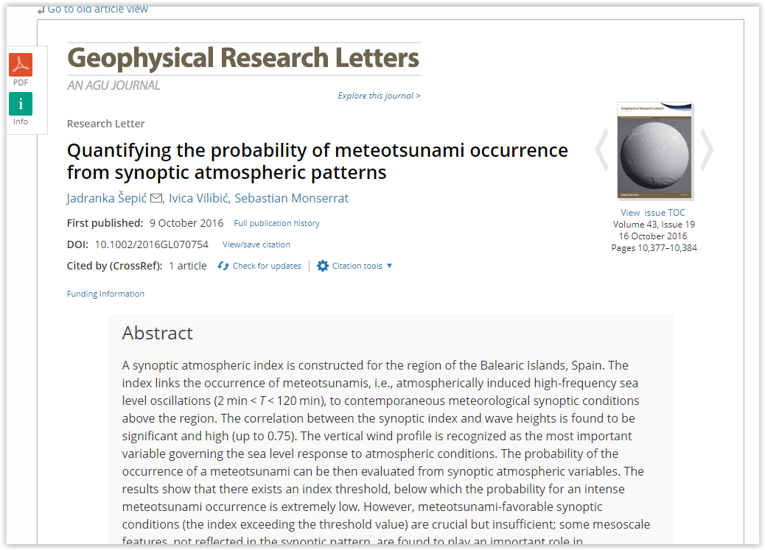
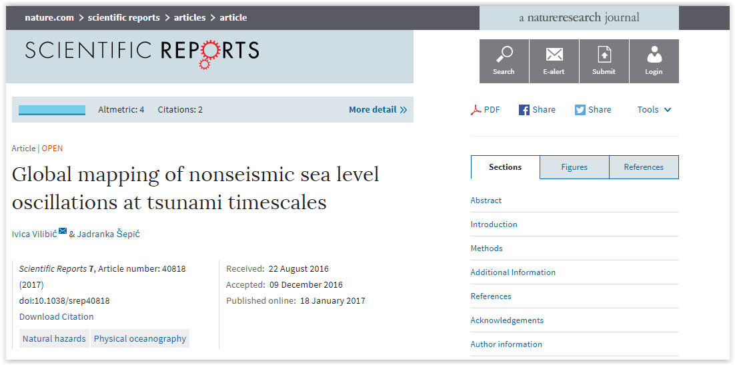
MESSI research topics
Three main topics have been pursued:
Analysis and numerical modelling of the 2014 multi-meteotsunami Mediterranean and the Black Seas event
Construction of a meteotsunami index – quantitative link between synoptic variables and height of sea level oscillations
Initial assessment of high-frequency oscillations at global scale
Six papers have been published, four are in preparation, and there are ideas for a few more ...

Slide 3
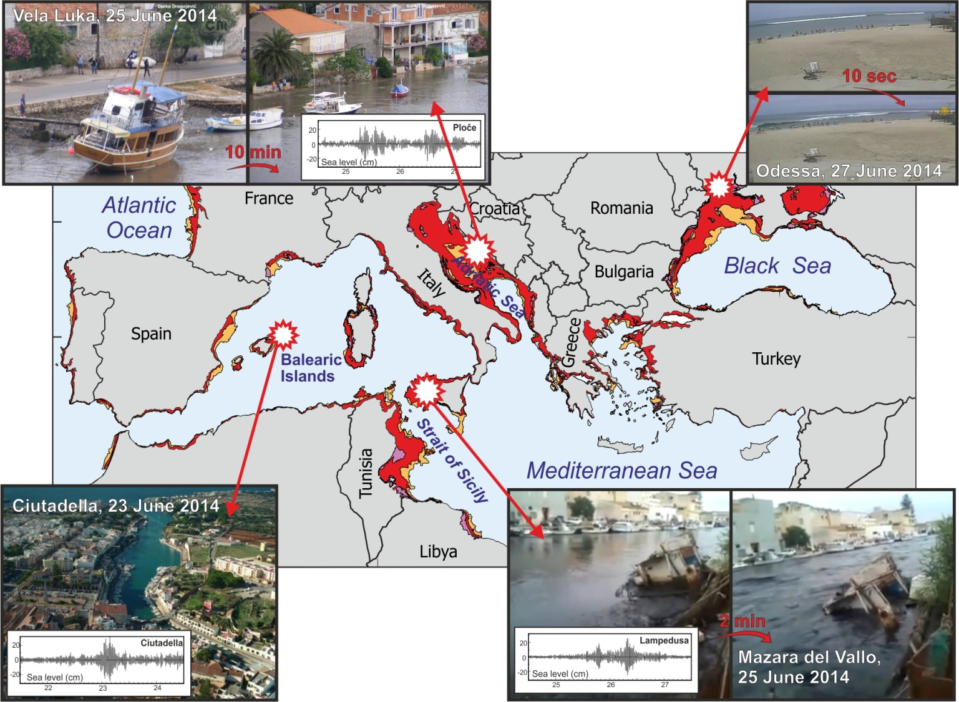
The June 2014 events
During 23 – 27 June 2014, four locations in the Mediterranean were hit by meteotsunami waves.
Ciutadella, 23/24 June - 1 m high waves
Middle Adriatic, 25-26 June - up to 3 m high waves
Mazara del Vallo (Sicily), 25 June – 1.5 m high waves
Odsessa (Ukraine), 27 June – 2 m high waves

Slide 4
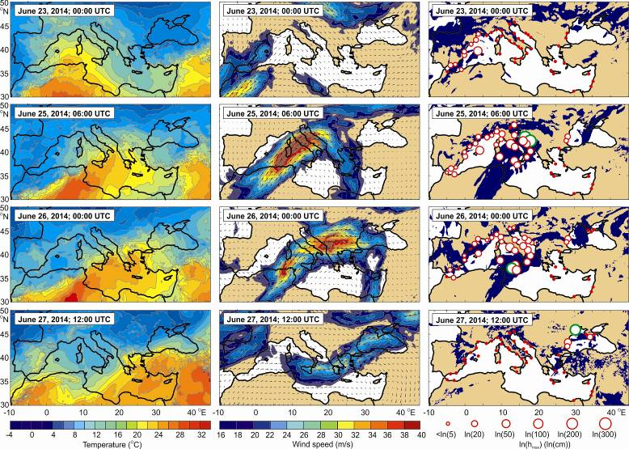
The June 2014 events
All of the June 2014 events were meteotsunamis.
Synoptic setting to all events was common:
low mean sea level pressure
inflow of warm African air at ~850 hPa
strong south westerly to westerly mid-tropospheric winds at ~500 hPa
unstable mid-tropospheric layers
These conditions favour generation and trapping of atmospheric gravity waves (a known source of meteotsunamis).
(Šepić et al., 2015, SciRep)

Slide 5
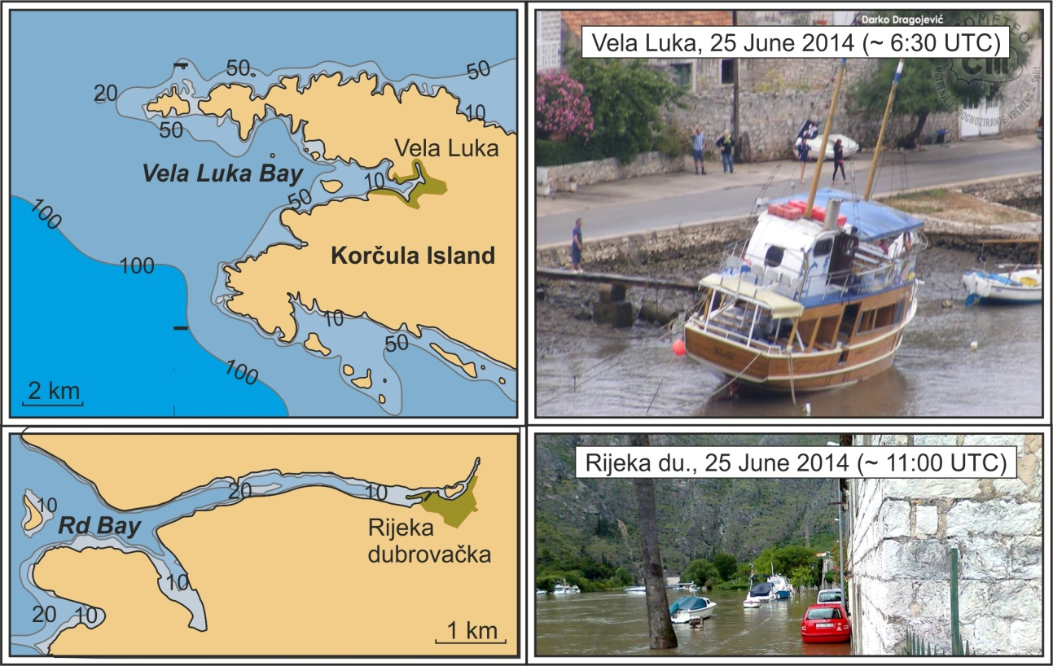
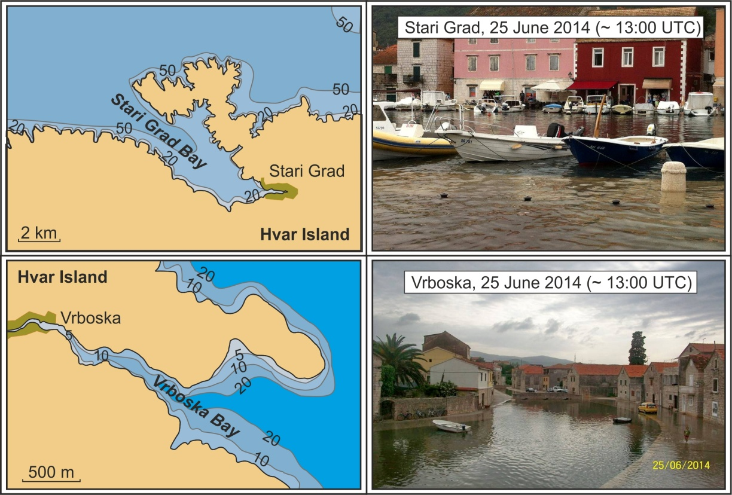
The Middle Adriatic June 2014 event
Adriatic bays and harbours were hit by at least four different individual meteotsunami events (Vela Luka, Rijeka dubrovačka, Stari Grad & Vrboska, Ston & Viganj) on 25 and 26 June 2014.
(Šepić et al., 2016, PAGEOPH)

Slide 6
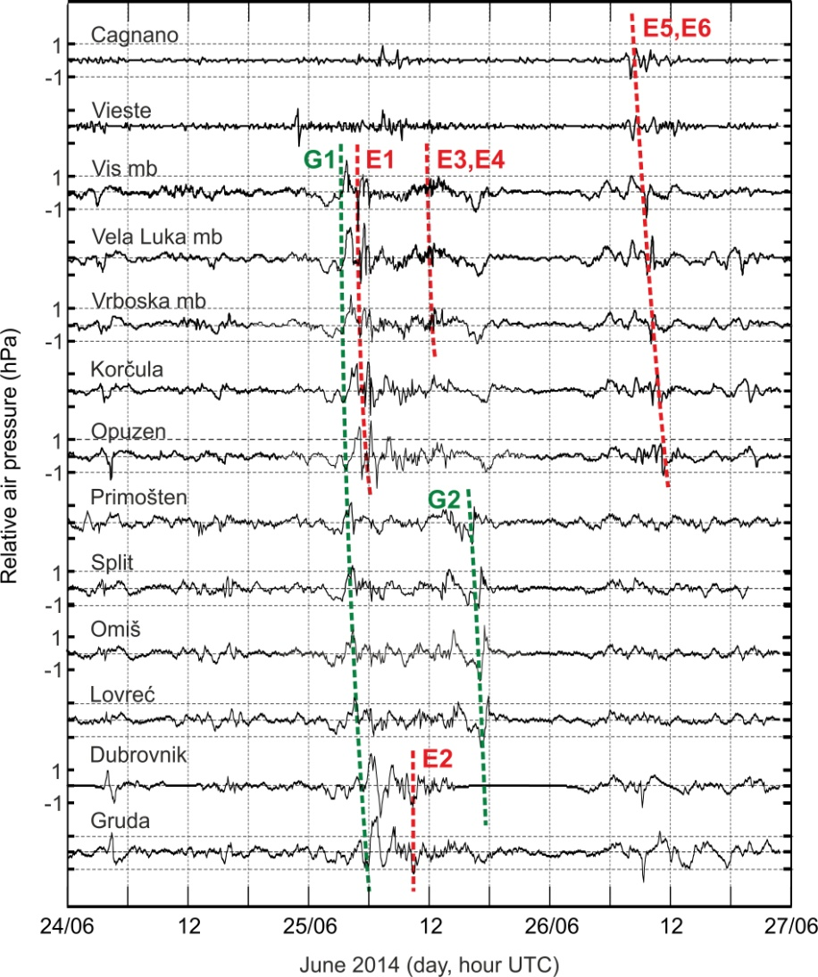
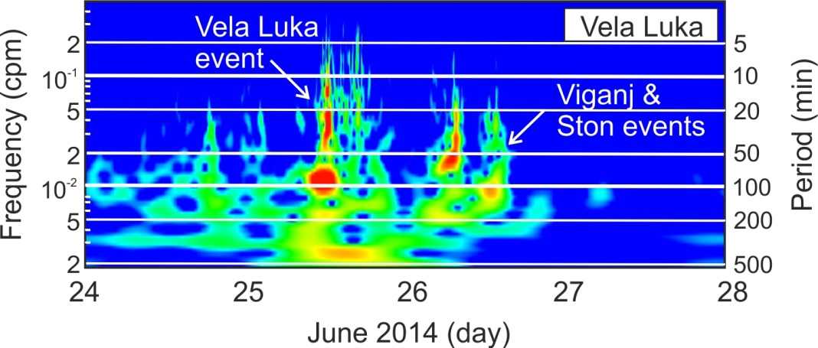
The Middle Adriatic June 2014 event – a few facts
A high number of pronounced air pressure disturbances propagated through the atmosphere during 25-26 June 2014, coincident with meteotsunami events.
At some stations oscillations were highly energetic!

Slide 7
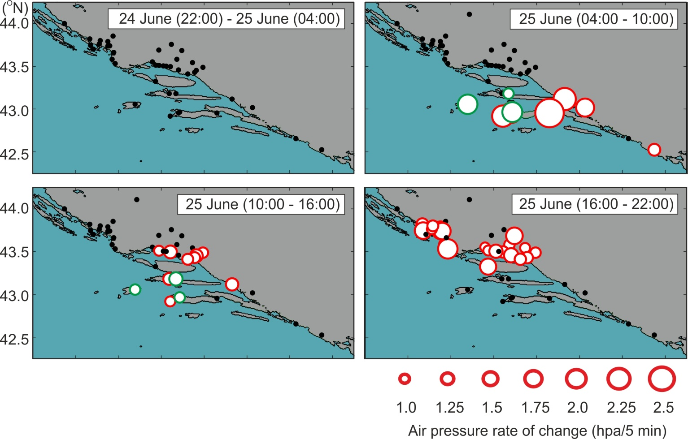
The Middle Adriatic June 2014 event – a few facts
Air pressure rates of change, 25-26 June 2014
Air pressure disturbances were of extremely limited propagation and cross propagation dimensions, and have appeared in a great number.

Slide 8
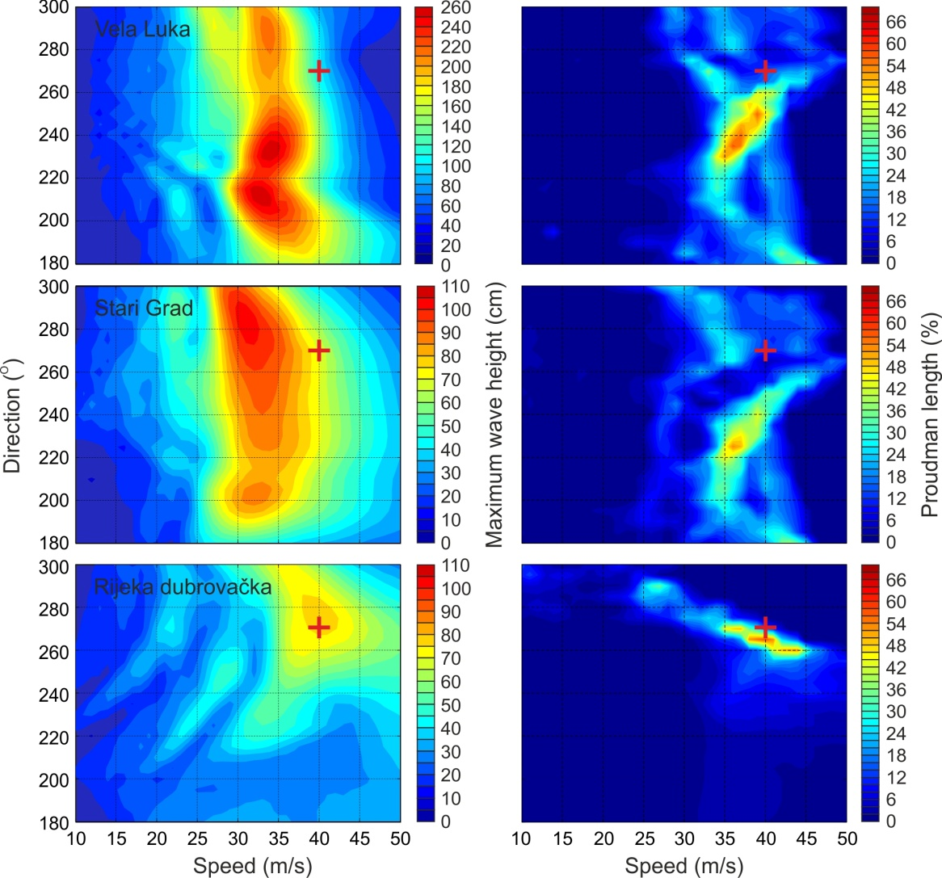
The Middle Adriatic June 2014 event – a few facts
Maximum wave height
Proudman length
Idealized experiments reveal that sea response is strongly sensitive on air pressure disturbance speed and direction
Depending on a hit location, different processes play a role in a final wave amplification

Slide 9
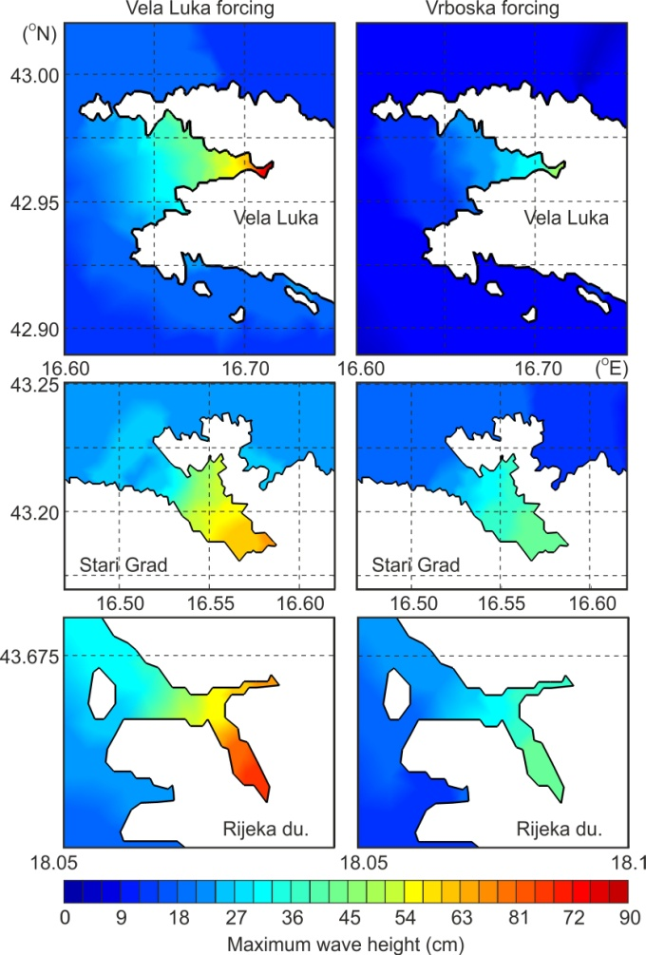
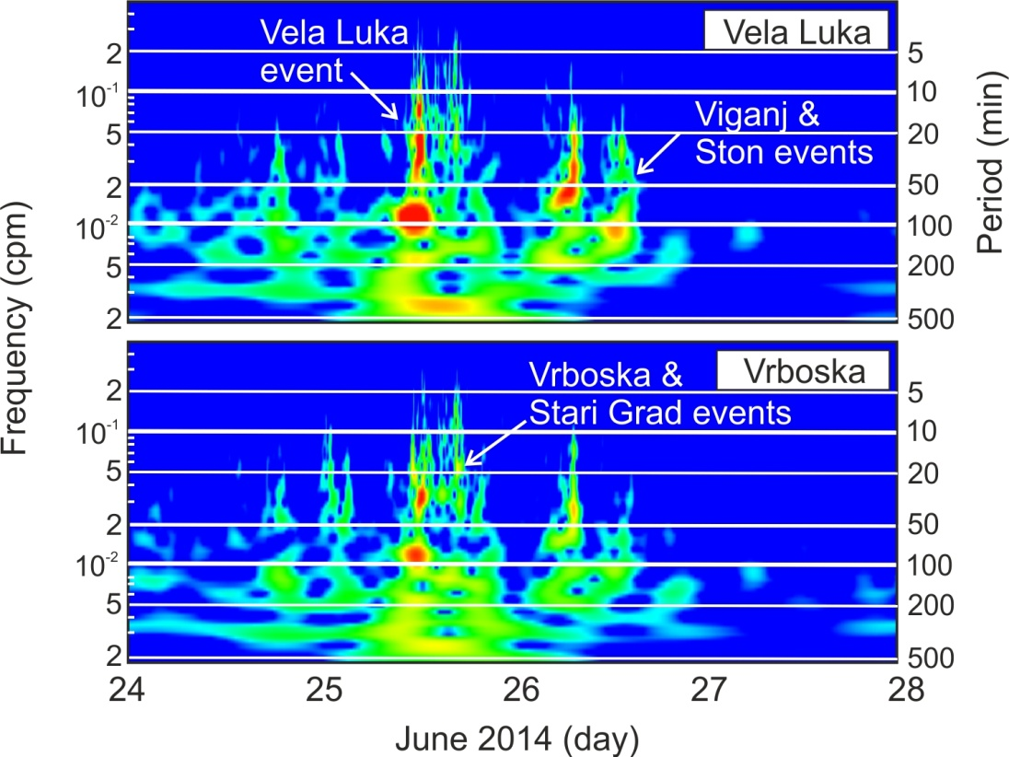
The Middle Adriatic June 2014 event – a few facts
Small changes in air pressure forcing result in several times higher wave heights → sea response is extremely sensitive to the finest details of forcing
VL forcing
Vr forcing
Forcing numerical model with air pressure time series measured at ~20 km distanced air pressure stations resulted in maximum modelled wave-height change of up to ~70 %!

Slide 10
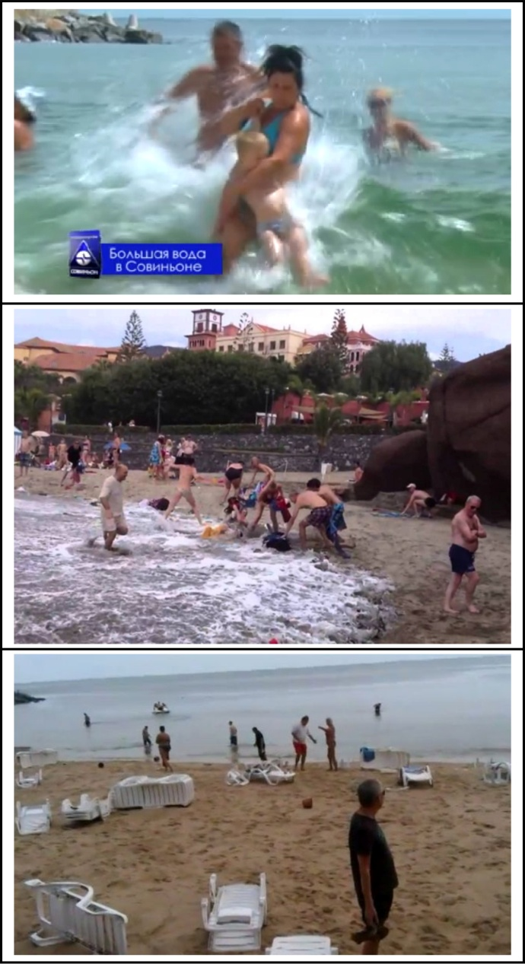
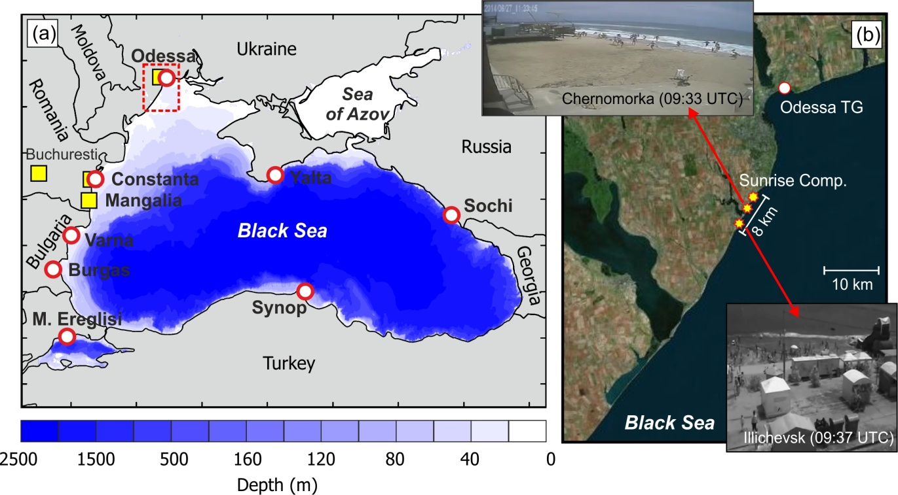
The Odessa June 2014 event
Three beaches in Odessa were hit by up to 2 m high meteotsunami waves at midday 27 June 2014
(Šepić et al., 2017, PAGEOPH)

Slide 11
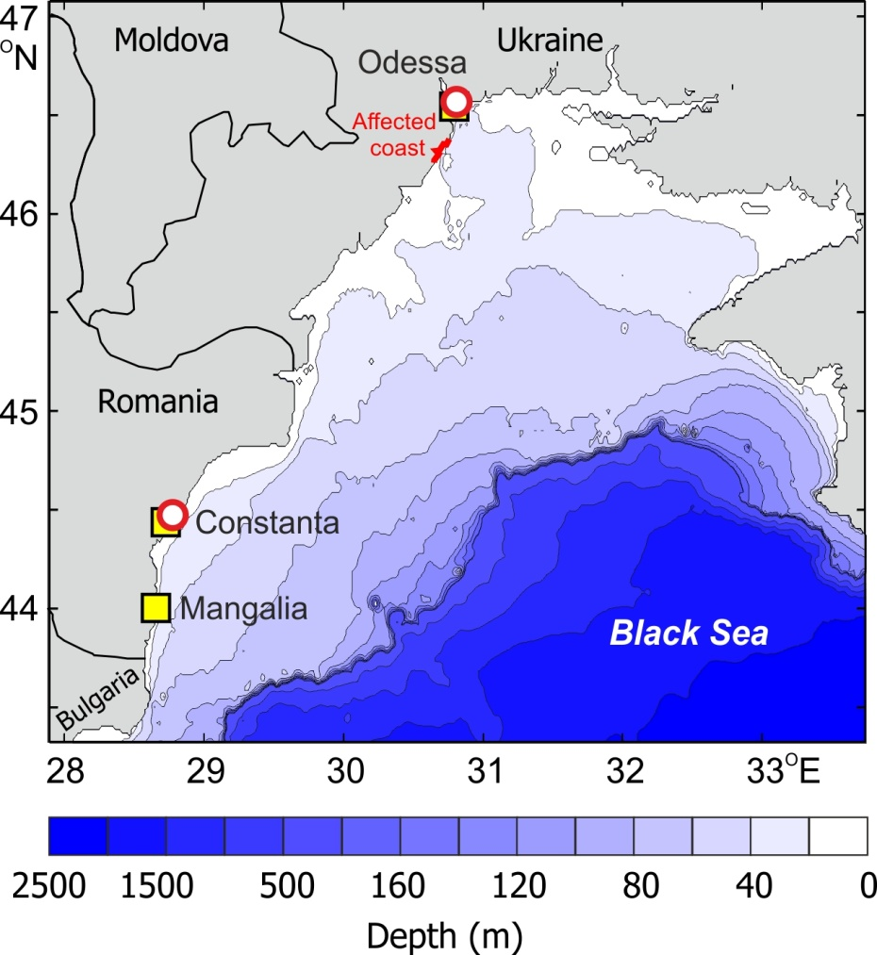
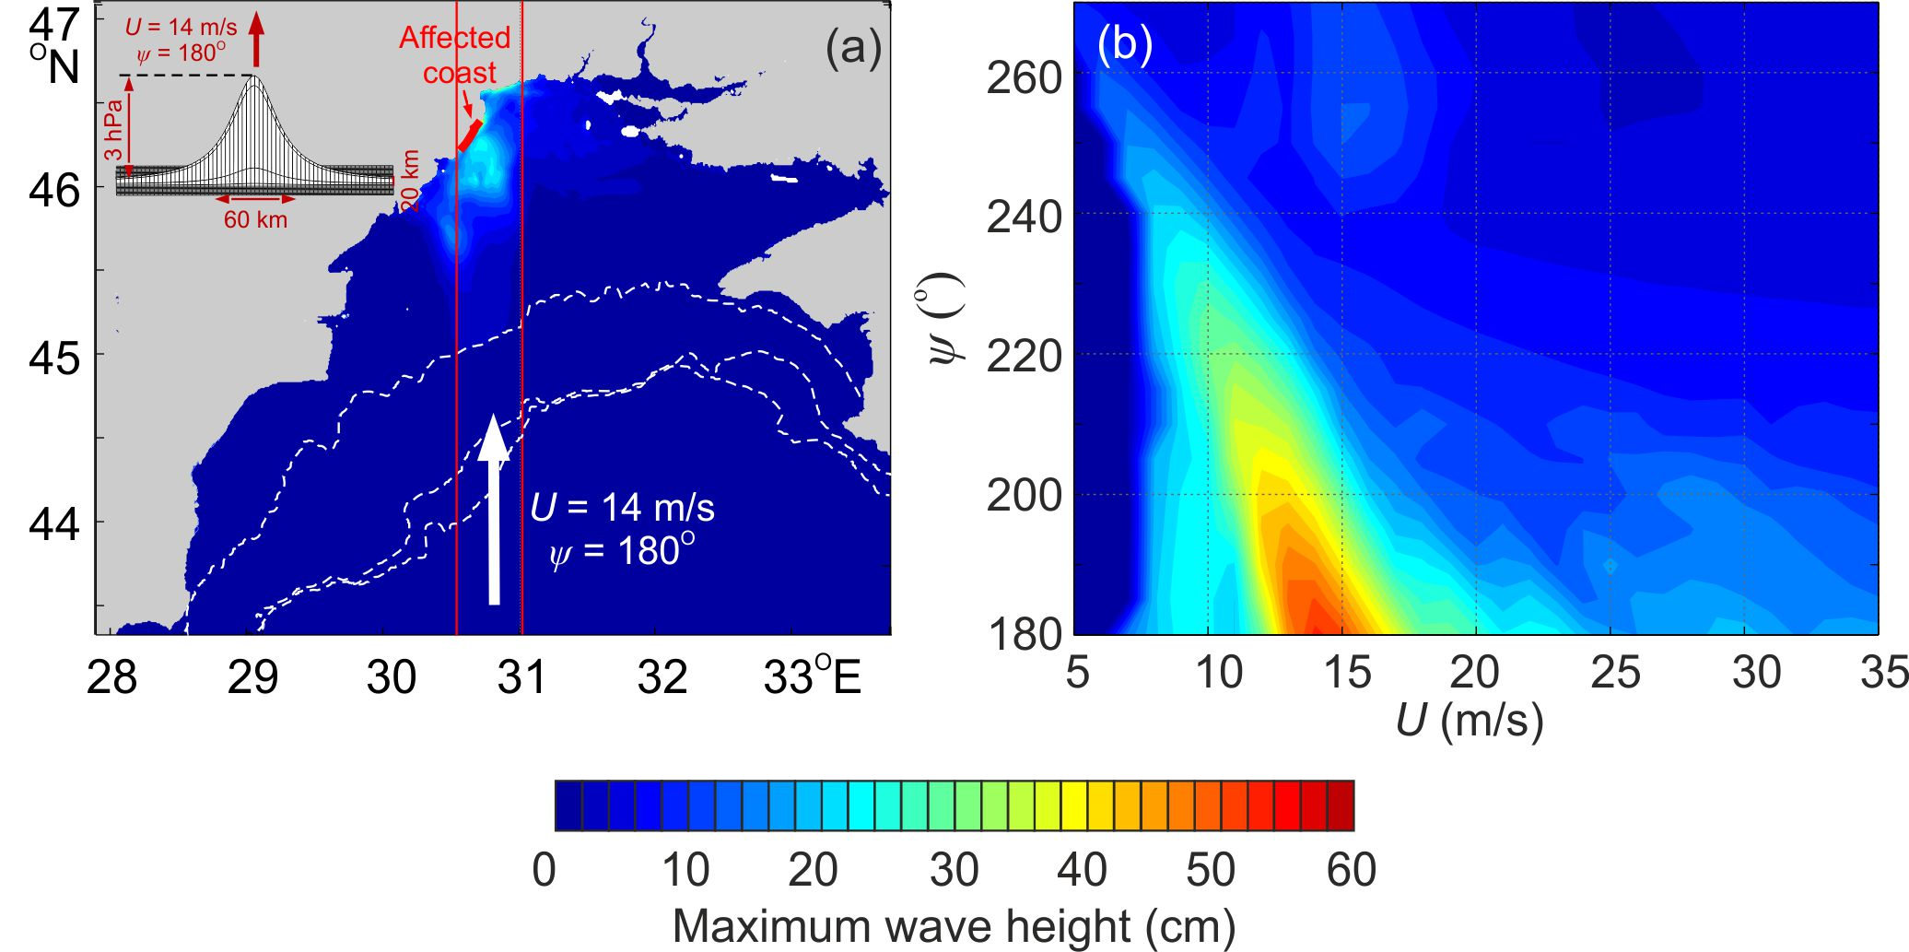
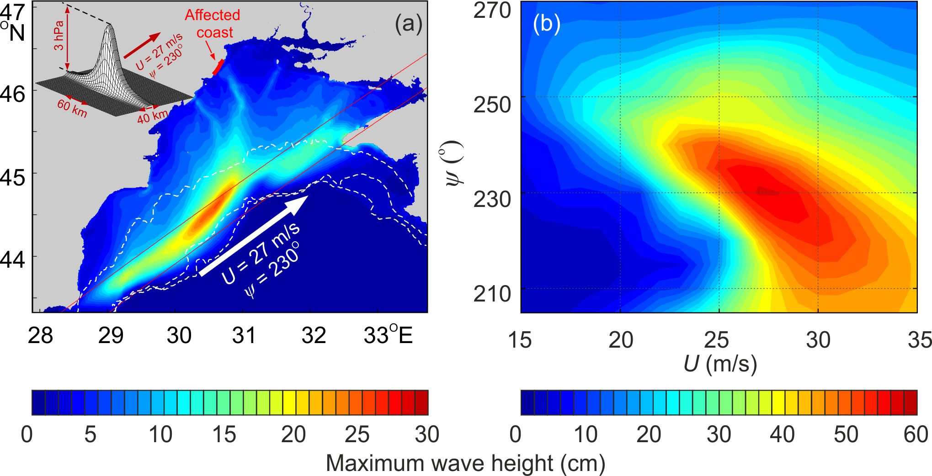
The Odessa June 2014 event
Barotropic ocean numerical model was used to reproduce the event
Two sets of experiments were run:
Air pressure disturbance propagating directly towards Odessa
Air pressure disturbance propagating over the shelf break
Model domain

Slide 12
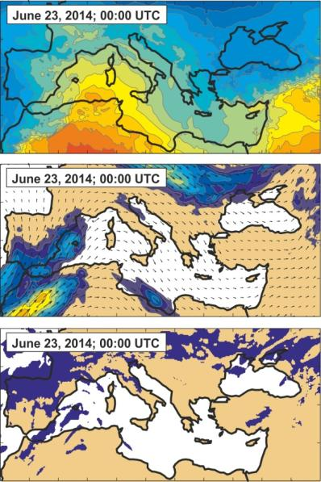
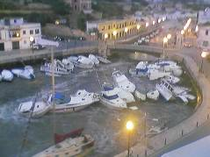
Meteotsunami index – a link between synoptics and meteotsunamis
Question: Can we quantify link between synoptic conditions and height of meteotsunamis?
3 - 4 m high waves in Ciutadella (Balearic Islands)
??
Leads to?o

Slide 13
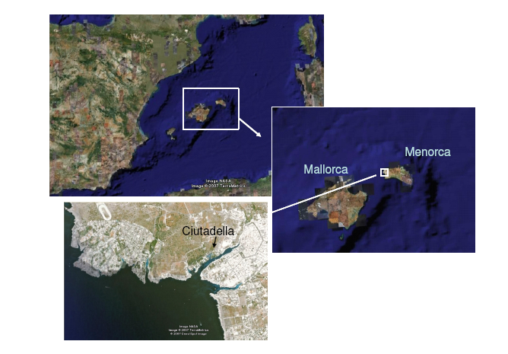
Meteotsunami index – a link between synoptics and meteotsunamis
(1) Area of interest:
Ciutadella (Balearic Islands)
(2) Ingredients:
(a) Time series of sea level heights
(b) ERA-Interim 1979 – 2016 synoptic variables

Slide 14
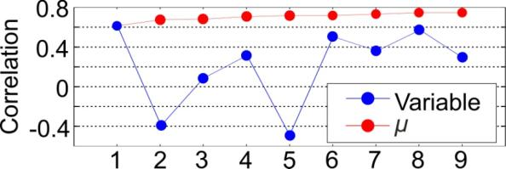
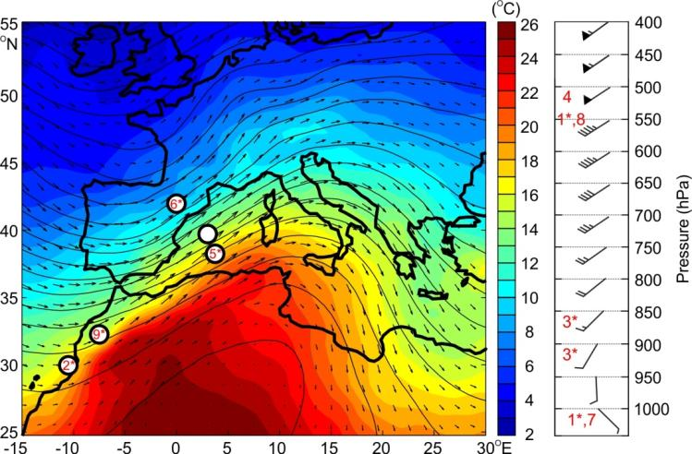
Meteotsunami index – a link between synoptics and meteotsunamis
(b) Keep variables with highest correlation with sea level heights
(1) Vertical wind difference; (2) horizontal mslp difference; (3) vertical temperature difference; (4) relative humidity; (5) horizontal geopotential difference; (6) horizontal temperature difference; (7) surface wind; (8) wind at 550 hPa; (9) horizontal temperature ratio
(3) Procedure
(a) Estimate correlations between sea level heights and various synoptic variables
(Šepić et al., 2016, GRL)

Slide 15
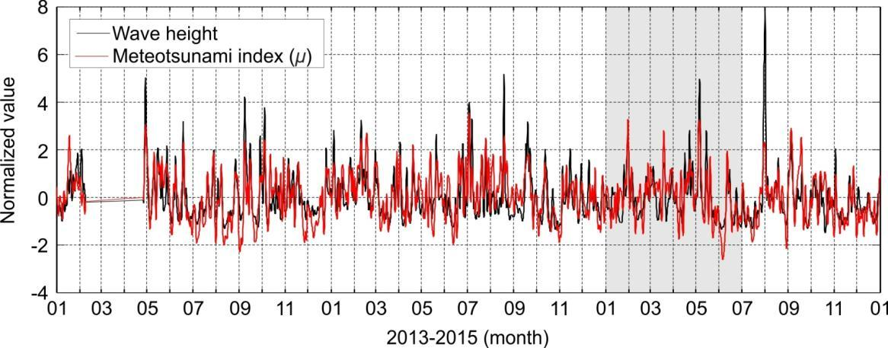
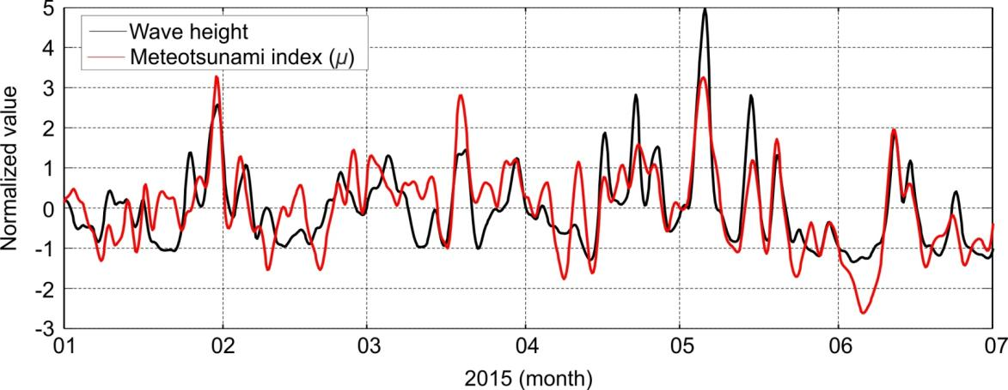
Meteotsunami index – a link between synoptics and meteotsunamis
Fine matching between time series of wave heights and time series of meteotsunami index (for period 2013 – 2015)

Slide 16
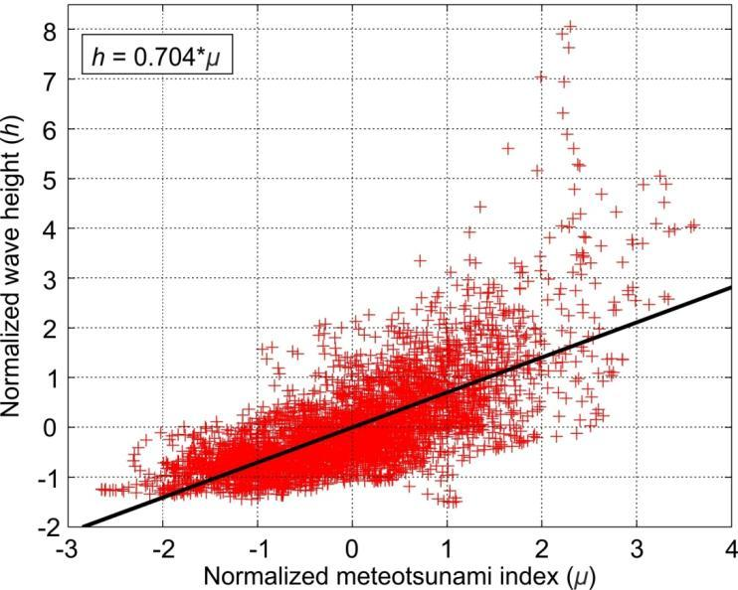
Meteotsunami index – a link between synoptics and meteotsunamis
Relation between normalized meteotsunami index and normalized wave heights
Implications:
There exists a MINIMUM of synoptic conditions that are necessary for a meteotsunami occurrence (μ > 1.6)
Tsunamigenic conditions (μ > 1.6) do not always imply moderate to strong meteotsunamis
No reliable estimates of meteotsunami strength can be obtained solely by synoptic forecasting

Slide 17
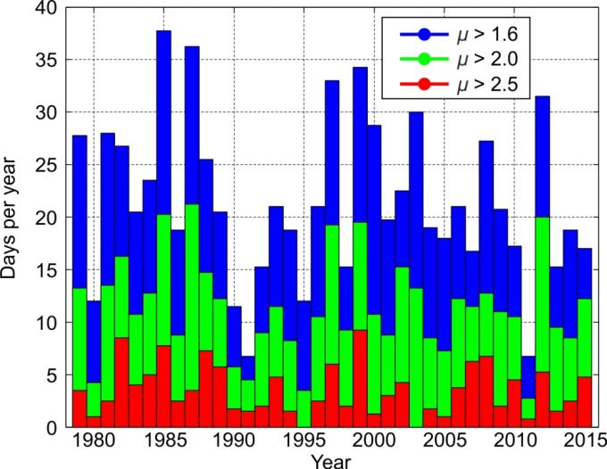
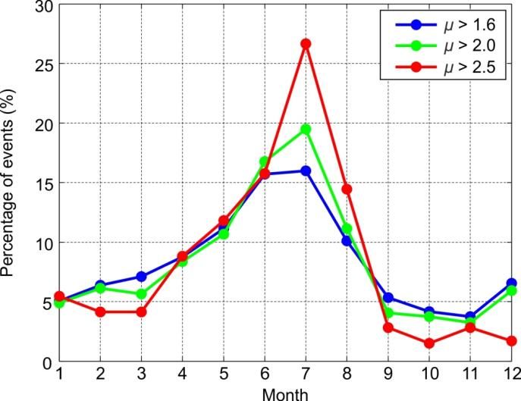
Meteotsunami index – a link between synoptics and meteotsunamis
Meteotsunami index was estimated for entire ERA Interim period (1979 – 2015):
14 out of 15 strongest historic meteotsunamis occurred for μ > 1.6
All destructive events (wave heights > 200 cm) occurred for μ > 2.0
Per month distribution of meteotsunamigenic indices
Per year distribution of meteotsunamigenic indices

Slide 18
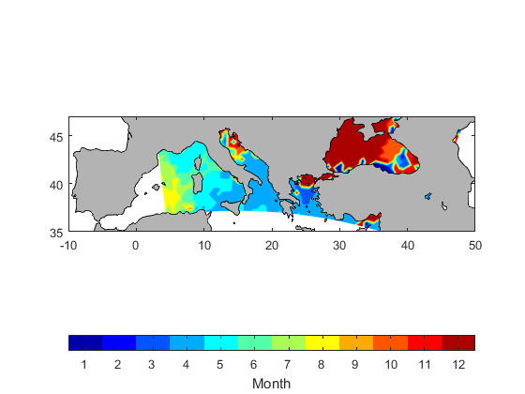
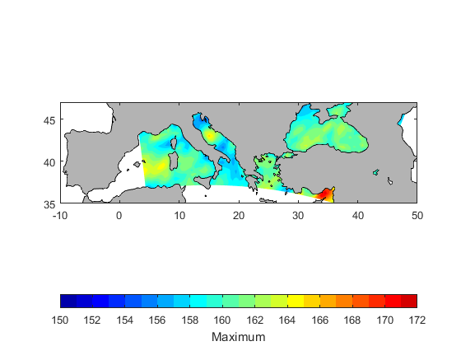
Meteotsunami index – past, present and future
CNRM (Centre National de Recherches Meteorologiques) simulations will be used to asses presence and strength of meteotsunami favorable conditions in past, present (HIST & EVAL runs) and future (RCP run) climates
Month of prelevance of meteotsunami favorable conditions – EVAL run
Maximum of meteotsunami index – EVAL run

Slide 19
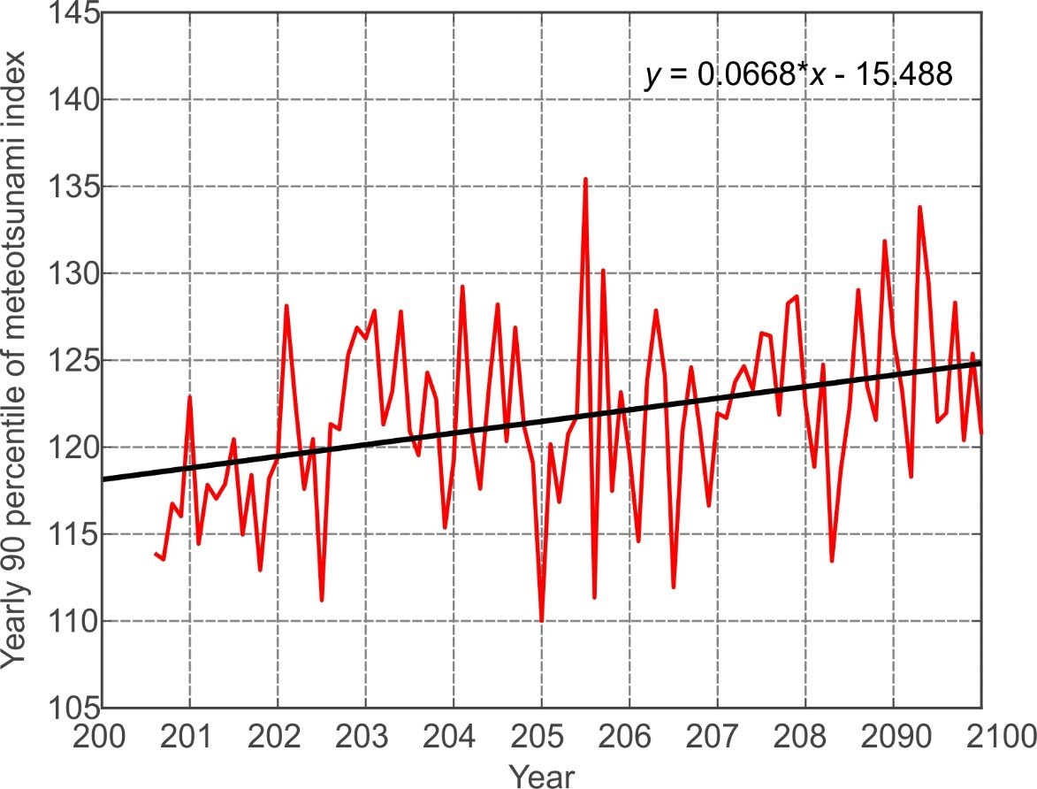
Meteotsunami index – past, present and future
Initial analysis indicate that tsunamigenic synoptic conditions might be stronger in future, especially for RCP85 run.
Per month distribution of meteotsunamigenic indices – RCP85
Evolution of yearly 90 percentile of meteotsunami index for Ciutadella (RCP85)

Slide 20
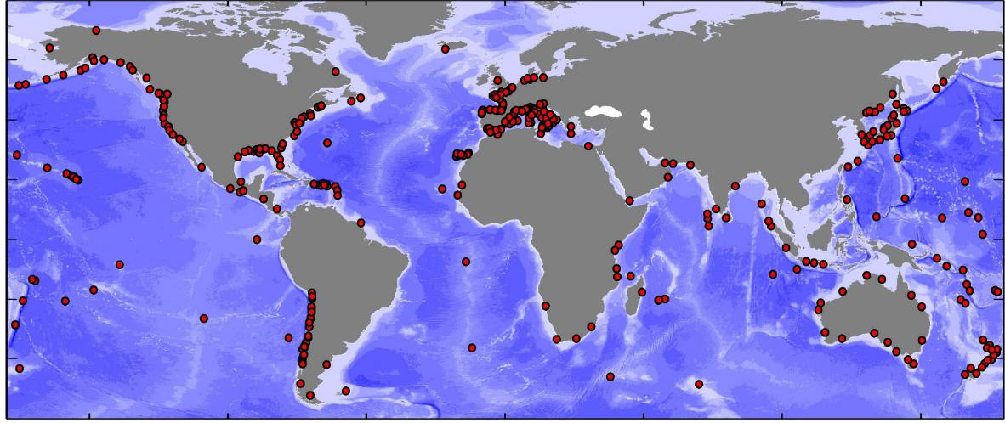
High-frequency sea level oscillations – global study
What is a global distribution of nonseismic sea level oscillations at tsunami timescales (NSLOTT)?
What is NSLOTT contribution to overall sea level extremes? Do synoptic conditions driving strongest NSLOTT events resemble tsunamigenic synoptic patterns?
1-min sea level data from a huge number of tide gauge downloaded from the IOC website

Slide 21
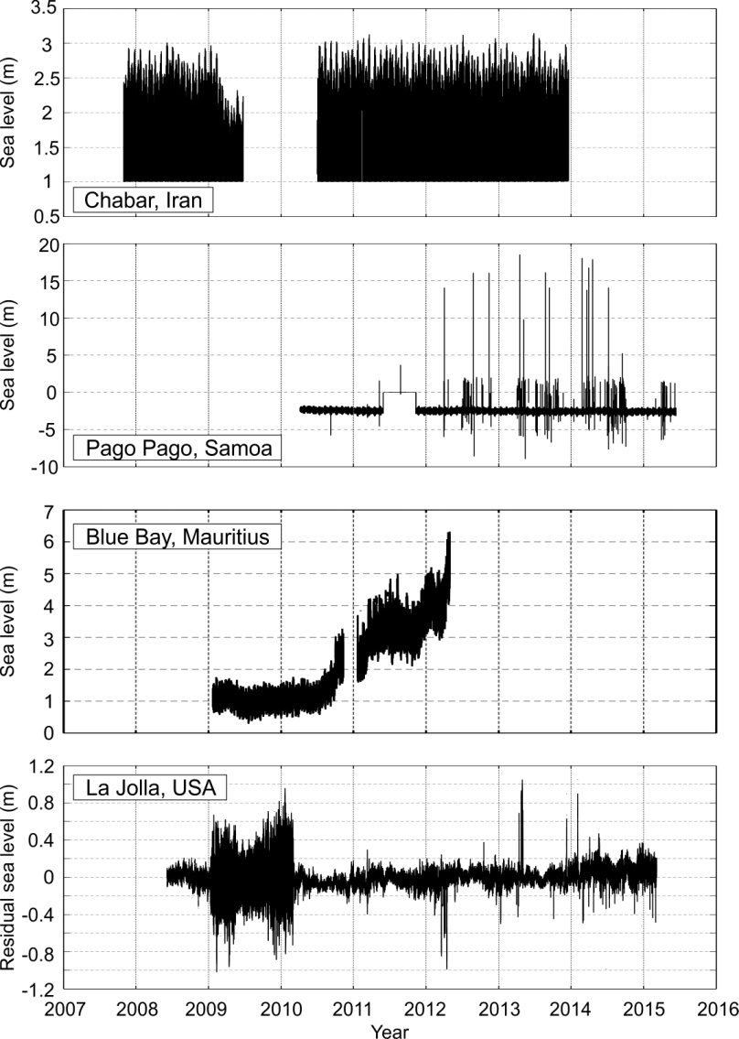
High-frequency sea level oscillations – global study
A lot of low quality data
Data origin: Intergovernmental Oceanographic Commission (IOC) Sea Level Station Monitoring Facility website (http://www.ioc-sealevelmonitoring.org.)
Conditions for selecting stations:
At least 12 months of data
Less than 10% of gaps
Qualitative data (data that can be repaired!)
Quality control:
Automatic despiking
Manual control for spikes, shifts, changes in tidal range and other changes
Data related to tsunamis omitted

Slide 22
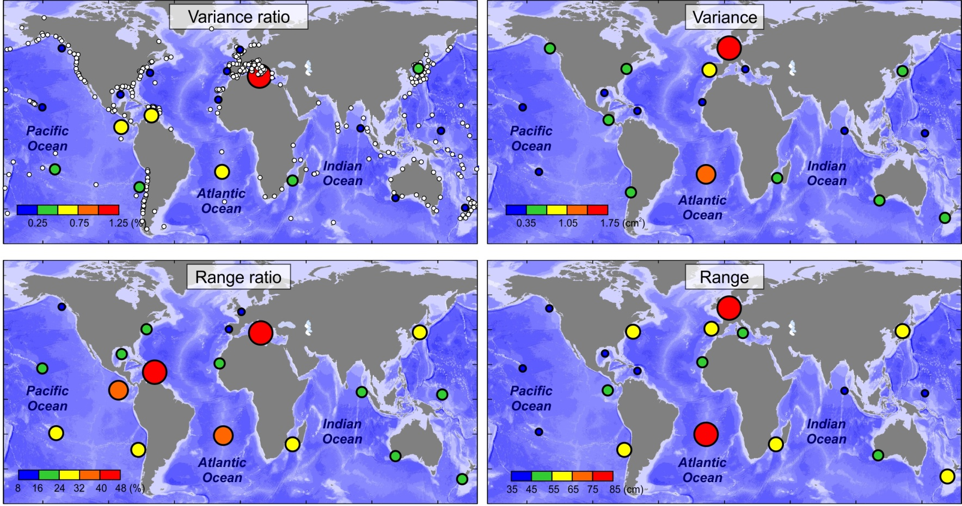
High-frequency sea level oscillations – global study
High-frequency oscillations contribute significantly to sea level extremes!

Slide 23
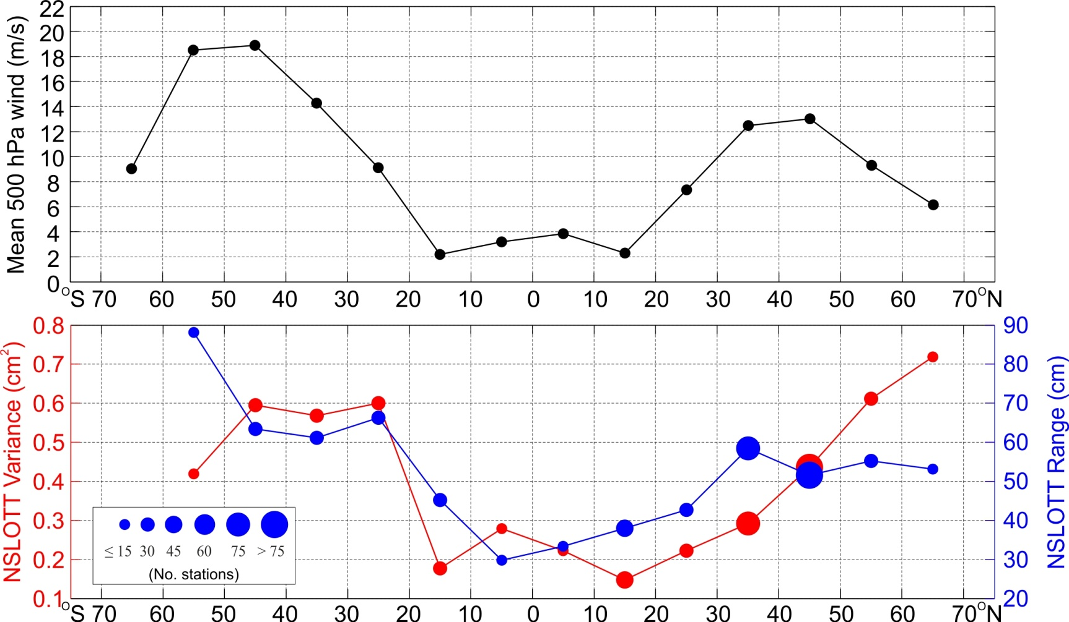
High-frequency sea level oscillations – global study
There is significant correlation between zonal NSLOTT variance and range, and zonal winds at 500-hPa
That implies a predominant atmospheric mechanism responsible for the NSLOTT, already found in the meteotsunami studies and called wave-ducting!
IOC data opens an opportunity for more global studies...
Mean wind speeds at 500-hPa level, and NSLOTT variances and maximum ranges (the size of a circle is proportional to the number of tide gauge stations in the respective zonal belt)

Slide 24
Publications
Šepić, J., Rabinovich, A. B., Sytov, V., 2017. Odessa tsunami of 27 June 2014: Observations and numerical modelling. Pure and Applied Geophysics.
Vilibić, I., Šepić, J., Pasarić, M., Orlić, M., 2017. The Adriatic Sea: a long standing laboratory for sea level studies. Pure and Applied Geophysics, 174, 3765-3811.
Vilibić, I., Šepić, J., 2017. Global mapping of nonseismic sea level oscillations at tsunami timescales. Scientific Reports, 40818, doi:10.1038/srep40818
Vilibić, I., Šepić, J., Rabinovich, A. B., Monserrat, S., 2016. Modern Approaches in Meteotsunami Research and Early Warning. Frontiers in Marine Sciences, http://dx.doi.org/10.3389/fmars.2016.00057
Šepić, J., Vilibić, I., Monserrat, S., 2016. Quantifying the probability of meteotsunami occurrence from synoptic atmospheric patterns. Geophysical Research Letters, doi: 10.1002/2016GL070754
Šepić, J., Međugorac, I., Janeković, I., Dunić, N., Vilibić, I., 2016. Multi-meteotsunami event in the Adriatic Sea generated by atmospheric disturbances of 25-26 June 2014. Pure and Applied Geophysics, doi: 10.1007/s00024-016-1249-4

Slide 25
Thank you for your attention!

